Slide 1
Geotechnical Grout selection
Alan A. Campoli, respec
BRAD YODER, Tri-state Water stoppers
Chris Moore, Cowin

Slide 2
Cement vs chemical Grouts
Long debated choice
Chemical used for wider spectrum of problems
Chemical developed in the 1960’s
Choice depends on geologic issues
Chemical yield
Greater compressive strength
Increased tensile strength
Lower viscosity
Variable set times

Slide 3
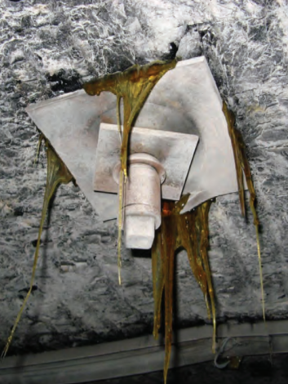
Grout types
Silicate
Acrylate
Polyurethane

Slide 4
silicates
Sodium or Urea based
Consolidation of loose strata
Pre-excavation grouting
Temporary shoring
Consolidation of fine soils and sands
Can yield 5000 psi compressive

Slide 5
Sodium Based
Penetrate small voids
Ultra low viscosity (4-8 cps)
200 psi compressive strength in 24 hours
Consolidate fine soils and sands
Not effected by water
Heaver than water
Will fall to bottom of standing water
Underpinning
Tie-back walls
Soil nailing

Slide 6
Urea based
Two-part system
Foams up to 30 times liquid volume
Foam 4 lb/square foot density
Low exothermic reaction
Stops water ingress or egress
Ultra-low viscosity (4-8 cps)
Cures in 24 hours
Tunneling face or canopy support
Low cost as compared to other chemical grouts
High volume pumping

Slide 7
Acrylates
Two-part system
Low viscosity (4-8 cps)
Safe and workable
Hardener is water with metal salt
Acrylic resin mixed with promoter
No expansion
Hard rubber to flexible gel
Soil consolidation
Waterproof curtain walls
Crack sealing
Simple cleanup

Slide 8
polyurethanes
Widely used
Foam, gel, or high compressive masses
Hydrophilic formulations
Single component with catalyst
Expands 5 to 10 times
Gel or flexible foam
Requires water in strata for activation
Hydrophobic formulations
Single or two component
Flexible foam to high strength solid
Wide range of viscosities
Tiny cracks to wide voids
Wide range of expansion and gel times
Requires void space

Slide 9
Case study
Multi level marble mine
700 ft deep
Karstic fracture system between mine and reserves
Two entry access required
High pressure water connected to surface
Previous crossing with cement grouting unsuccessful
Geologic assessment of fracture system
Polyurethane grouting in advance of mining

Slide 10
Geologic assessment
Core drilling on three levels
Model fracture system on 700 ft level
Ground water monitoring
Fractures connected to surface
Water pressure over 200 psi at 700 level
Water flows vertically and horizontally in fractures
Fractures as wide as 15 feet
Predicted fractures limited to 5 feet in 700 level
Wider fractures could not be ruled out

Slide 11
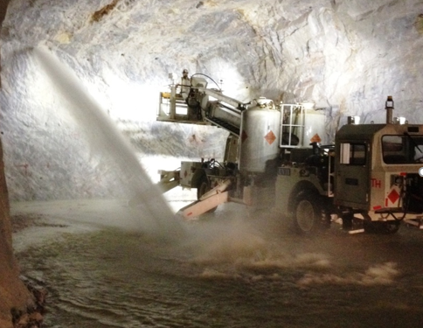

Slide 12
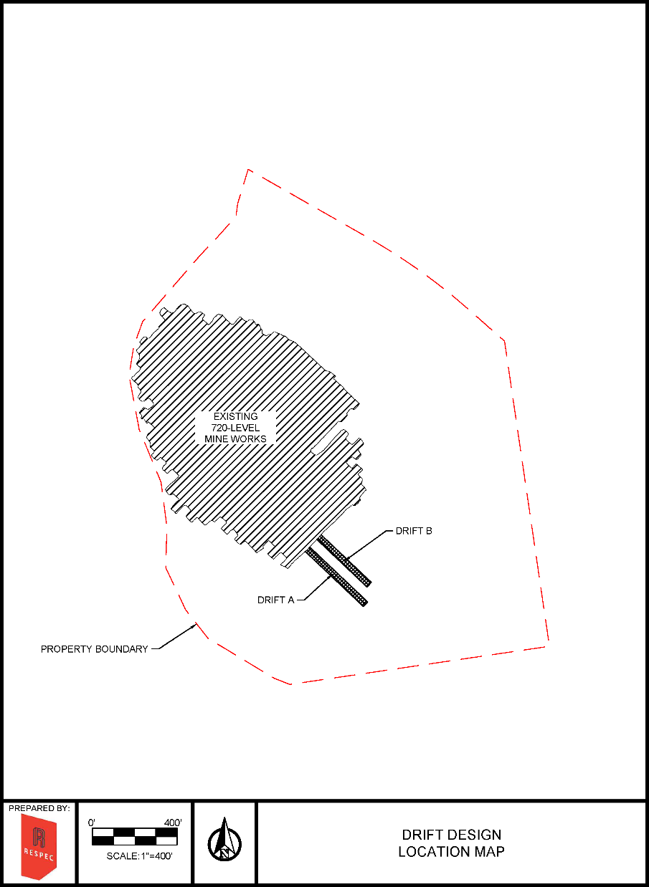

Slide 13
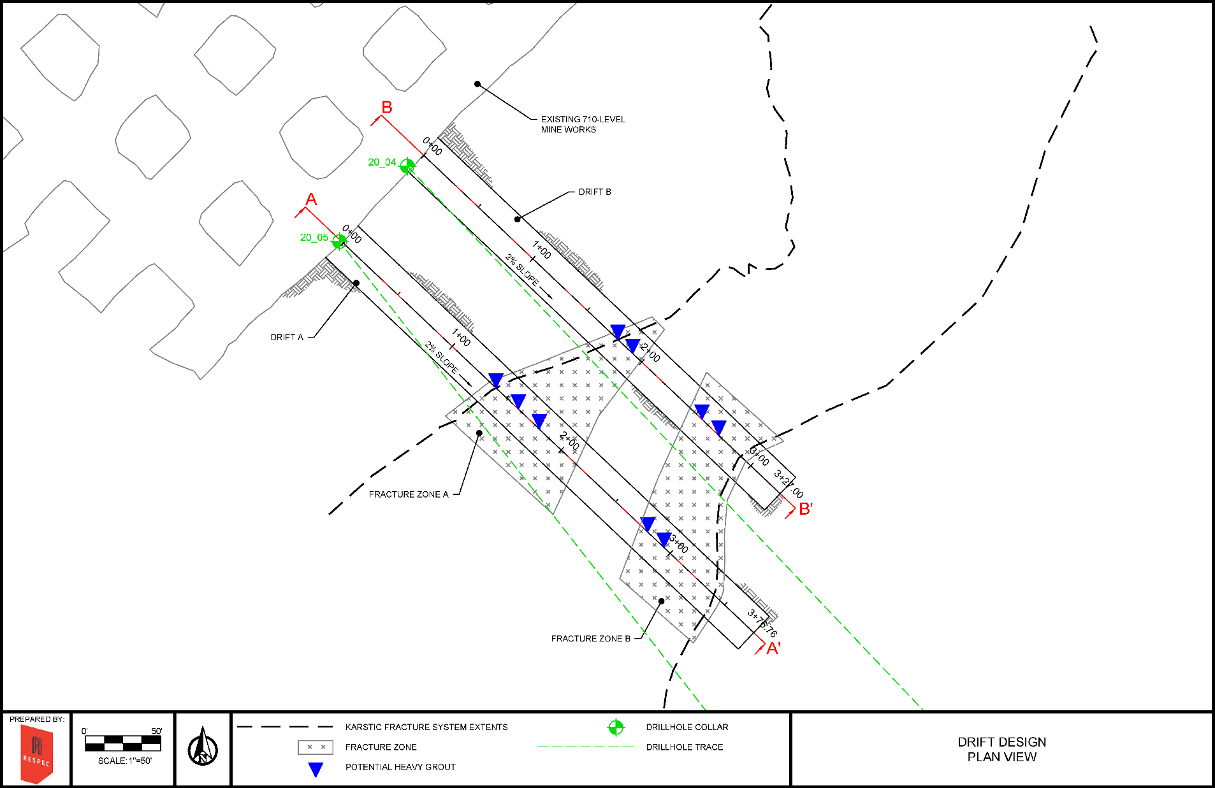

Slide 14
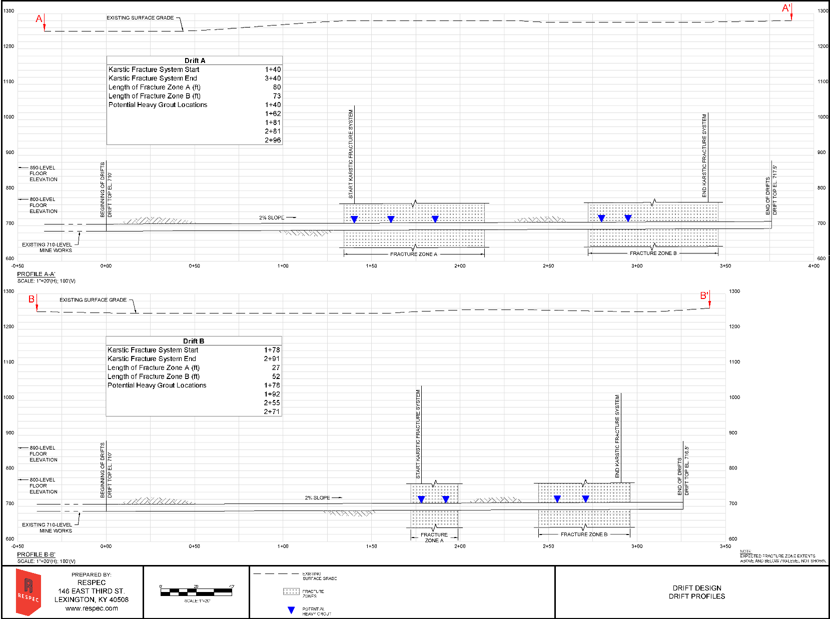

Slide 15
Planned Mining procedure
Drift advancement in 15 ft rounds
Simultaneous advancement of A and B
A kept 50 ft in advance of B
Guard against simultaneous fracture exposure
Lateral grout flow to minimize grouting in B
30 ft exploratory holes before each round
Water flow immediately stopped with mechanical packers
Drilling through packers to 30 ft depth
Grout to stop water flow
12,000 gallons of three formulations estimated
16,000 gallons to complete the project
Current TTL price $45 a gallon

Slide 16
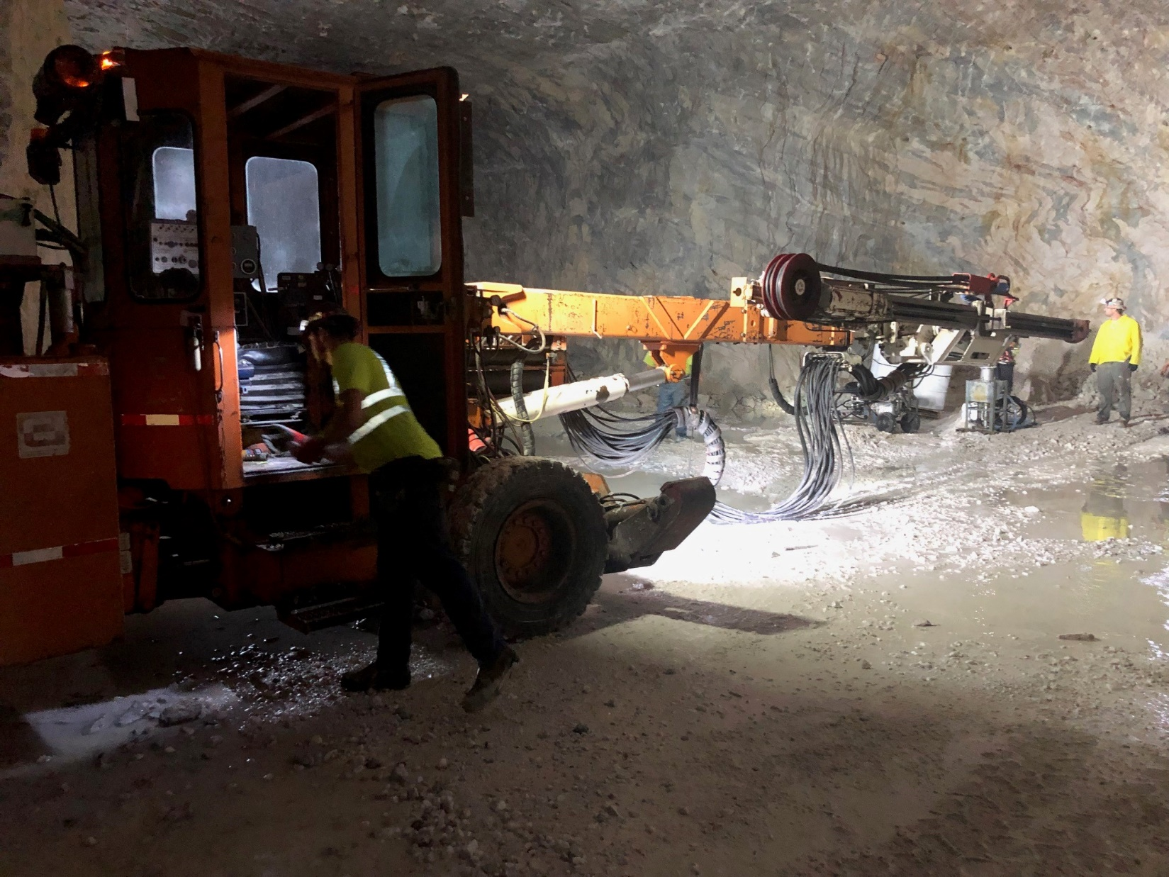

Slide 17
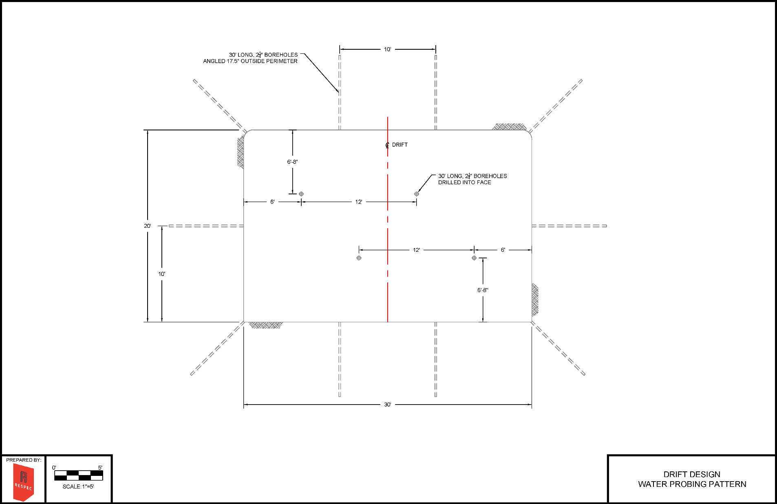

Slide 18
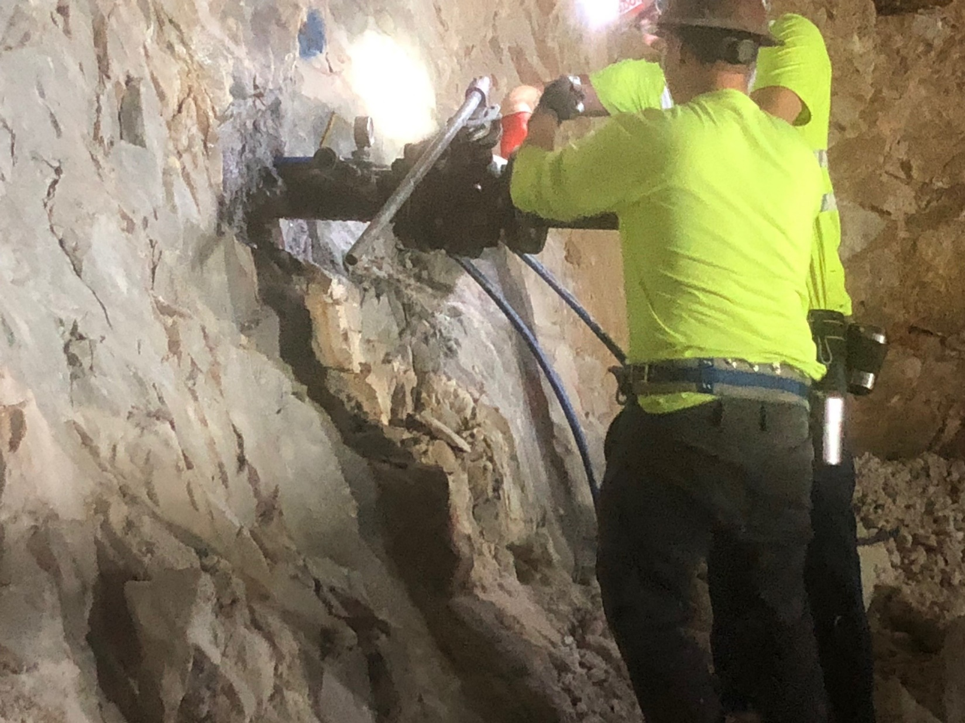

Slide 19
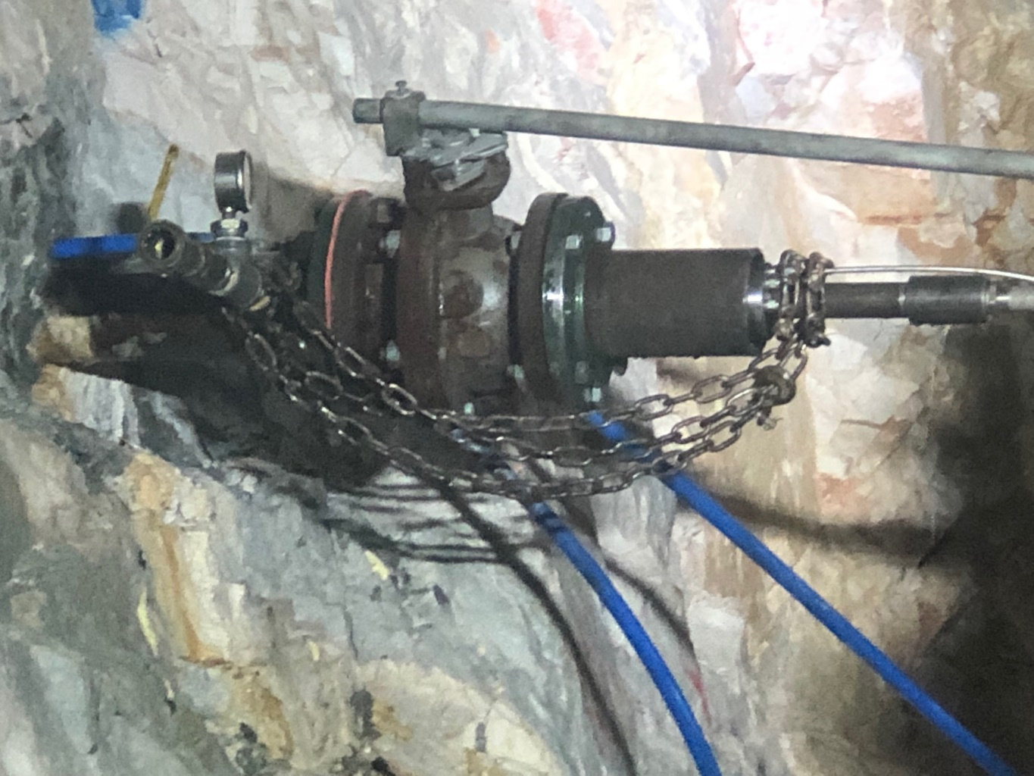

Slide 20
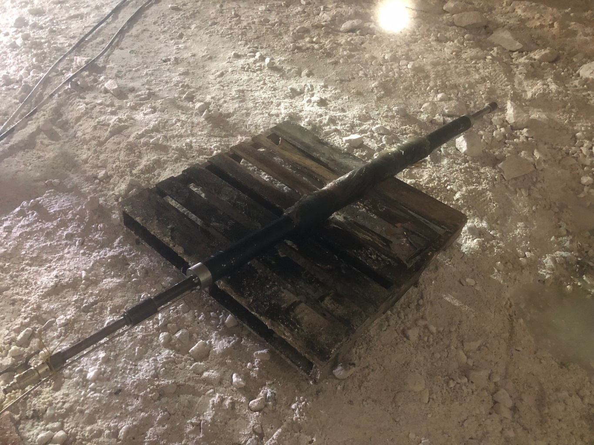

Slide 21
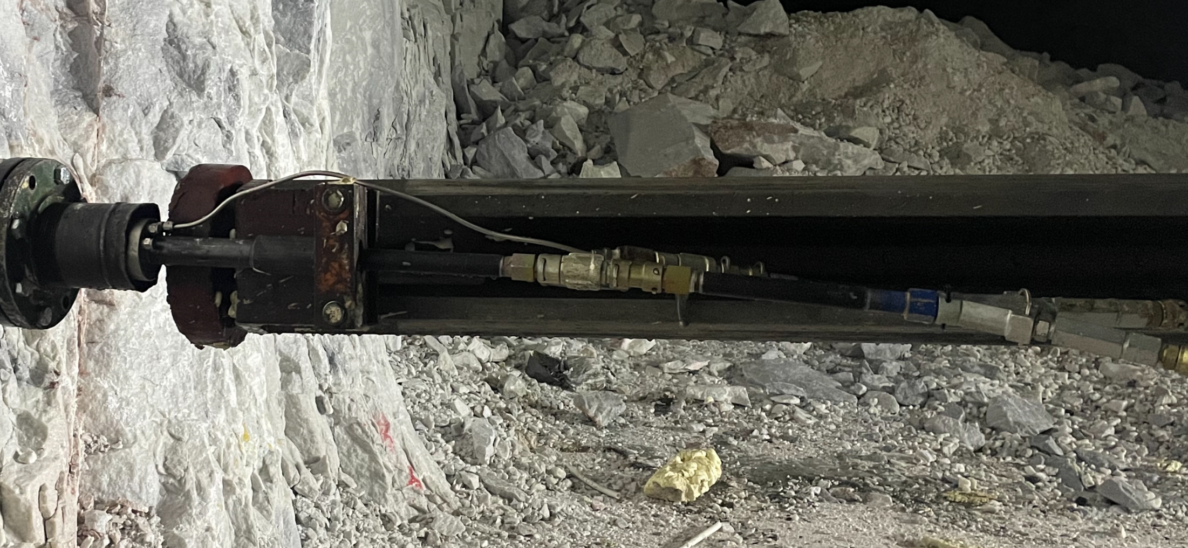

Slide 22
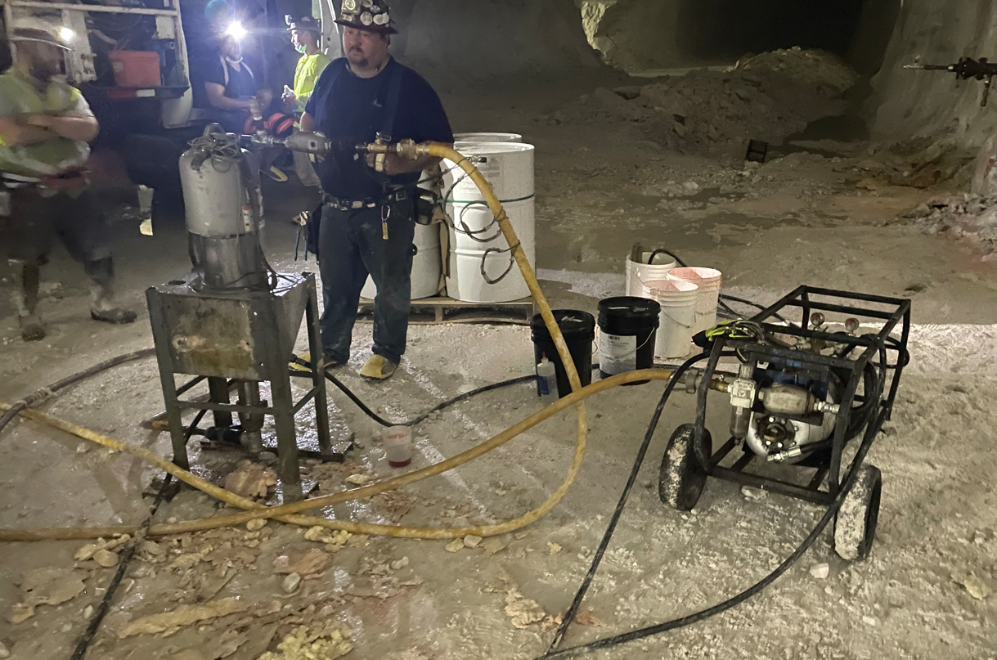

Slide 23
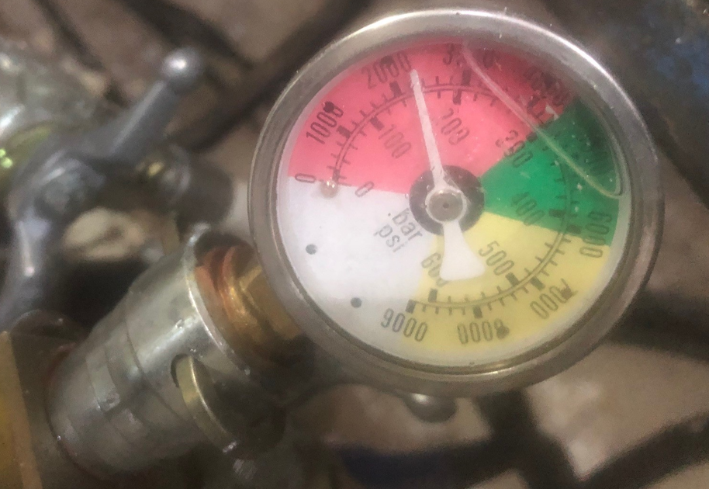

Slide 24
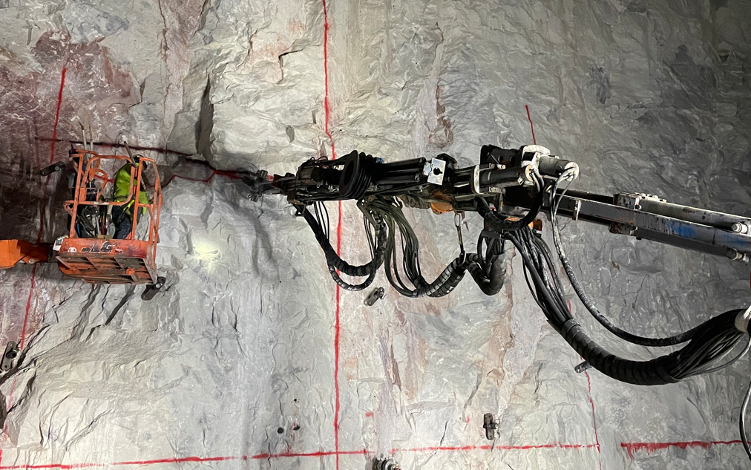

Slide 25
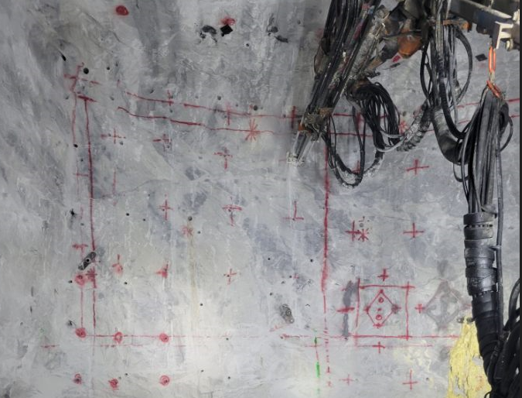

Slide 26
Grouts employed
Tsw/jsc flex
Single component flexible hydrophobic grout
Reaction time controlled by catalyst
Slow set allowed long distance pumping
Filled the exploratory boreholes to fracture zone
Foamed as expected
Compressed into impermeable plug when hole filled

Slide 27
Grouts employed
TSW INSTA-SET
Two component hydrophobic resin
2.5 pounds per cubic foot density
High yield expanding 24-30 times
Compressive strength of 25 psi
Set time fast to penetrate 30 ft injection
Use discontinued early in project

Slide 28
Grouts employed
TSW AG-4
Two component hydrophobic resin
4 pounds per cubic foot density
Medium yield expanding 18 times
Compressive strength of 80 to 100 psi
Used exclusively after TSW INSTA-SET discontinued
Filled fractures along 30 ft injection holes
Immediately moving water across the face
Migrated 25 ft laterally in wide fractures

Slide 29
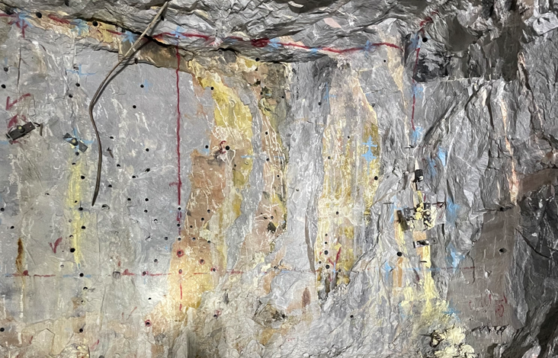

Slide 30
Project modification
Entry A encountered a +5 ft lateral void
Entry A abandoned
Entry B completed
Entry C mined on opposite side of entry A
Grout pumped in entry B visible in entry C

Slide 31
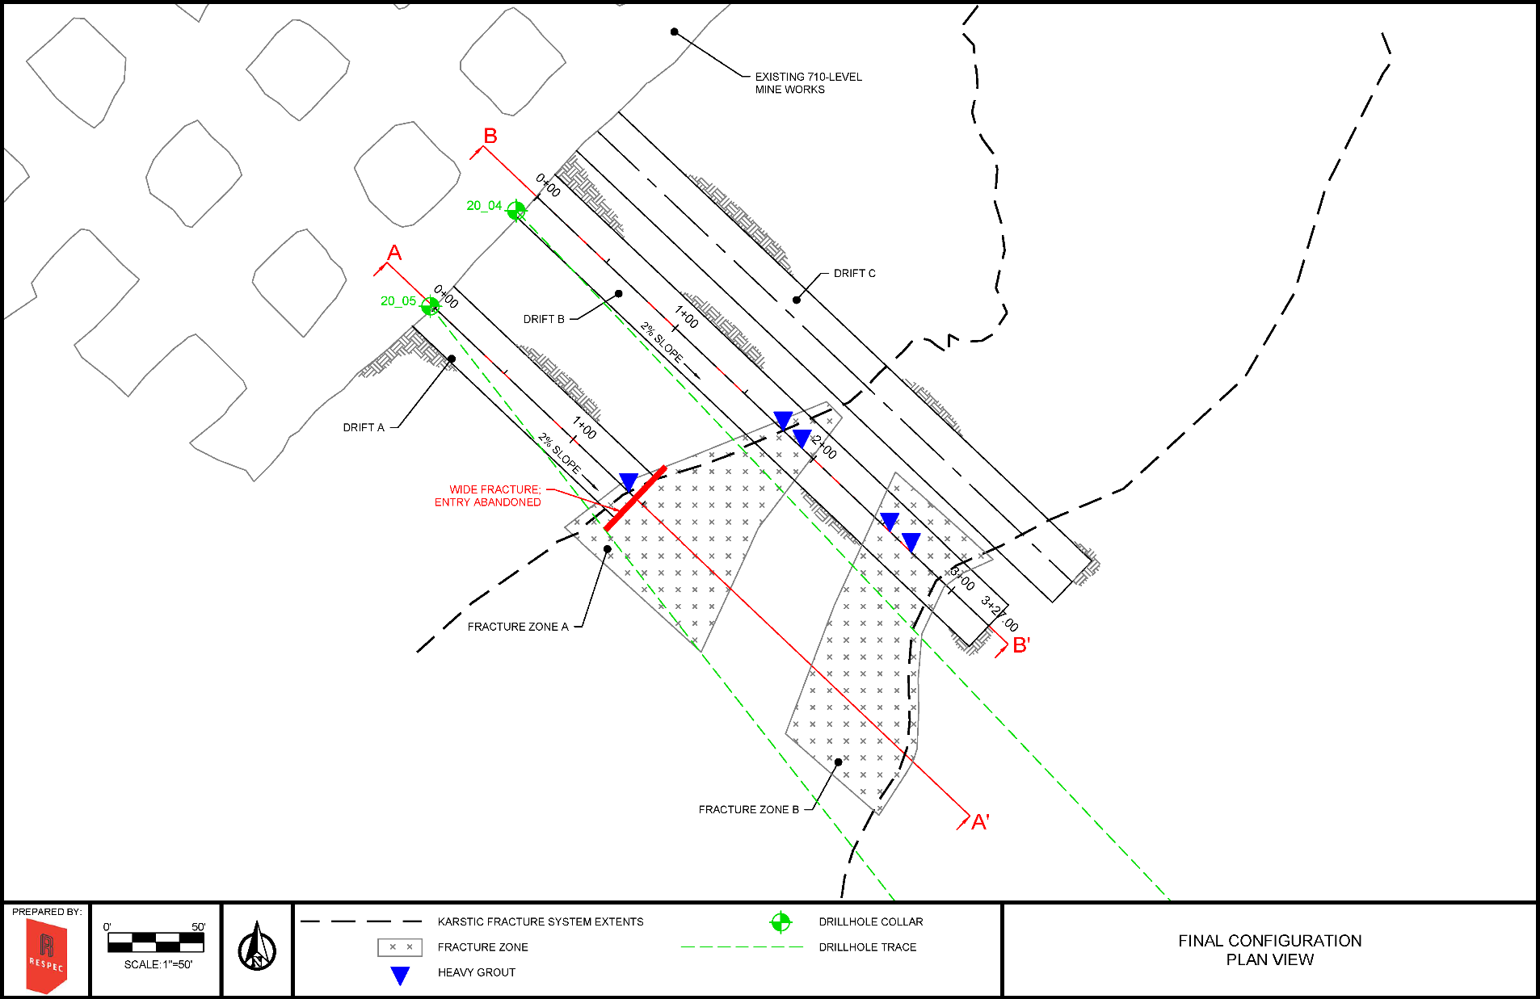

Slide 32
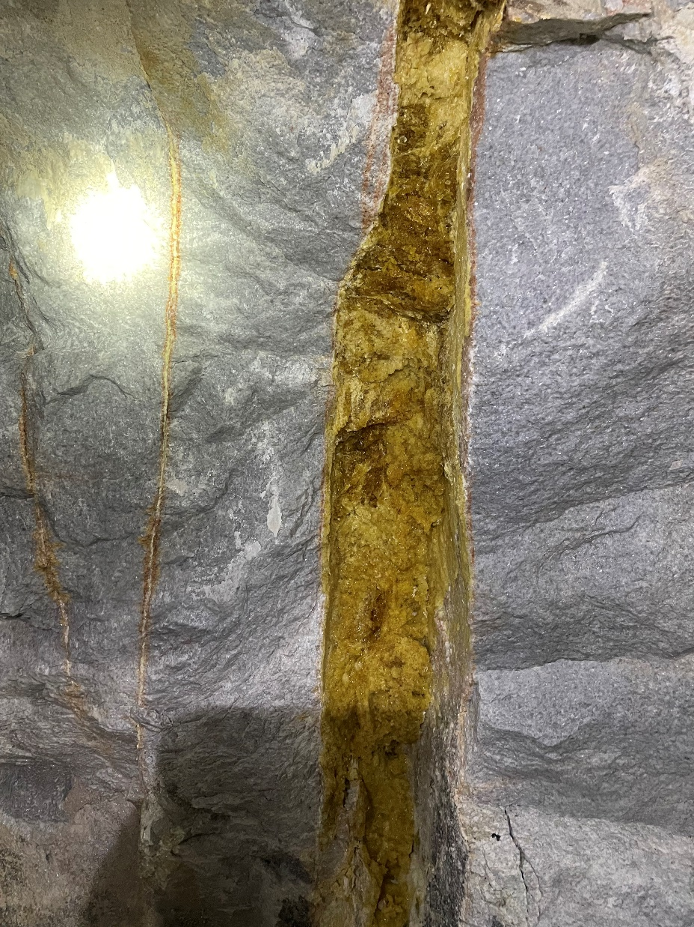

Slide 33
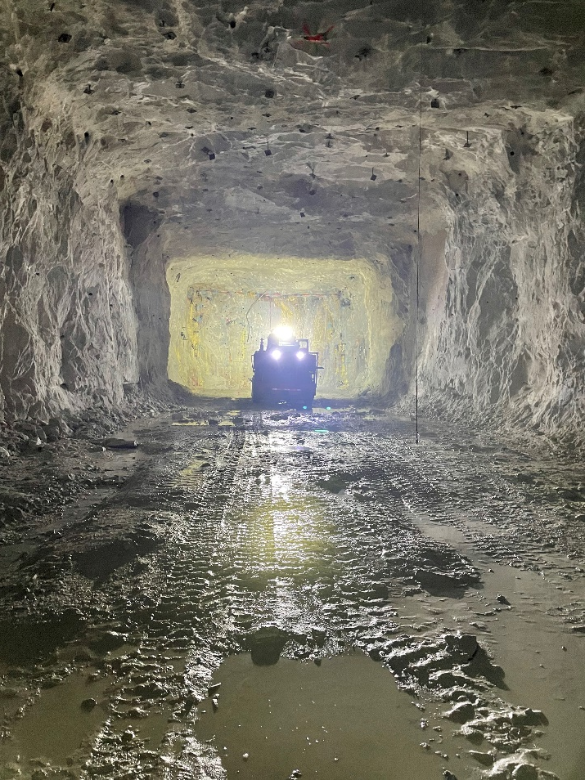
Conclusion
Stable mine layouts can be designed with good understanding of rock being mined
Problem areas can be identified by geologic mapping.
Numerous grouting options are available.
Support methodology must be compatible with geologic conditions.

