Slide 1


Investigation of Airflow Distribution in Large opening Mines through Field Studies and CFD Modeling
Dr. Shimin Liu
Penn State University
1

Slide 2
Outline
Part 1: Background and Research Motivation
Part 2: Field Surveys and Data Collection
Single level and multi level data collection
Field survey for CFD model
Part 3: CFD Modeling and Simulations
Booster Fan Placement Study
Part 4: Conclusion & Future Work

Slide 3
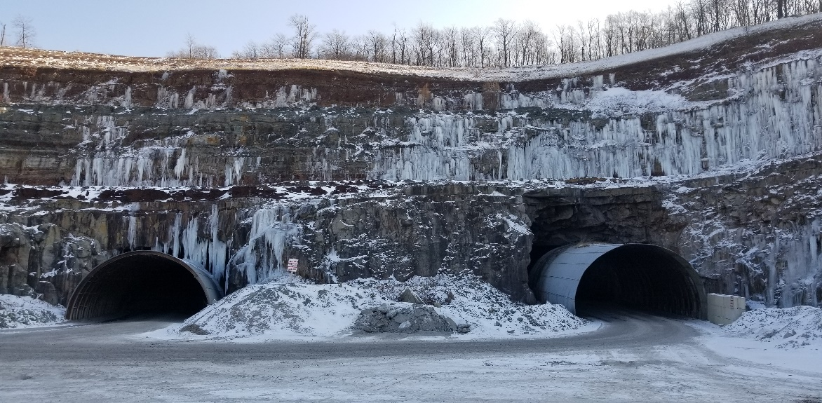
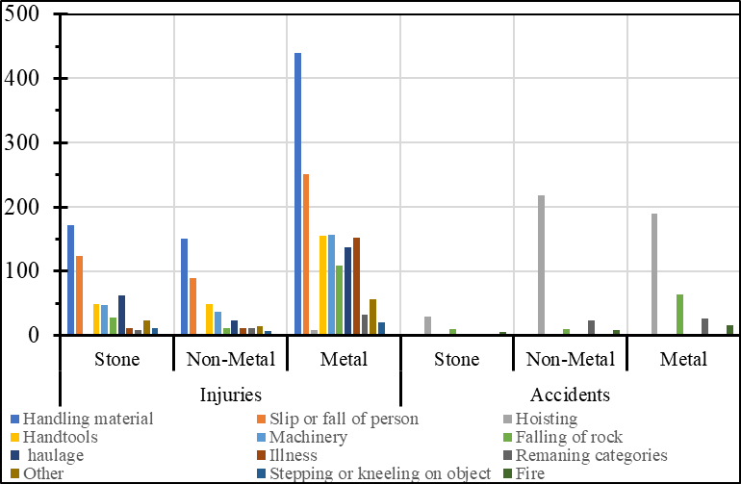
Background & Motivation
Field Surveys & Data Collection
CFD Modeling
Conclusions & Future Work
Mining and its Importance
90+ billion dollars in domestic value of nonfuel minerals in 2021
Metals – 33+ billion
Industrial minerals 56+ billion
3.3+ trillion value added to gross domestic product
17 nonfuel minerals are fully imported
14 critical minerals were 100% reliant of foreign sources
Underground mining accounts for a large portion of mine operations
Accidents/Injuries/Illnesses are still challenging for the industry
Source: USGS Mineral Commodity Summary 2022
Mine Type | Count 2020
Coal | 1009
Metal/NonMetal | 1173
Stone | 4281
Sand & Gravel | 6251
Source: NIOSH data and Statistics
Source: MSHA accident/injury/Illness database

Slide 4

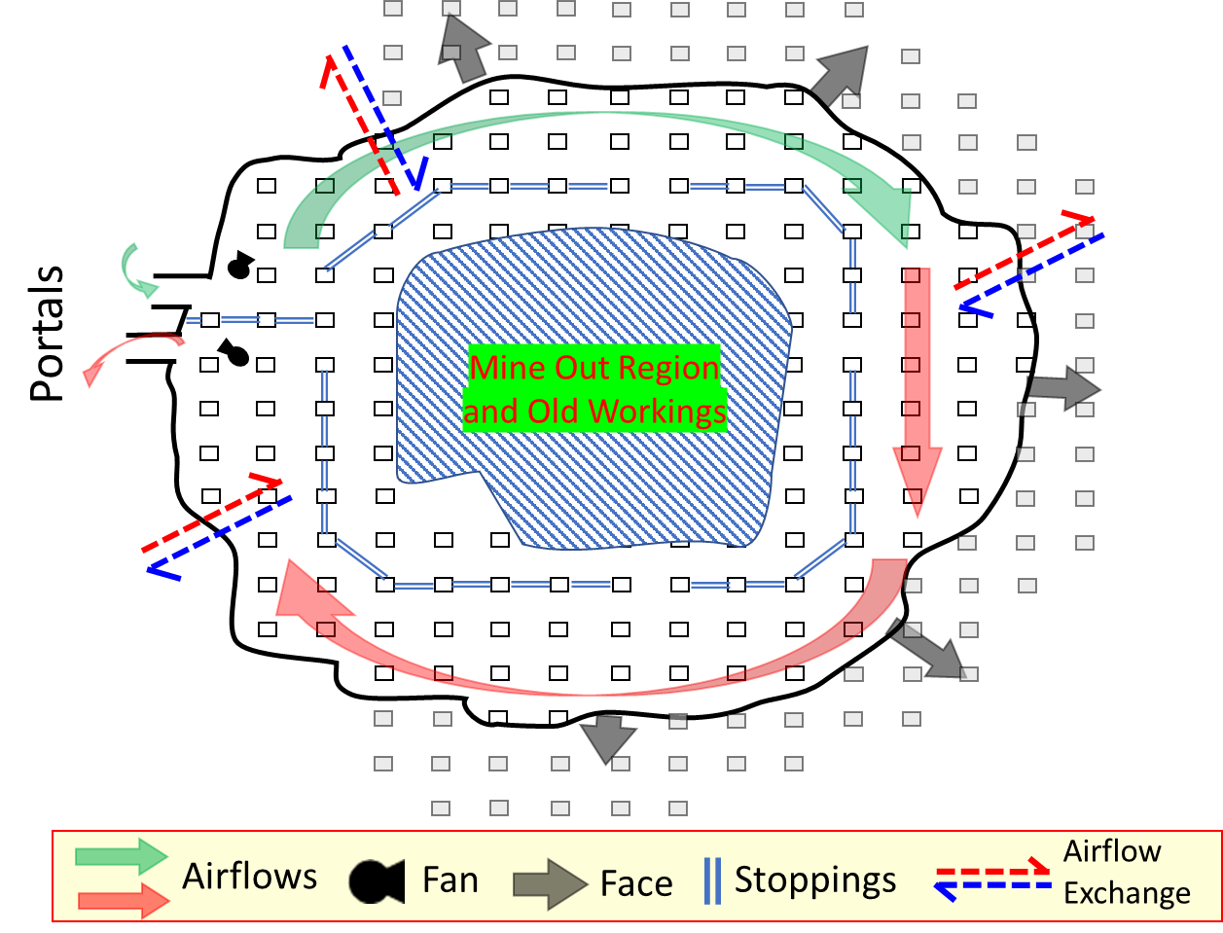
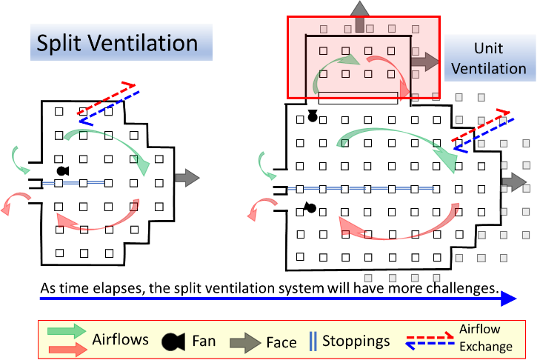
Background– Ventilation schemes
Background & Motivation
Field Surveys & Data Collection
CFD Modeling
Conclusions & Future Work
Large-opening mines account for ~ 60% of the metal and nonmetal mines operating in the United States.
Mine ventilation schemes and challenges
Perimeter
Unquantified exchange between perimeter and center mined out regions
Booster fan placement
Split (and unit)
Imbalanced airflow around corners
Less feasible for larger mines
4

Slide 5
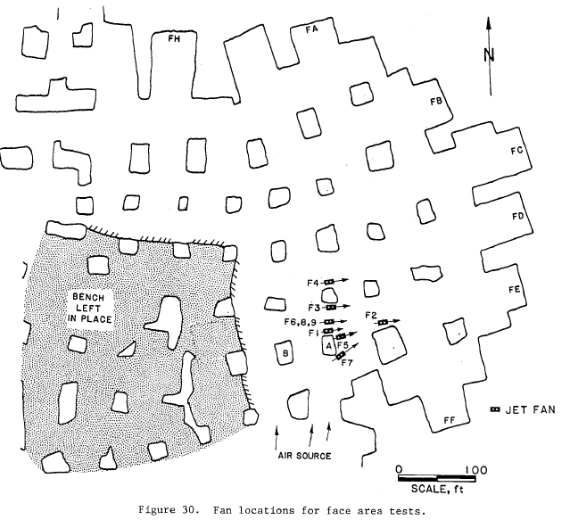
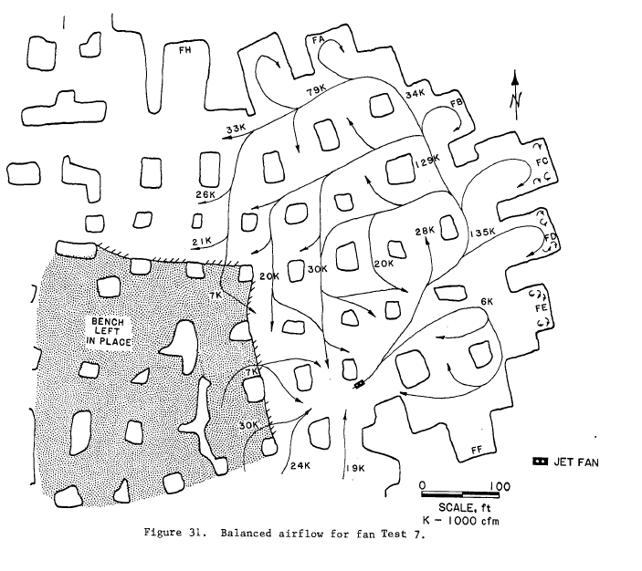
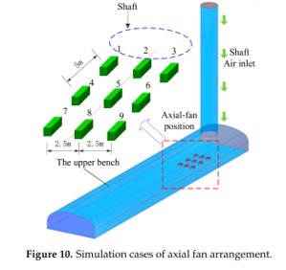
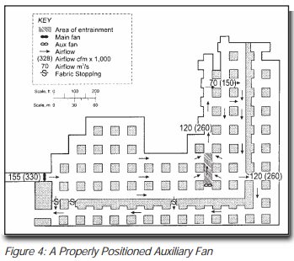
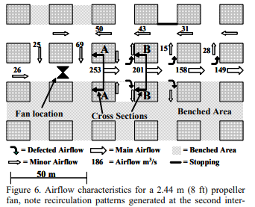
Background– Booster Fan Studies
Background & Motivation
Field Surveys & Data Collection
CFD Modeling
Conclusions & Future Work
  Booster fan Studies in large opening environments
  Dunn et al., 1983 - Testing Jet Fans in Metal/Nonmetal mines with Large Cross-Sectional Airways
  Krog and Grau, 2006 - Fan selection for Large opening mines Vane-axial or Propellor fans - Which to choose?
  Grau and Krog, 2009 Ventilating large opening mines
  Sun et al., 2018 fan placement for tunnel (drift) application
Figures 30 and 31 from Dunn et al., 1983
Figure 4 from Grau and Krog, 2009
Figure 10 from Sun et al., 2018
Figure 6 from Krog and Grau, 2006
5
Notes:
Krog and Grau 2006 is pivotal for fan selection and entrainment discussions. This slide discusses papers specifically about booster fan placement within the entry/section of LOM environment

Slide 6
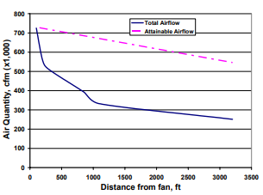
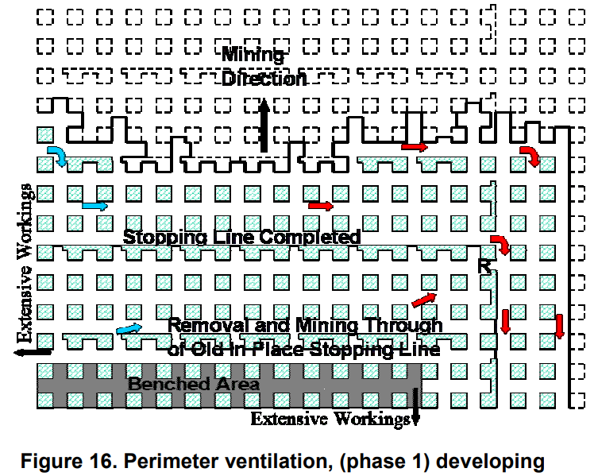
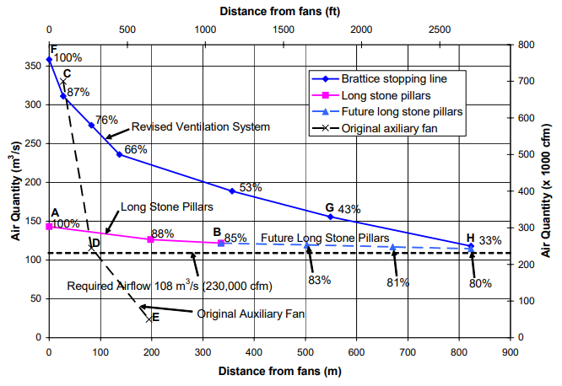
Background– NIOSH studies in 2000’s and others
Background & Motivation
Field Surveys & Data Collection
CFD Modeling
Conclusions & Future Work
Figure 10 from Grau et al., 2004
  Airflow studies in large opening environments
  Krog et al., 2004 - Ventilation planning layouts for Large opening mines
  Grau et al., 2004 - Raising the bar of ventilation for large-opening stone mines
  Grau et al., 2006 - Maximizing the ventilation of large-opening mines
Figure 16 from Krog et al., 2004
Figure 5 from Grau et al., 2006
6
Notes:
This slide focuses on ventilation / general airflow around LOM. Not specifically about Booster fan placement but rather how the whole system interacts to achieve optimal efficiency.

Slide 7
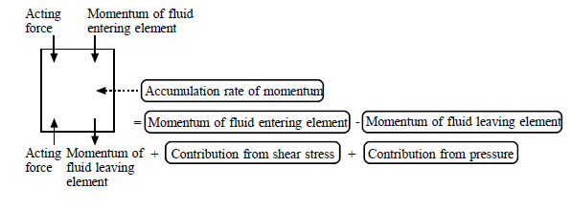
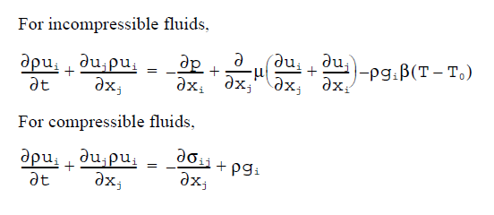
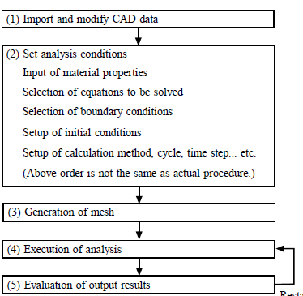
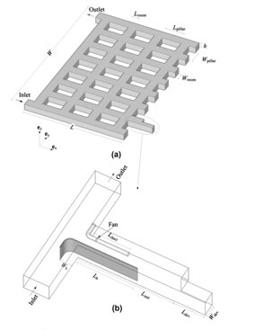
Background– CFD background
Background & Motivation
Field Surveys & Data Collection
CFD Modeling
Conclusions & Future Work
Figure from Cradle handbook
CFD is widely used throughout the mining industry
  Mine ventilation airflow
  Dust/pollutant dispersion and control
  Others
Limited booster fan studies
Limited overall sectional ventilation studies
Focus on auxiliary vent near the face (pollutant control)
Pressure change
Source
Unsteady Acceleration
Convective Acceleration
Viscous Diffusion
Figures from Sasmito et al., 2013
Stress Tensor
Introduction of Turbulence models
7

Slide 8
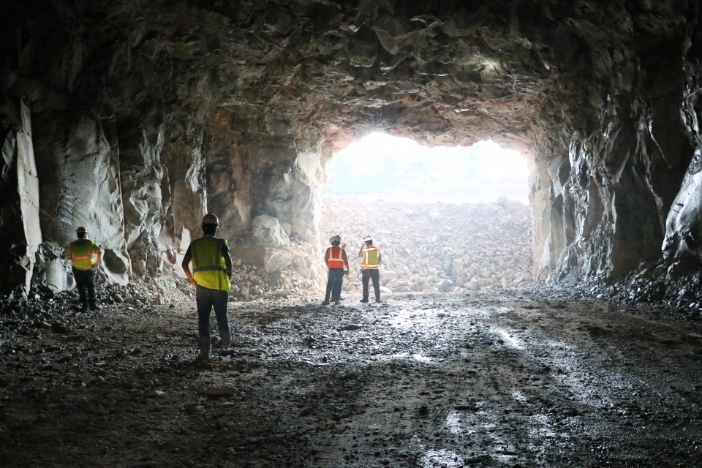
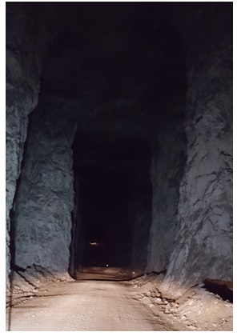
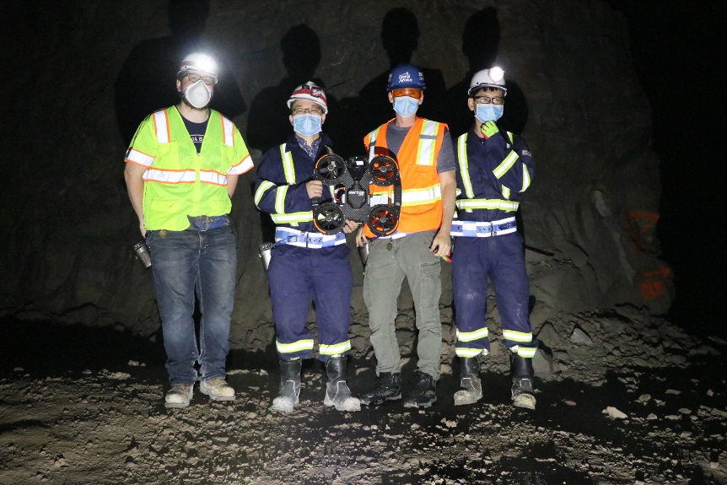
Background & Motivation
Field Surveys & Data Collection
CFD Modeling
Conclusions & Future Work
Large Opening mine Ventilation Challenges
LOM = Cross-sectional area >1000 ft²
Ventilation Challenges:
Large volume required
Unquantified exchange between mine and perimeter system
Common ventilation techniques aren't typically used
Natural ventilation
Booster fan placement
Ventilation related costs can be 20%-50% of the operating costs
Optimization and Planning challenges
Bast of new portal opening
Roadway of LOM, > 50 ft height.
Group photo of drone test
8
All pictures from our field studies at partner mines

Slide 9
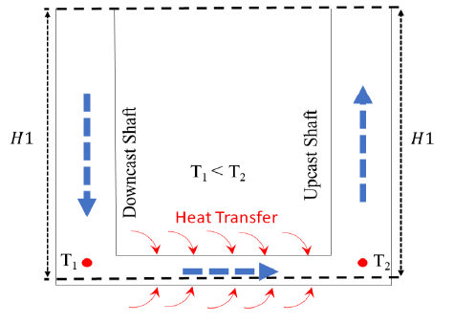
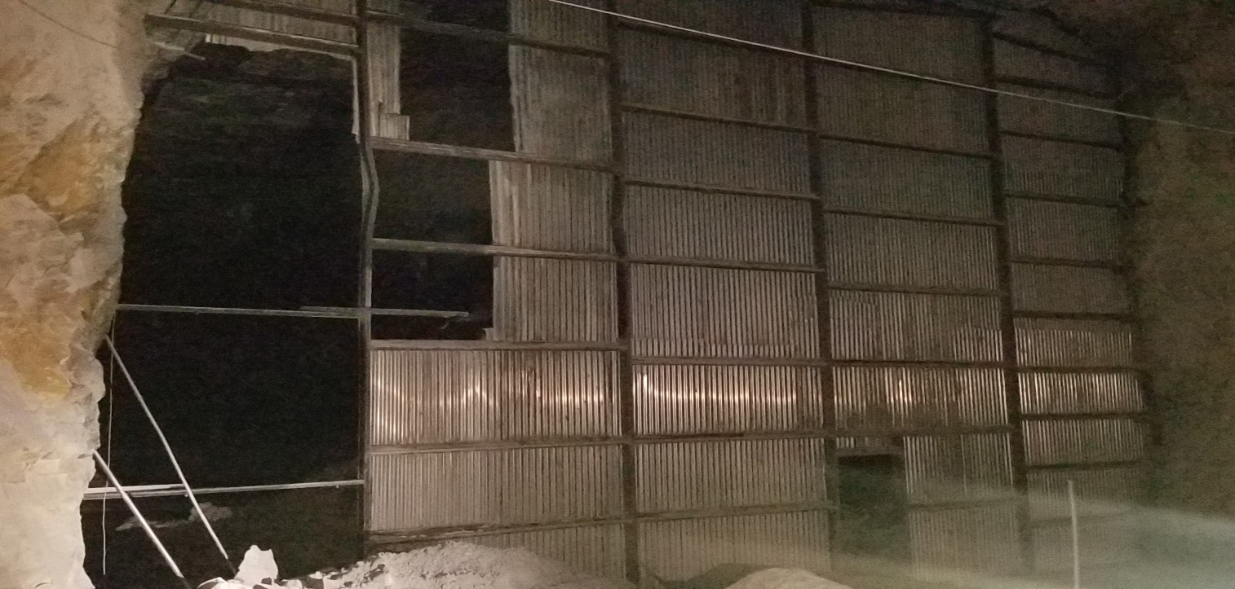
Background & Motivation
Field Surveys & Data Collection
CFD Modeling
Conclusions & Future Work
Research Motivation
Challenges facing Large opening Mines:
Extremely low air-course resistance
Difficulty in controlling and directing airflow to where needed
Seasonal variation in natural ventilation pressure significantly influences ventilation
Improper location of booster fans may result in undesired recirculation's
Unpredictable airflow variation
Diesel particulate matters dilution (160 µgTC/m³ )
Low and variations of the air exchange ratio
Multi-level mine airflow optimization

Slide 10
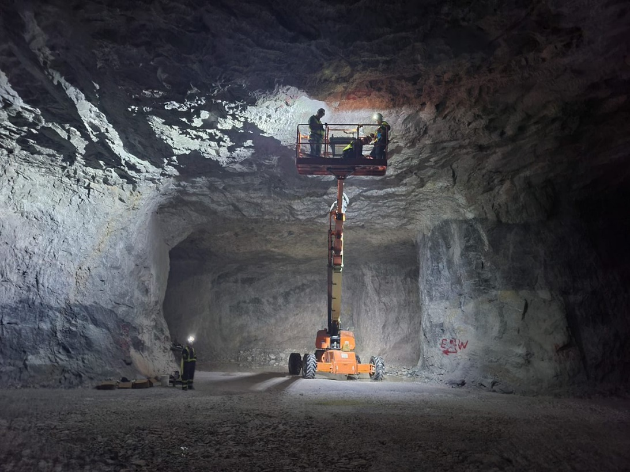
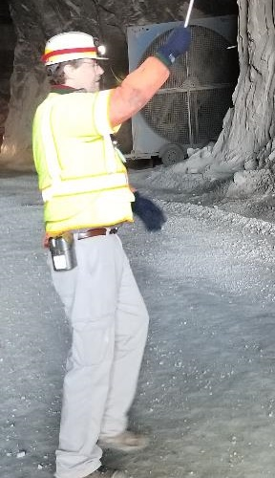
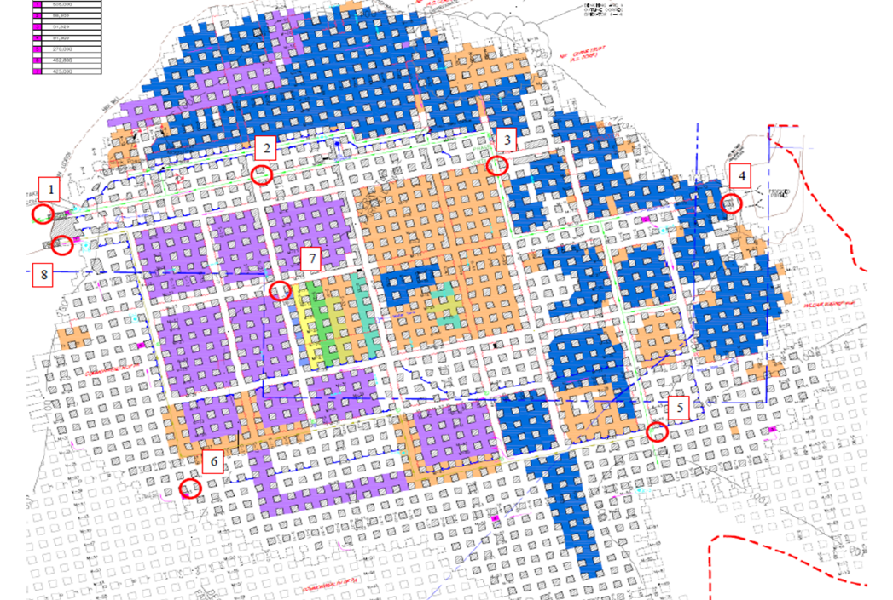
Background & Motivation
Field Surveys & Data Collection
CFD Modeling
Conclusions & Future Work
Research Objectives
Booster Fan (BF) Placement:
Conduct mine scale ventilation survey
Determine optimal location for CFD modeling
Create a CFD simulation which can model the booster fan placement about the perimeter ventilation scheme
Evaluate the different booster fan positions inside the entryway to offer guidance of BF placement strategies for mine operators.
Booster Fan

Slide 11
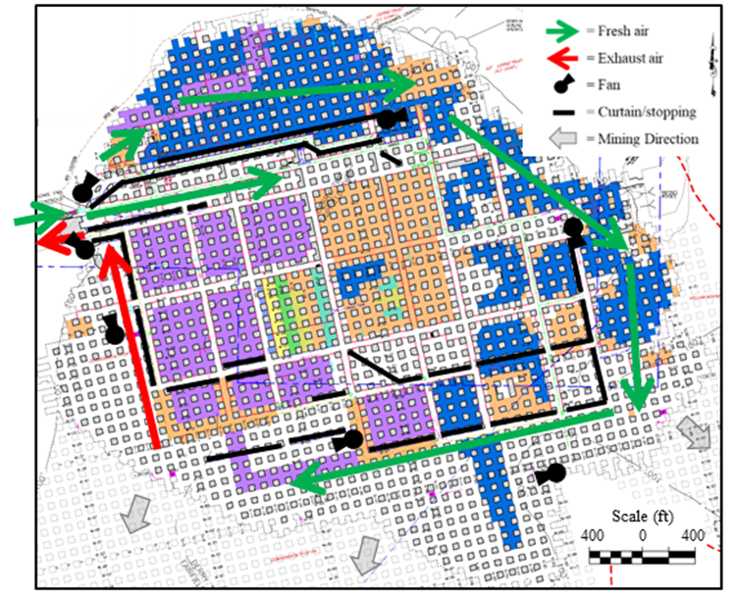
Background & Motivation
Field Surveys & Data Collection
CFD Modeling
Conclusions & Future Work
Partner Mine
Single Level underground limestone mine
Southwestern Pennsylvania
Drift access
4 portals – 2 on east and 2 new portals on the west side of the mine
Perimeter ventilation scheme
40 ft. x 30 ft. entry widths and heights
7 booster fans (propellor) and curtains/stoppings used throughout
Different colors indicate different levels of benching

Slide 12
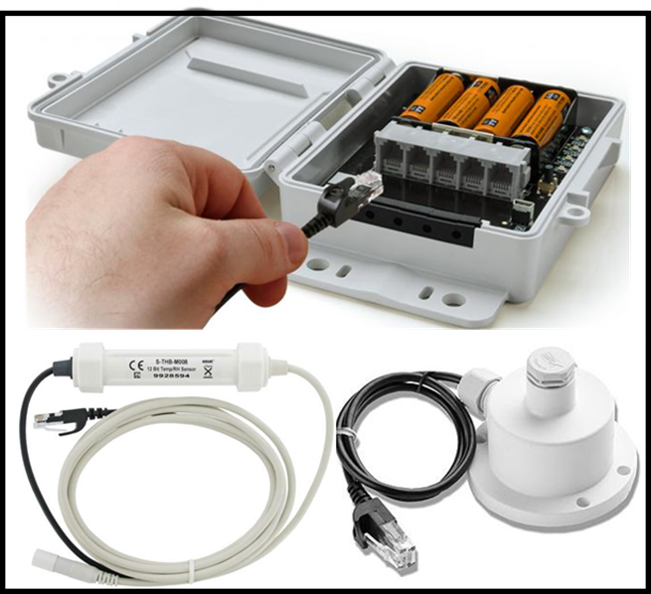
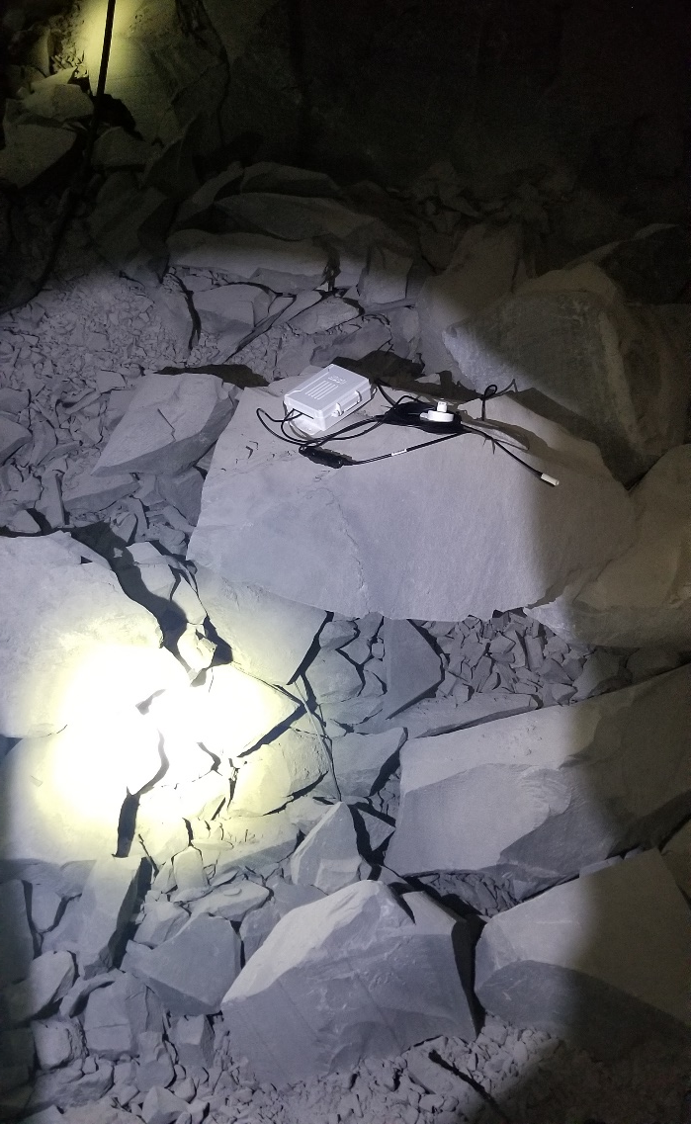
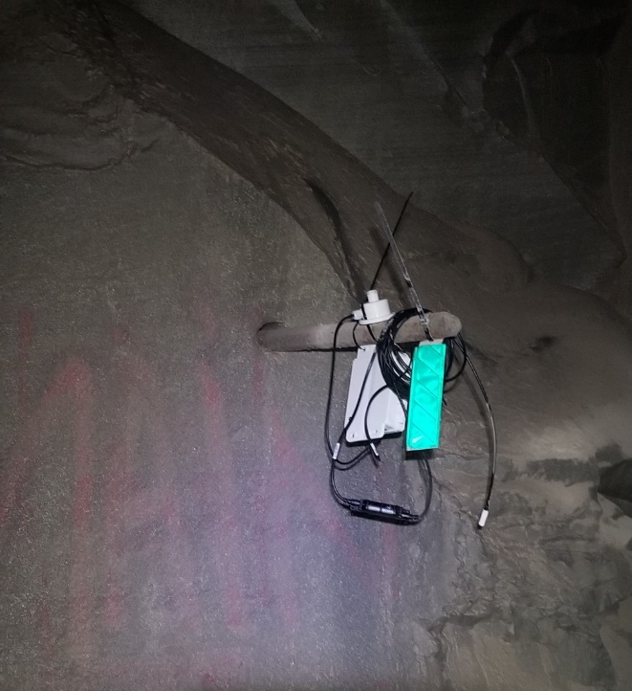
Background & Motivation
Field Surveys & Data Collection
CFD Modeling
Conclusions & Future Work
Atmospheric monitoring
Onset – HOBO micro data logging stations:
8 stations
1 year survey
Temperature, Barometric pressure, Relative humidity
Temperature: ± 0.21°C from -40°C to 75°C
Pressure: ± 3 mbar (300 pa) from 660 to 1070 mbar (66 kPa to 107 kPa)
RH: ± 2.5% from 0% to 100%
1 minute measurement frequency
~ 180 days of battery life
Logger placement
Berms of less used areas
Ribs in high traffic areas

Slide 13

Background & Motivation
Field Surveys & Data Collection
CFD Modeling
Conclusions & Future Work
Year Long In-Mine Data collection
8 HOBO data loggers
Monitoring locations
(1 & 8) Inlet/Outlet
(2 & 3) ~ 10 & 30 Cross cuts inby the inlet portal
(4) At the newly opened portal on the west side
(5) Beginning of the mining faces
(6) Near the end of the mining faces
(7)Middle of the mine (older bypassed section)
Every ~90 days batteries were replaced and the data offloaded from the loggers
June 2020 through July 2021
3
4
2
1
8
7
5
6

Slide 14
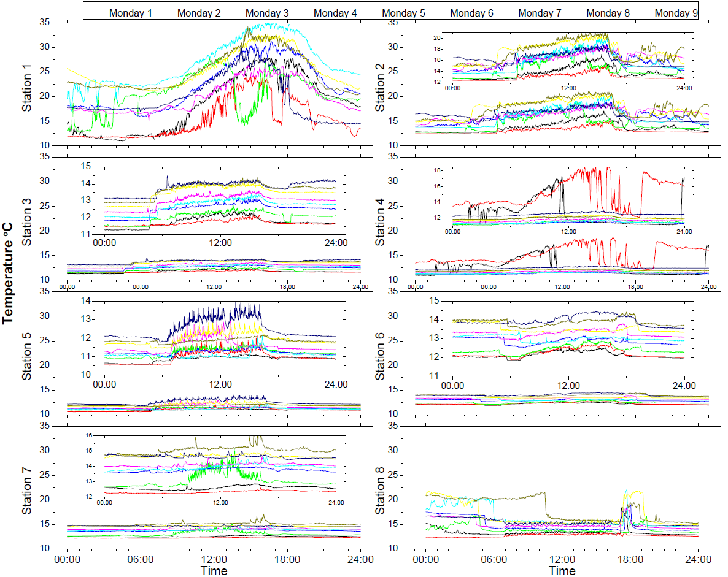
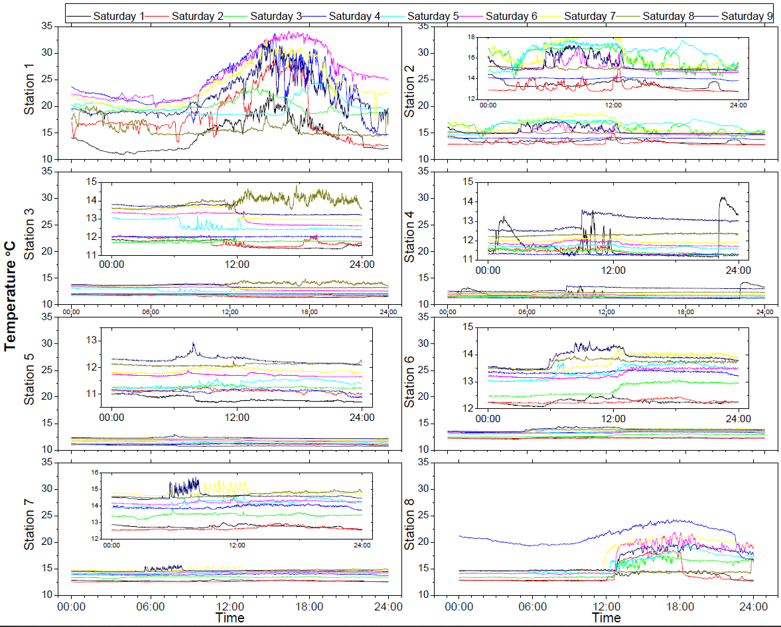
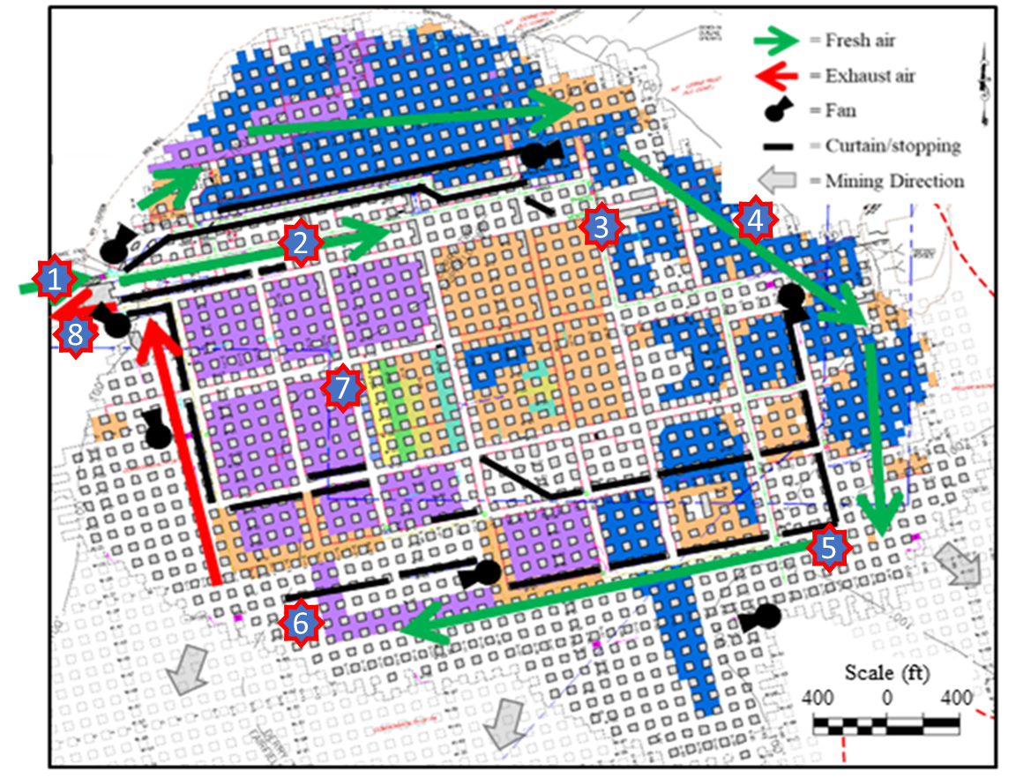
Background & Motivation
Field Surveys & Data Collection
CFD Modeling
Conclusions & Future Work
Results - Daily data from Stations, Mondays and Saturdays
Daily trends are seen throughout all 8 locations
Attenuation between stations 1-3 of surface conditions
Location 4 follows general mine trend (outlet)
Locations 5 and 6 show production trends

Slide 15
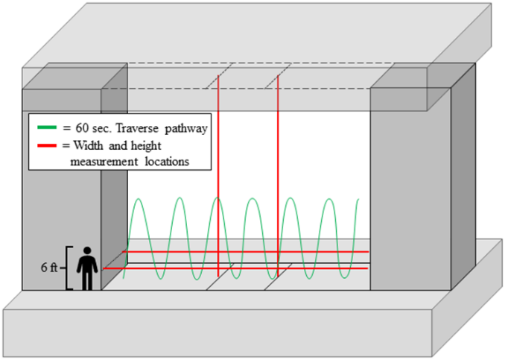
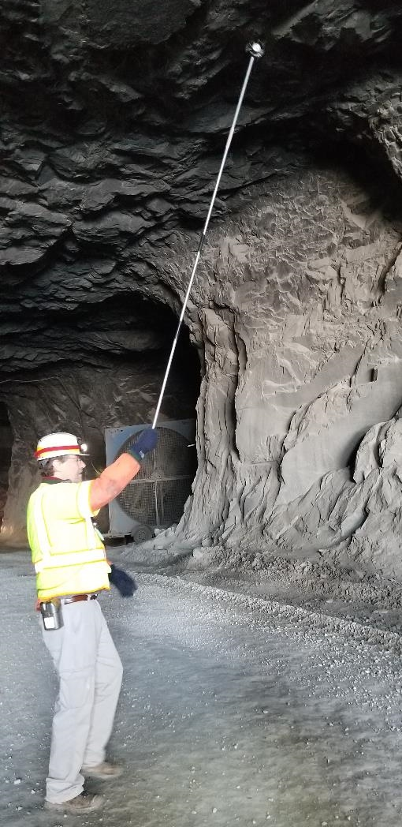
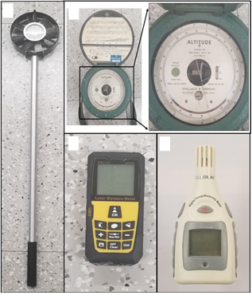
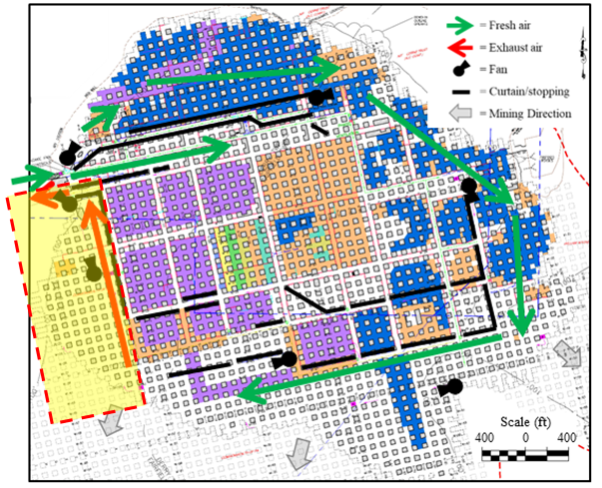
Background & Motivation
Field Surveys & Data Collection
CFD Modeling
Conclusions & Future Work
Field Survey
  Variables measured in Field Survey:
  Air velocity (m/s)
  Cross sectional area (m²)
Pressure (kPa)
Temperature (°C)
Relative humidity (%)
Booster fan settings
Survey was conducted in spring season

Slide 16

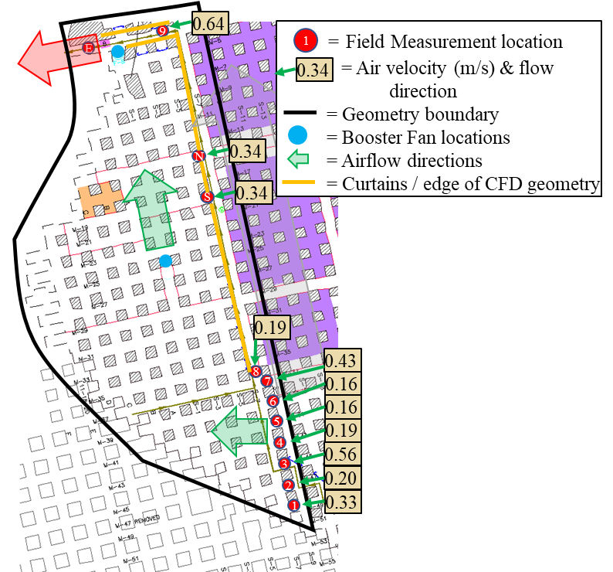
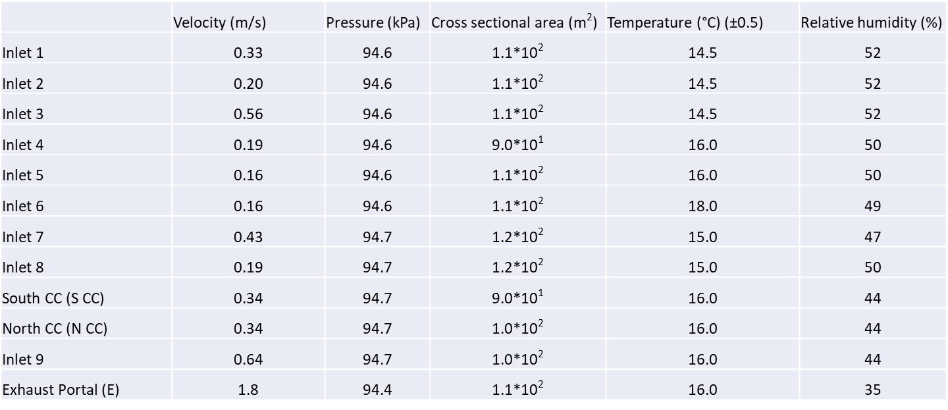
Background & Motivation
Field Surveys & Data Collection
CFD Modeling
Conclusions & Future Work
Selection of Modeling Region
Return section of the mine for CFD modeling
No benching
2 booster fans within the geometry
Clearly defined stopping line for the boundary
Minimal inlets/outlet to measure
Temperature, Pressure, Relative humidity, cross sectional area, airflow, and BF positions were recorded
EBF
IBF

Slide 17
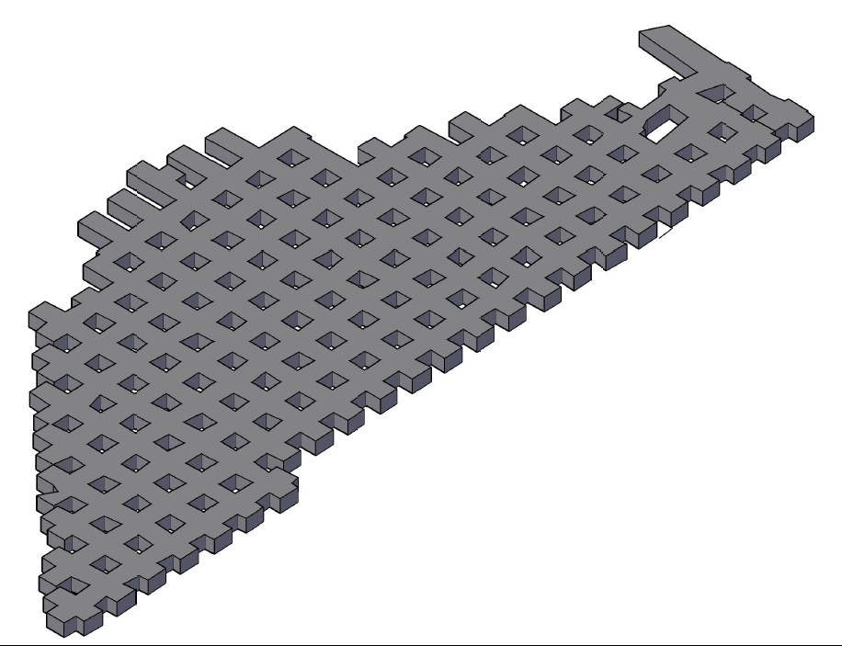
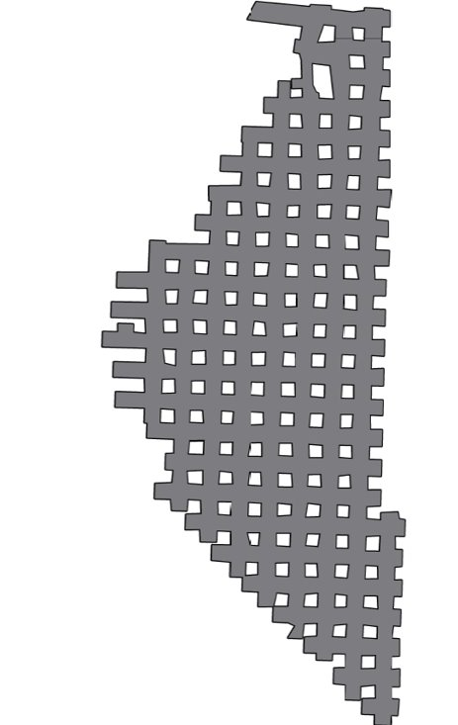
Background & Motivation
Field Surveys & Data Collection
CFD Modeling
Conclusions & Future Work
Geometry for CFD Model
  Geometry
  1:1 mine to model scale
  2 booster fans are inside the model domain (IBF, EBF)
  11 mass flow inlets with 1 pressure exhaust portal
  Fans
  Both fans were 12 ft. diameter fans modeled as 12ft. x 12 ft. boxes.
  Fans are volume defined flow
  Positioned in the entry same as in-mine
    IBF parallel to entry in the center of two pillars
    EBF near the left rib on a 45° angle to the entry (pictured in slide 15)
EBF
IBF
= Booster fan
= Curtains (wall conditions)
= Measurement locations (inlet for CFD model)
= Exhaust for CFD model
Mining Direction

Slide 18
Background & Motivation
Field Surveys & Data Collection
CFD Modeling
Conclusions & Future Work
Boundary Conditions for CFD model
Model Type | Steady State, RANS - standard k-ɛ
Fluid | Air - incompressible (airflows under 100 m/s are commonly modeled as incompressible)
Gravity | -Z direction
Initial Pressure & Temperature | 94kPa, 17°C
Inlet conditions | Mass flow defined
Outlet conditions | Natural Outflow – non constant pressure outflow
Wall condition | rough surface, wall roughness = 0.04m
Booster fans | Constant Volume flux - (mine defined airflow values)
Meshing | Undefined mesh structure with target size of 0.5 m refined around booster fan entries and inlets/outlets to 0.25 m ~ 13 million cells
Convergence criteria | 5*10⁻⁴
EBF
IBF
Mining Direction

Slide 19
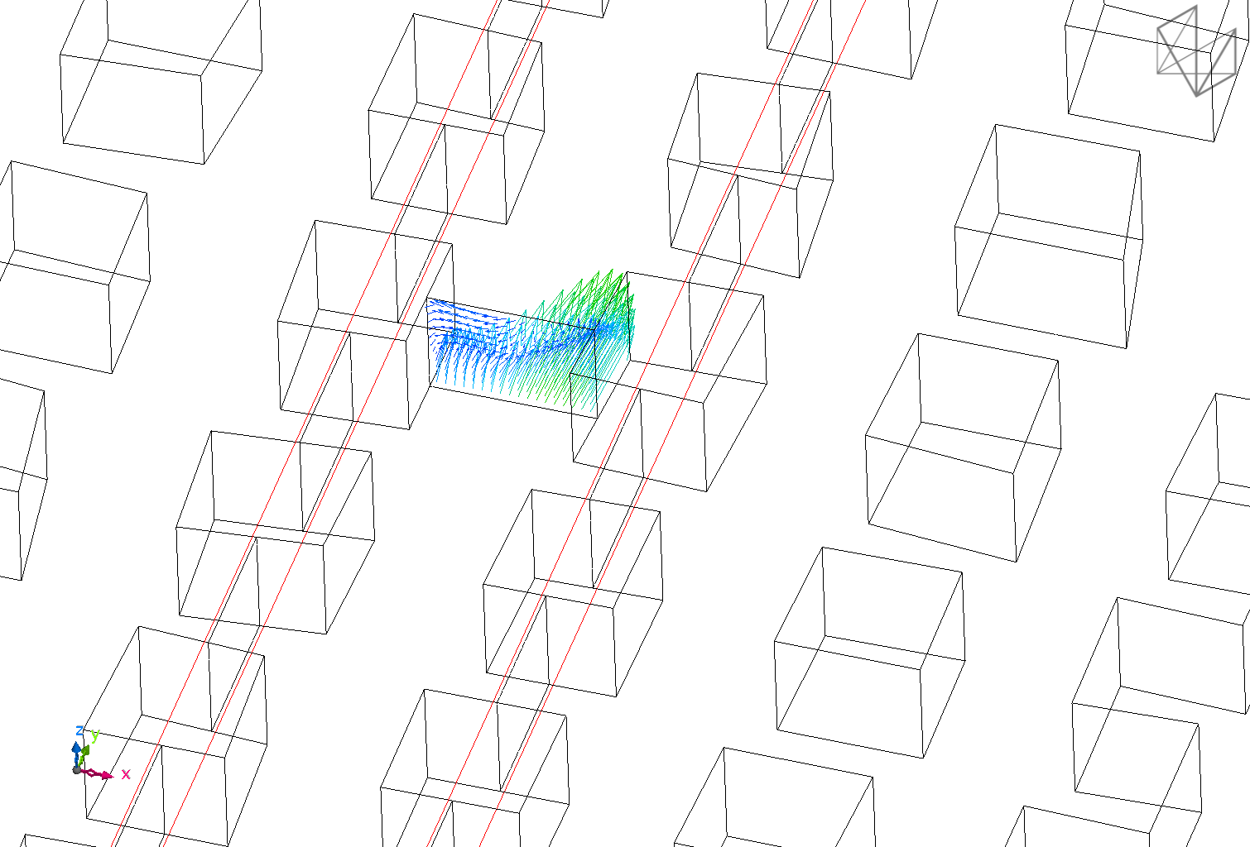
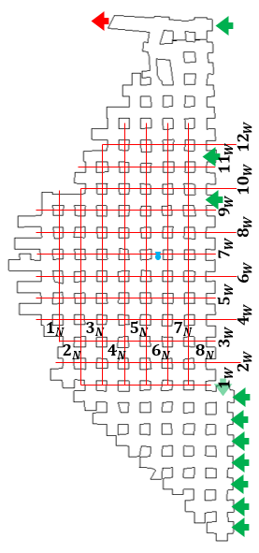

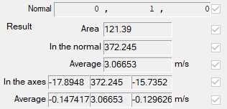
Background & Motivation
Field Surveys & Data Collection
CFD Modeling
Conclusions & Future Work
Calculation of Airflow
A’
  20 Planes (1_{N}-8_{N}, 1_{W}-12_{W}) used to calculate airflow thorough entries and cross cuts
    Area weighted vector integration
  Recirculation was defined as the negative flow divided by the total flow
  Airflows normalized by the Booster fan airflow
Scale (ft)
200 0 200
A

Slide 20
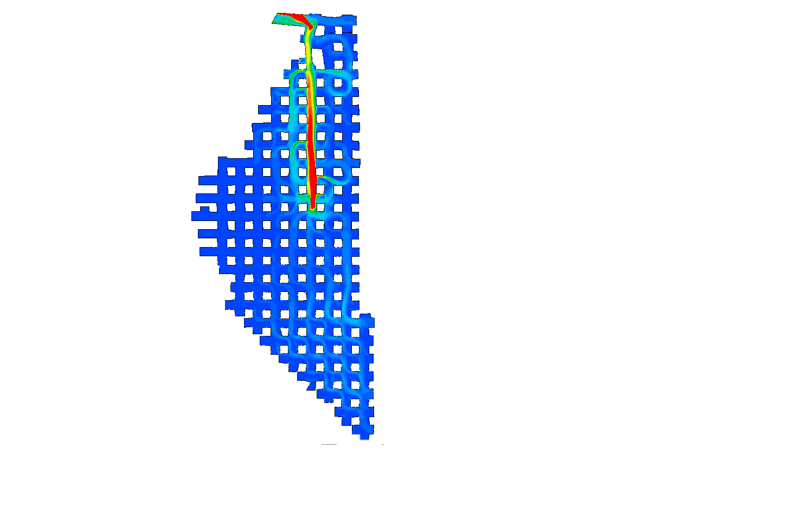
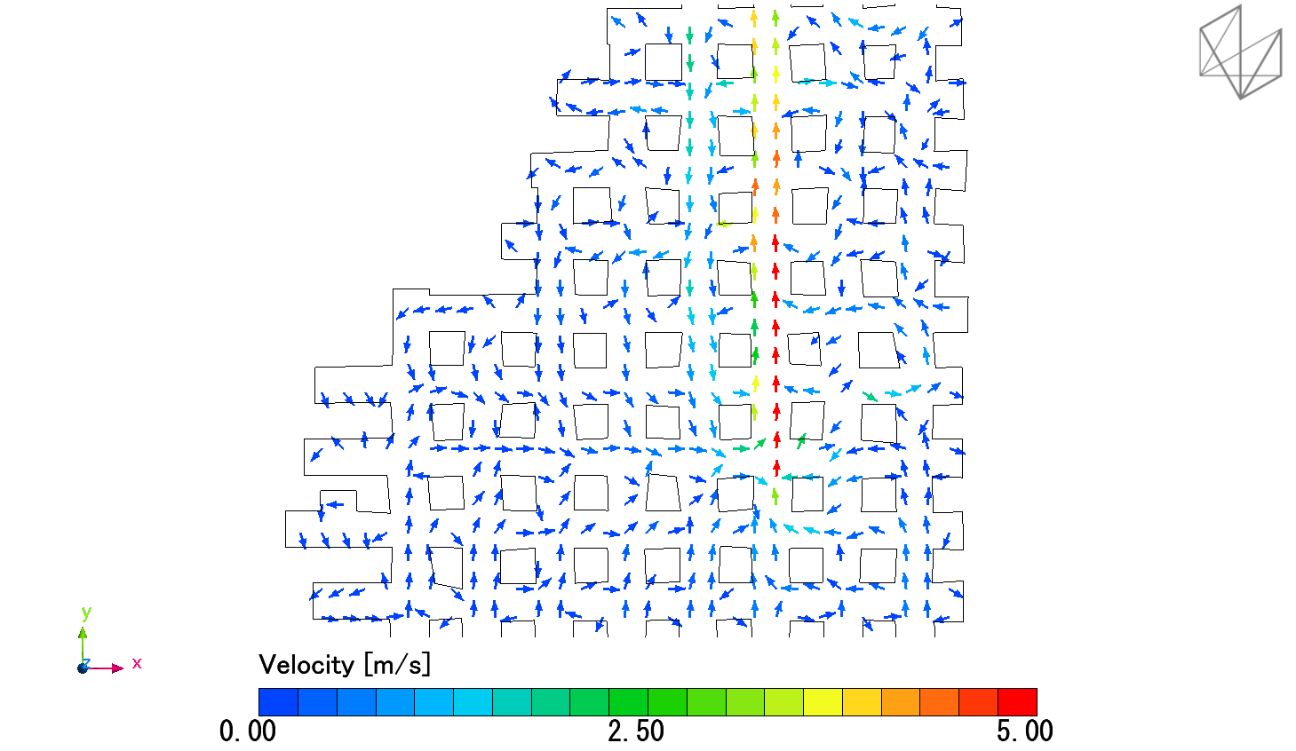

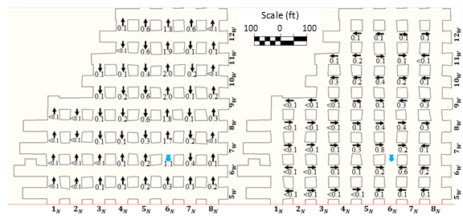

Background & Motivation
Field Surveys & Data Collection
CFD Modeling
Conclusions & Future Work
Calculation of Airflow
A C
Scale (ft)
200 0 200
A’ C
  Airflows normalized by the Booster fan airflow
  Airflow in 2nd adjacent entry to left reached maximum of 0.2x booster fan setting
  Airflow in entries 1N to 3N never exceeded 0.1x booster fan setting

Slide 21
Background & Motivation
Field Surveys & Data Collection
CFD Modeling
Conclusions & Future Work
Airflow in adjacent entries
  Booster fan setting - 425,000 CFM
    Equivalent to average entry airflow of ~5.87 ft/s (1.79 m/s)
  Booster fan fails to obtain airflow above 0.5 m/s in 2nd adjacent entry (~30% booster fan setting)
  Booster fan fails to obtain airflow above 0.25 m/s in 4th adjacent entry (~ 15% booster fan setting)
  Purpose of booster fan must be considered
    Create turbulence and dilution of pollutants around face?
    Create airstream to maximize exchange ratios?

Slide 22
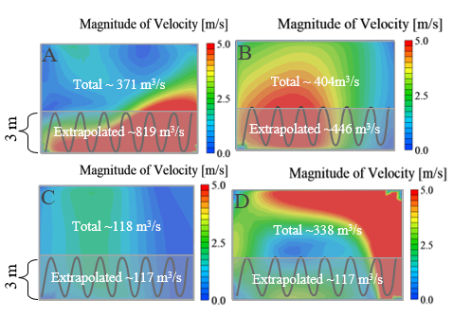
Background & Motivation
Field Surveys & Data Collection
CFD Modeling
Conclusions & Future Work
Recommendations of Airflow measurement
  A – 1 pillar downstream Booster Fan (~25 meters)
  B – 4 pillars downstream booster fan (~100 meters)
  C – Adjacent booster fan entry
  D - ~ 20 meters downstream exhaust fan around 90° intersection
  Measurements should be taken at least 4 pillars downstream using traditional traverse covering ~ 1/3 of entry height
  Non booster fan entries can be taken anywhere

Slide 23
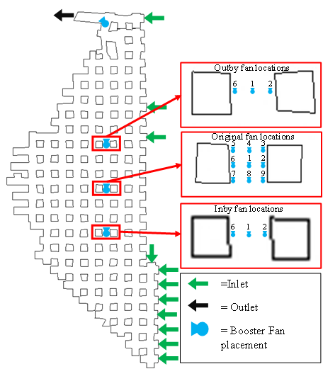
Background & Motivation
Field Surveys & Data Collection
CFD Modeling
Conclusions & Future Work
Booster Fan Placement within entry
  Booster fan placement
  A grid pattern of 9 locations
  2 entries inby the original location
  2 entries outby the original location
  Airflow calculated in the same way
  Same boundary conditions were used for all simulations
Scale (ft)
200 0 200

Slide 24
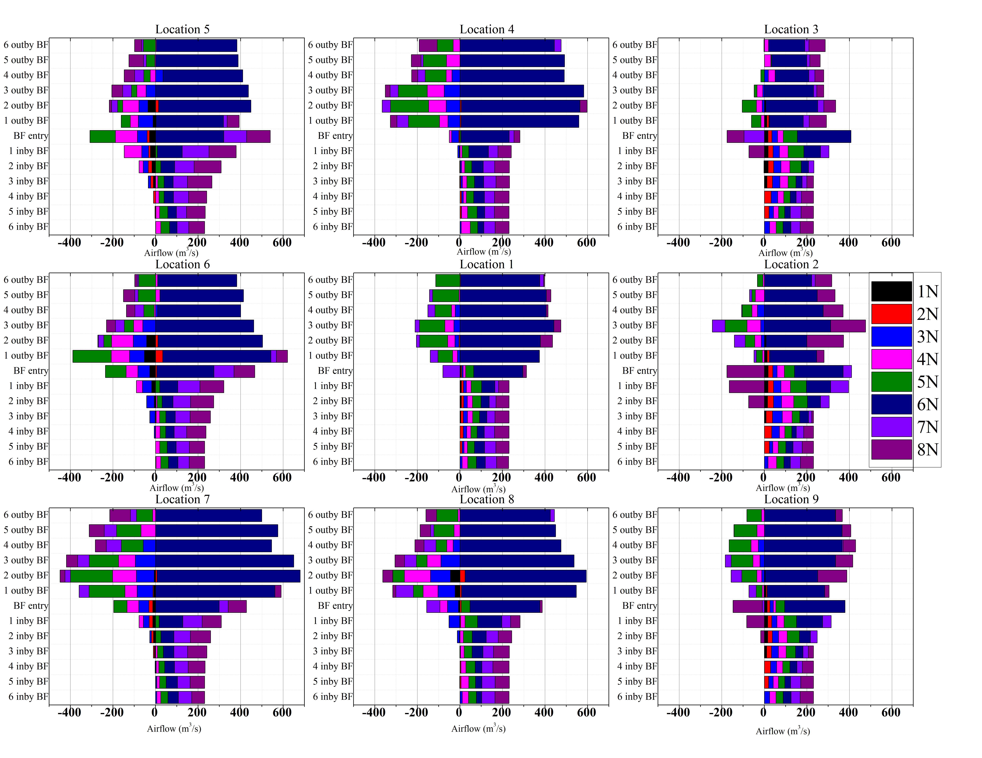
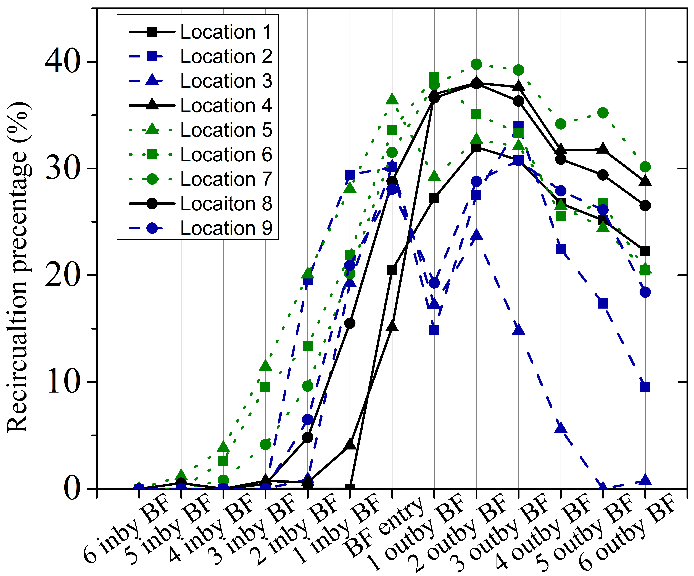
Background & Motivation
Field Surveys & Data Collection
CFD Modeling
Conclusions & Future Work
CFD Results
  Other BF placements
  Highest air movement occurred in left and center locations
  Back fan locations (7, 8, 9) had highest air entrainment
  Right locations (Blue lines) saw least recirculation
  Left locations (Green lines) had highest recirculation with larger airflows through face entries (1_{N}-3_{N})
Notes:
Mention Grau 2004 and how they note airflow reaches maximum for propellor fans ~ 170 ft downstream and In our simulations it reached maximum typically at 2 or 3 downstream which is 160 ft ( measurement frequency was ± 80 ft). They also not to get maximum entrainment a large gradient between adjacent entries must be seen which is consistent with out simulations. When there is positive airflow through entry 7N and 8N (purple and dark purple on far right of the bars) then airflow is minimized through booster fan entry but when 7N and 8N are negative creating maximum gradient then airflow is high.

Slide 25
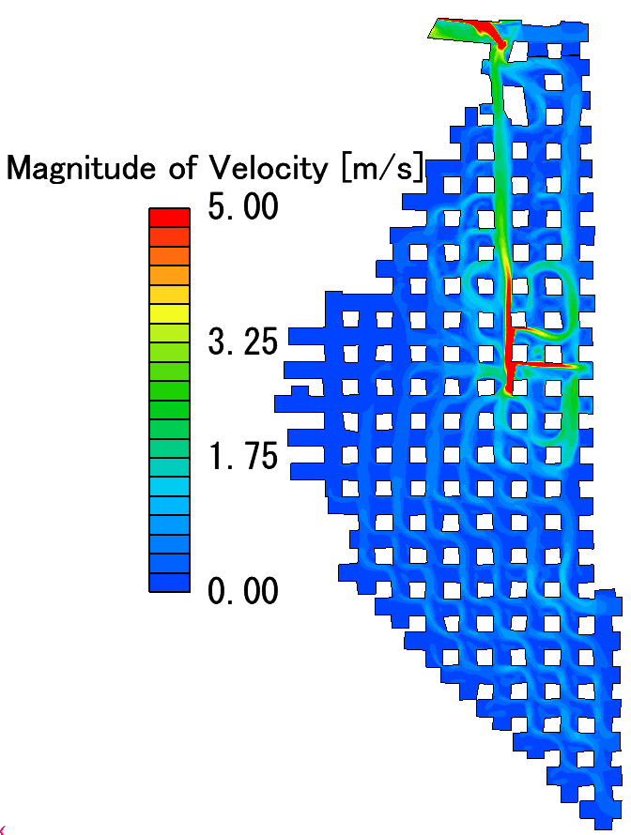

Background & Motivation
Field Surveys & Data Collection
CFD Modeling
Conclusions & Future Work
Booster Fan Placement within entry
  Fan placement - in terms of Pillar geometry to ensure maximum entrainment
  Recommendations
  Booster fan should be placed either in middle of the entry or on the same as the open airways (face area)
    Maximize airflow and entrainment from the face areas
    Minimize “wasted” airflow around curtain line entries
  Location 7 left adjacent entry airflow reaches maximum airflow 3-4 pillars downstream (red arrow)
Location 2 – middle right
Location 7 – Back left

Slide 26


Background & Motivation
Field Surveys & Data Collection
CFD Modeling
Conclusions & Future Work
CFD Results
  Other BF placements
  Inby Location 1 and original location 6 had the
    Highest airflow and air entrainment
    Highest airflow around the face area
  Similar recirculation percentages peaking around 35% of total air movement

Slide 27
Background & Motivation
Field Surveys & Data Collection
CFD Modeling
Conclusions & Future Work
Conclusions
  Airflow measurement locations
  Airflow measurements should be taken at least 4 pillars downstream of booster fan when using traditional traverse covering ~ 1/3 of entry height
    Non-booster fan entry makes no difference
  Booster fan Placement study
  Booster fan should be placed either in middle of the entry or on the same as the open airways (face area)
    Inby Location 1 and original location 6 had:
      Highest airflow and air entrainment
      Highest airflow around the face area
  Similar recirculation percentages peaking around 35% of total air movement
  Confirmed findings in Krog and Grau, 2006
    Propellor fan reaches maximum airflow ~ 170 ft. (160 in our simulations )
    Air entrainment is maximized when large velocity gradients are observed between adjacent entries
  Purpose of booster fan must be considered
    Create turbulence and dilution of pollutants around face?
    Create airstream to maximize exchange ratios?

Slide 28
Background & Motivation
Field Surveys & Data Collection
CFD Modeling
Conclusions & Future Work
Future Work
  CFD and Booster fans
  Continue with booster fan placement withing the mining sections
  Investigate/Confirm findings from Dunn et al., 1983 in various geometries
  Introduce pollutant/dust simulations into discussion about booster fan placement in perimeter ventilation schemes
  Natural Ventilation
  Utilize the 1 year+ worth of in-mine atmospheric data from single level large opening stone mine partner
  Investigate the role of natural ventilation utilizing correlations, statical methods, and working schedule of the mine operator.

Slide 29
Background & Motivation
Field Surveys & Data Collection
CFD Modeling
Conclusions & Future Work
Thank you!
Questions?
Special thanks to our industry partners!
This work was financially supported by The National Institute of Occupational Safety and Health (NIOSH) under contract No. 75D30119C05743

