Slide 1
The NIOSH Noise Mapper Application
Yousef Elmashae, PhD
Research Industrial Hygienist
Pittsburgh Mining Research Division
PACA Underground Mine Conference
October 06, 2022

Slide 2
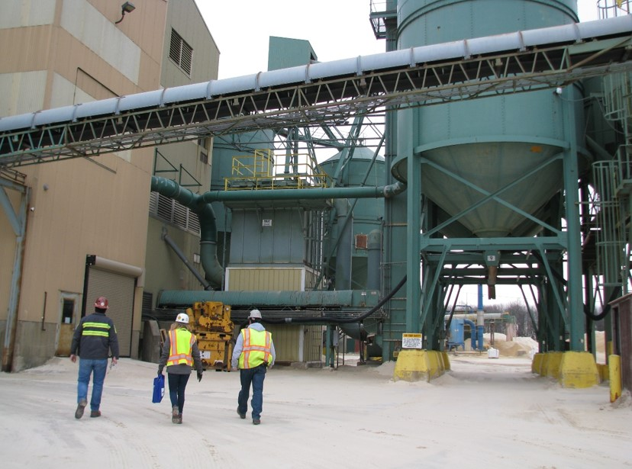
The NIOSH Noise Mapper Application
Acknowledgements
Project team:
Jessie Mechling
Shawn J Peterson
Amanda Azman
IT Support:
Gregory Cole
Jonathan Fritz

Slide 3
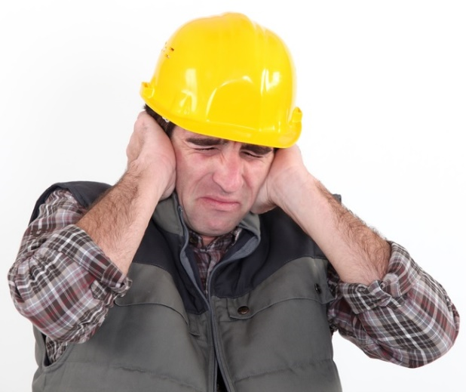
Background
Exposure to high noise levels can increase physical and psychological stress levels, reduce productivity, and lead to inner ear hair cell neurodegeneration, resulting in permanent hearing loss ^{(1-3).}
It has been estimated that 22 million U.S workers are exposed to hazardous noise levels; therefore, occupational hearing loss is the most common work-related illnesses in the United States.⁽⁴⁾
Hearing loss at work is typically preventable through hearing loss prevention strategies and technologies.

Slide 4
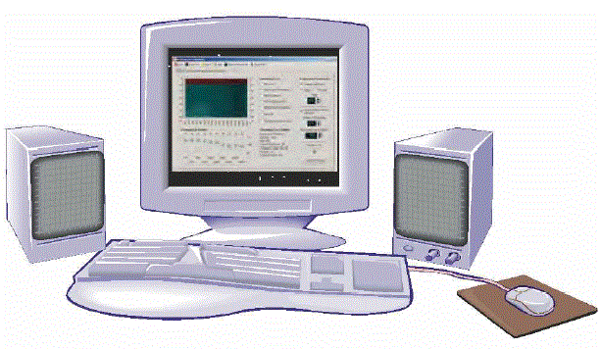
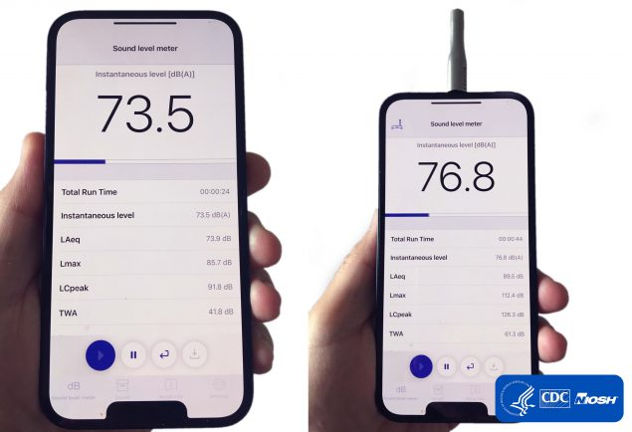
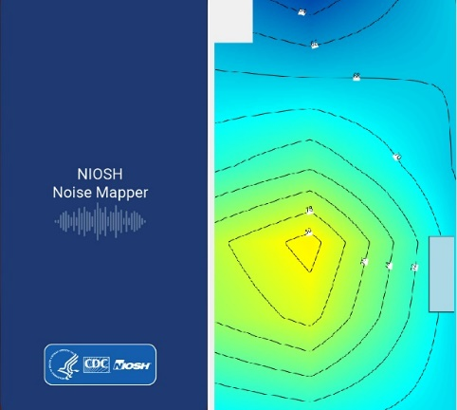
Background
The National Institute of Occupational Safety and Health (NIOSH) has developed various tools and guidelines to increase the effectiveness of hearing conservation programs in order to prevent occupational hearing loss, such as:
NIOSH Hearing Loss Simulator,
The NIOSH Sound Level Meter Application,
Currently developing NIOSH Noise Mapper Application.

Slide 5
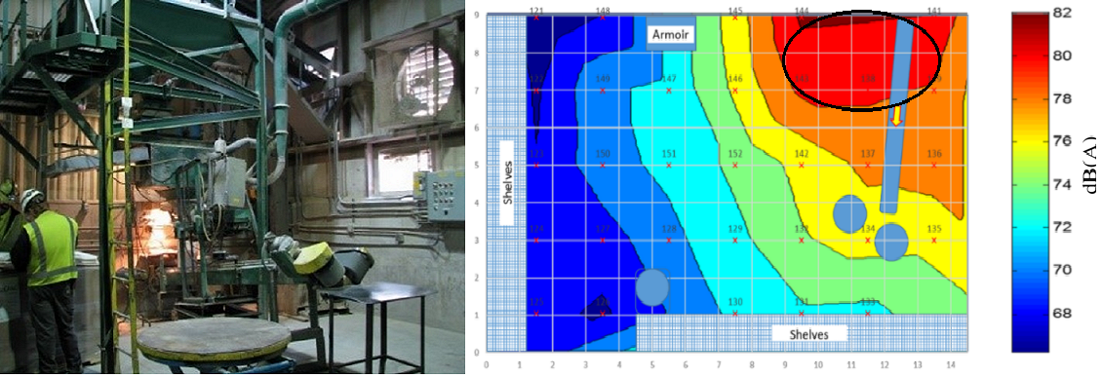
Background
Traditional noise mapping is usually implemented using software
Photograph of manual bagging station at mine, and the corresponding sound contour map

Slide 6
Benefits of using the Nosie Mapper Application
The NIOSH Noise Mapper Application can be used as an alternative, low-cost solution to traditional noise contour maps.
Sound contour maps provide visual images of the spatial distribution of sound levels within facilities; facility management may incorporate these maps into hearing conservation programs
Help in identifying noise hazards and relevant noise-generating machinery and/or operations in order to prioritize and target the most effective interventions.
Help in identifying locations for noise hazard signage, locating personal protective equipment (such as ear plug dispensers).

Slide 7
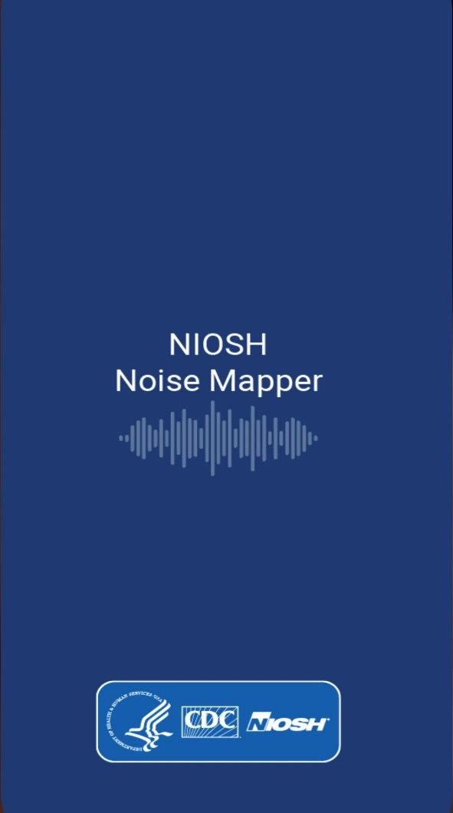
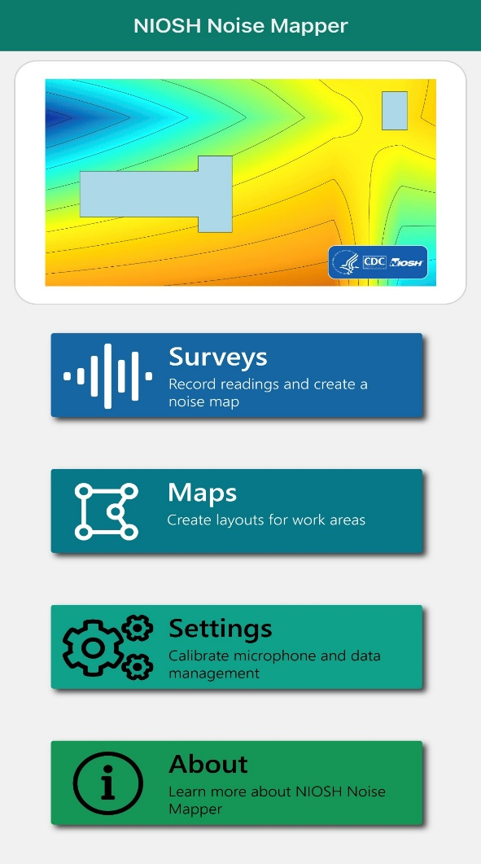
Features of the NIOSH Noise Mapper Application
Surveys button: allows users to record noise level readings and create a noise map.
Maps Button : allows users to create layouts for work areas
Settings button: allows users to calibrate microphone and data management (export and import data)

Slide 8
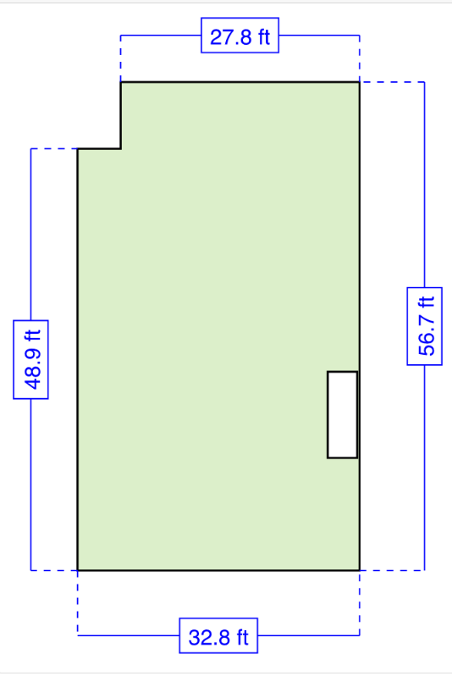
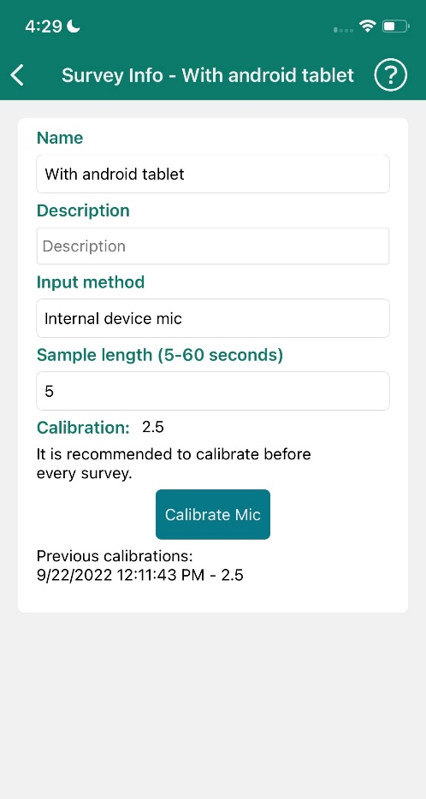
Using the NIOSH Noise Mapper Application
Create Map Layout
Calibrate Mic

Slide 9
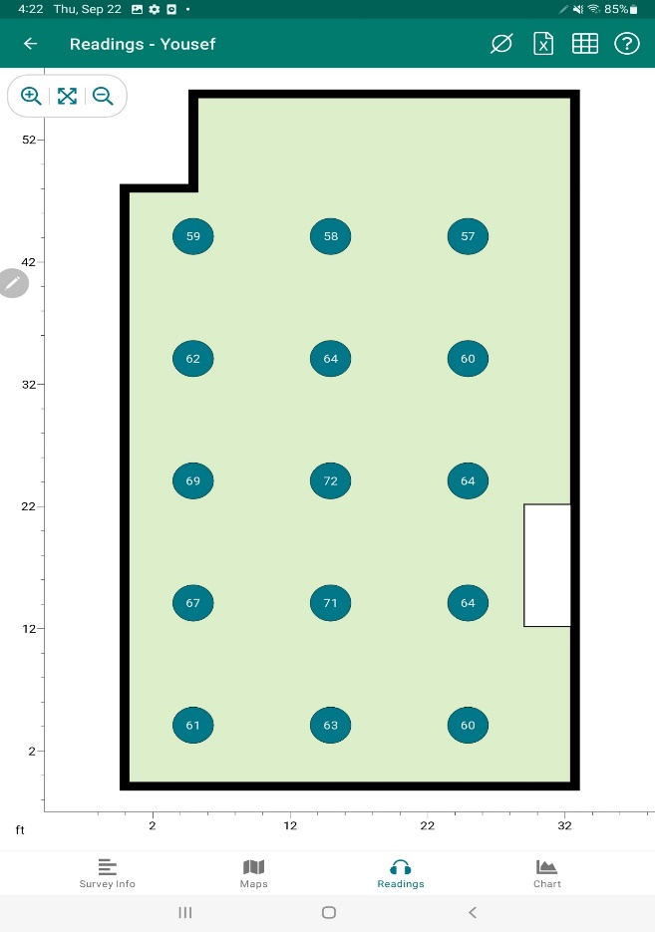
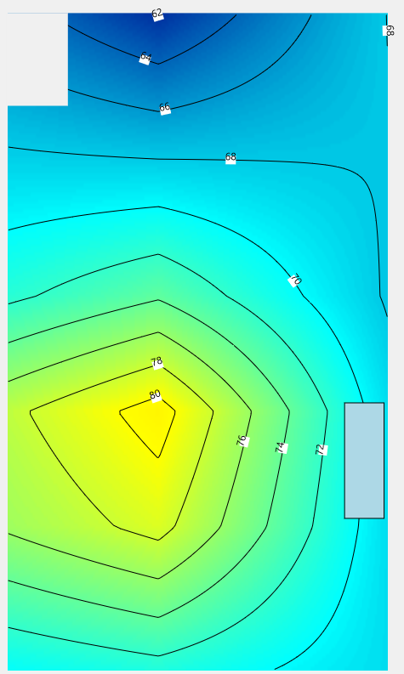
Using the NIOSH Noise Mapper Application
Measure Noise
Generate Noise Contour Map

Slide 10
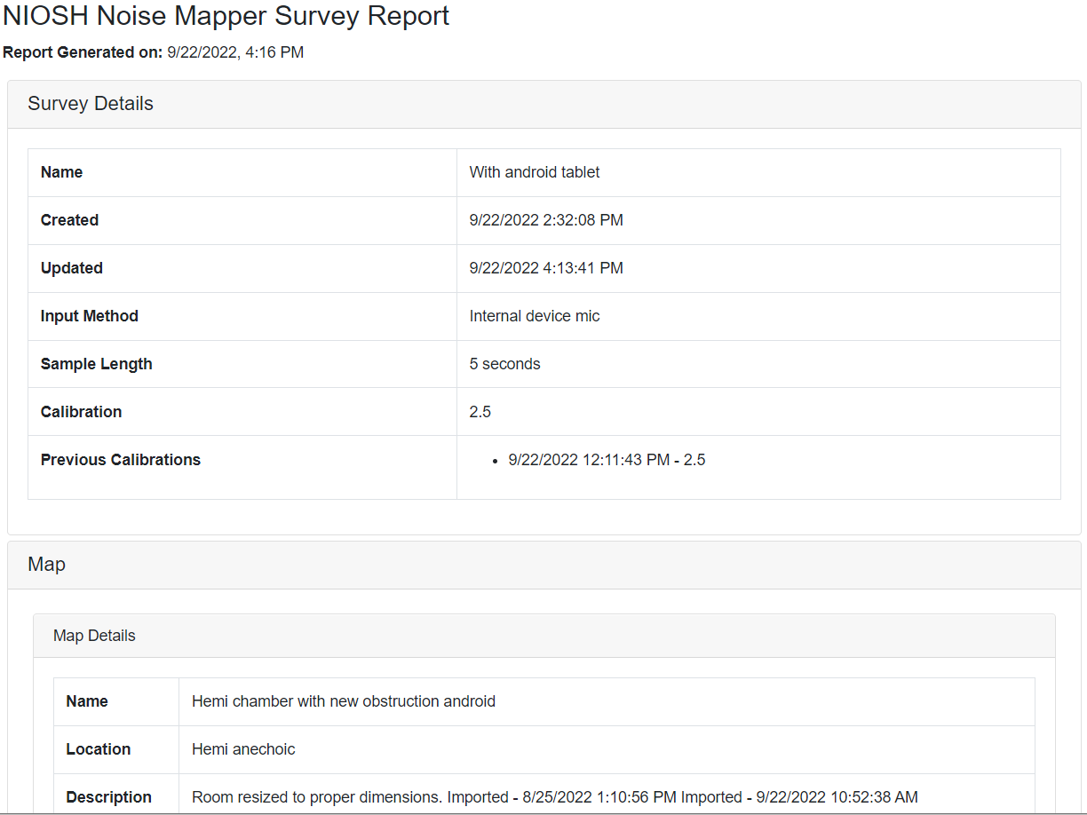
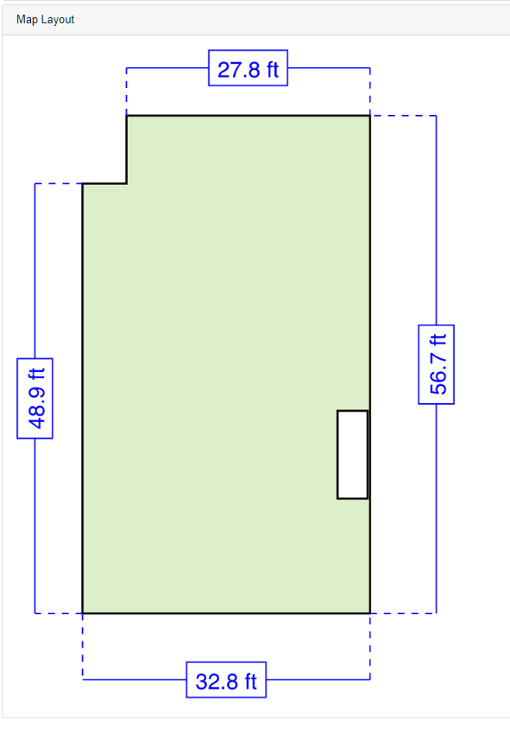
Using the NIOSH Noise Mapper Application
NIOSH Noise Mapper Survey Report
NIOSH Noise Mapper Survey Report
Map Layout

Slide 11
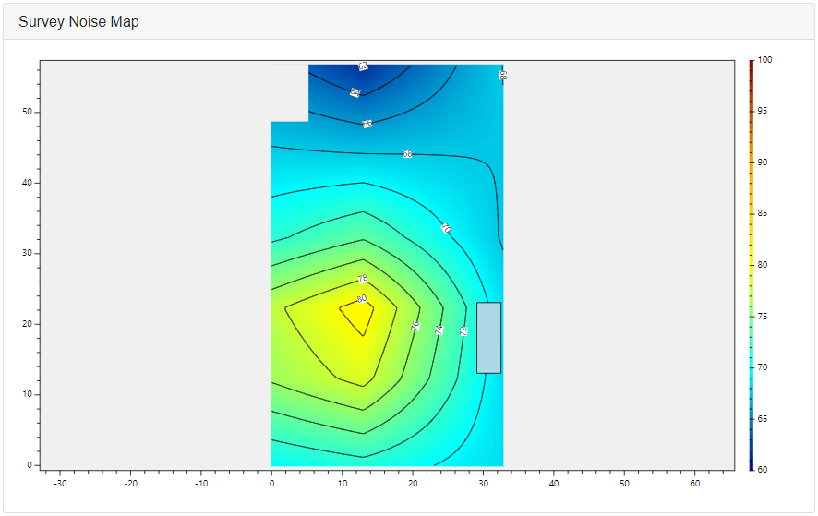
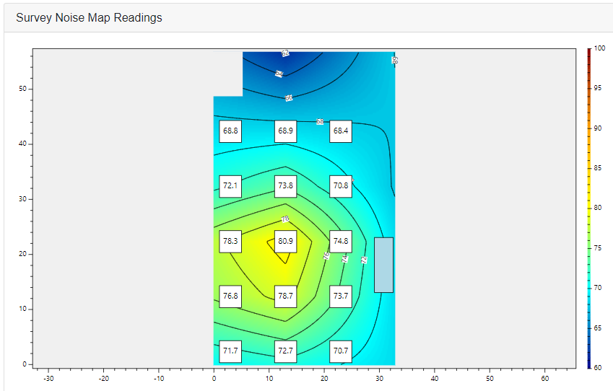
Using the NIOSH Noise Mapper Application
NIOSH Noise Mapper Survey Report
Survey Noise Map
Survey Noise Map Reading

Slide 12
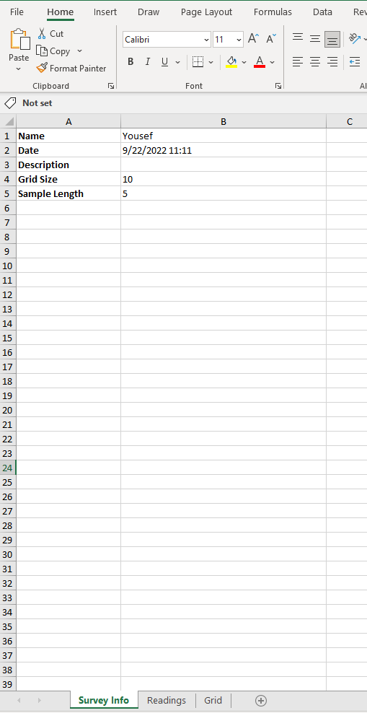
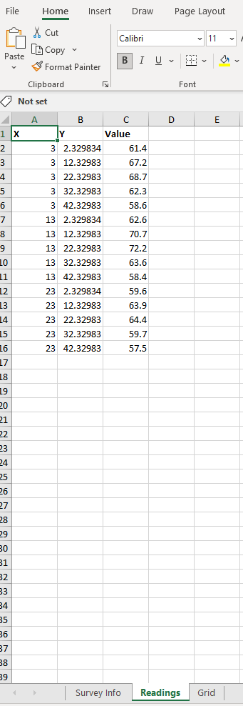
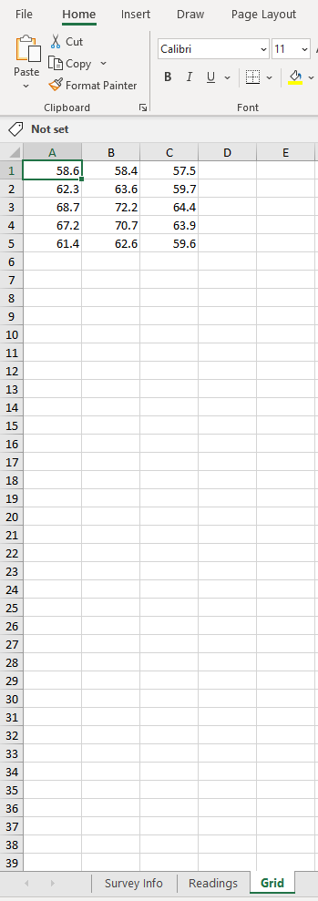
Using the NIOSH Noise Mapper Application
NIOSH Noise Mapper Data Management
Survey Information
Noise Reading (X,Y)
Noise Reading (Grid)

Slide 13
Using the NIOSH Noise Mapper Application NIOSH NOISE MAPPER ( Video)

Slide 14
References
OSHA. Occupational Noise Exposure. Accessed sept 17, 2022. https://www.osha.gov/SLTC/noisehearingconservation
Bahadori, R. S., and B. A. Bohne. 1993. Adverse effects of noise on hearing. American Family Physician 47, no. 5:1219-1226.
NIOSH. Noise and Hearing Loss Prevention: Facts and Statistics. http://www.cdc.gov/niosh/topics/noise/stats.html. Accessed June 17, 2022.
NIOSH. “Noise And Hearing Loss Prevention”, Accessed June 17, 2022. https://www.cdc.gov/niosh/topics/noise/default.html
Robert D. Bruce. “Engineering Controls for Reducing Workplace Noise”, National Academy of Engineering, SEP 1, 2007, Accessed June 24, 2022. https://www.nae.edu/7687/EngineeringControlsforReducingWorkplaceNoise

Slide 15
Thank you !
Any Questions? Yousef Elmashae Office: 412-386-5366 yelmashae@cdc.gov

