Slide 1
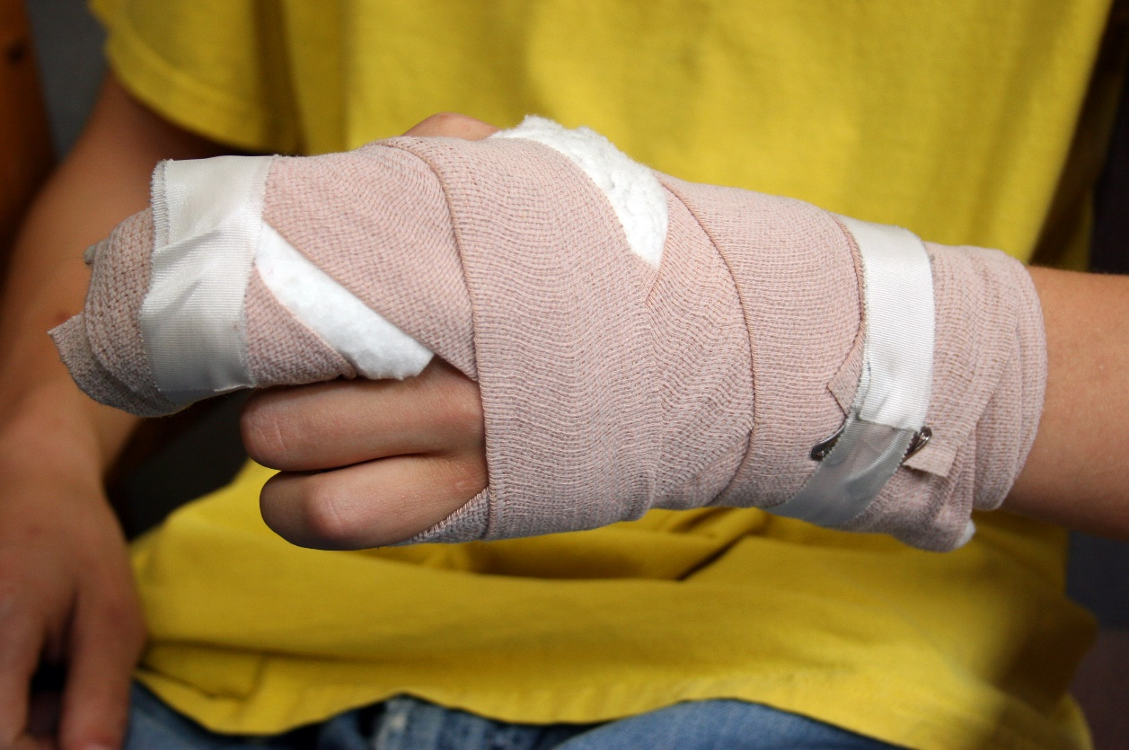
Hand and Finger Injuries in the U.S. Mining Industry, 2011—2017
Mahiyar Nasarwanji
Senior Service Fellow
Health Hazards Prevention Branch
Pittsburgh Mining Research Division
PACA Underground Mine Conference
October 6, 2022, Canonsburg, PA
Notes:
One component of manual materials handling project

Slide 2
Acknowledgements
John Heberger
Jonisha Pollard
Lydia Kocher

Slide 3
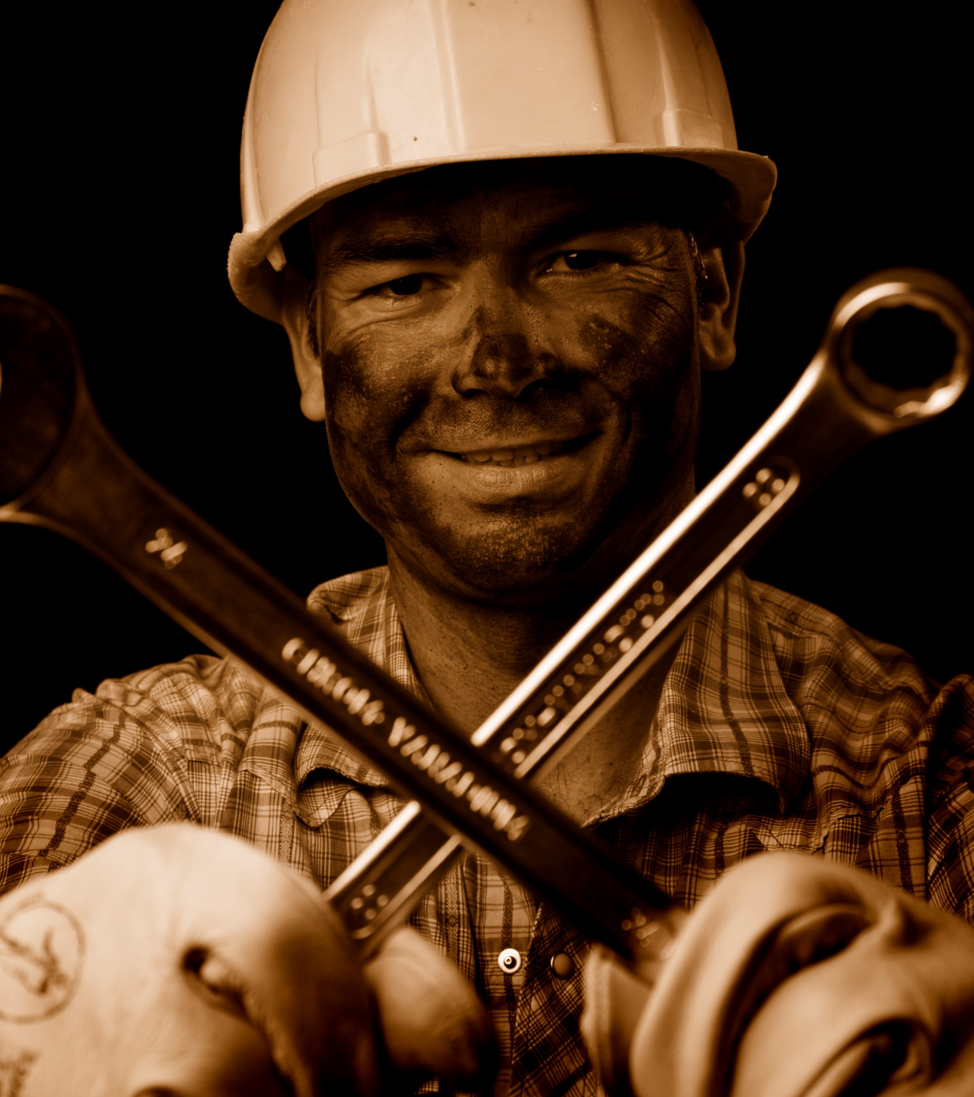
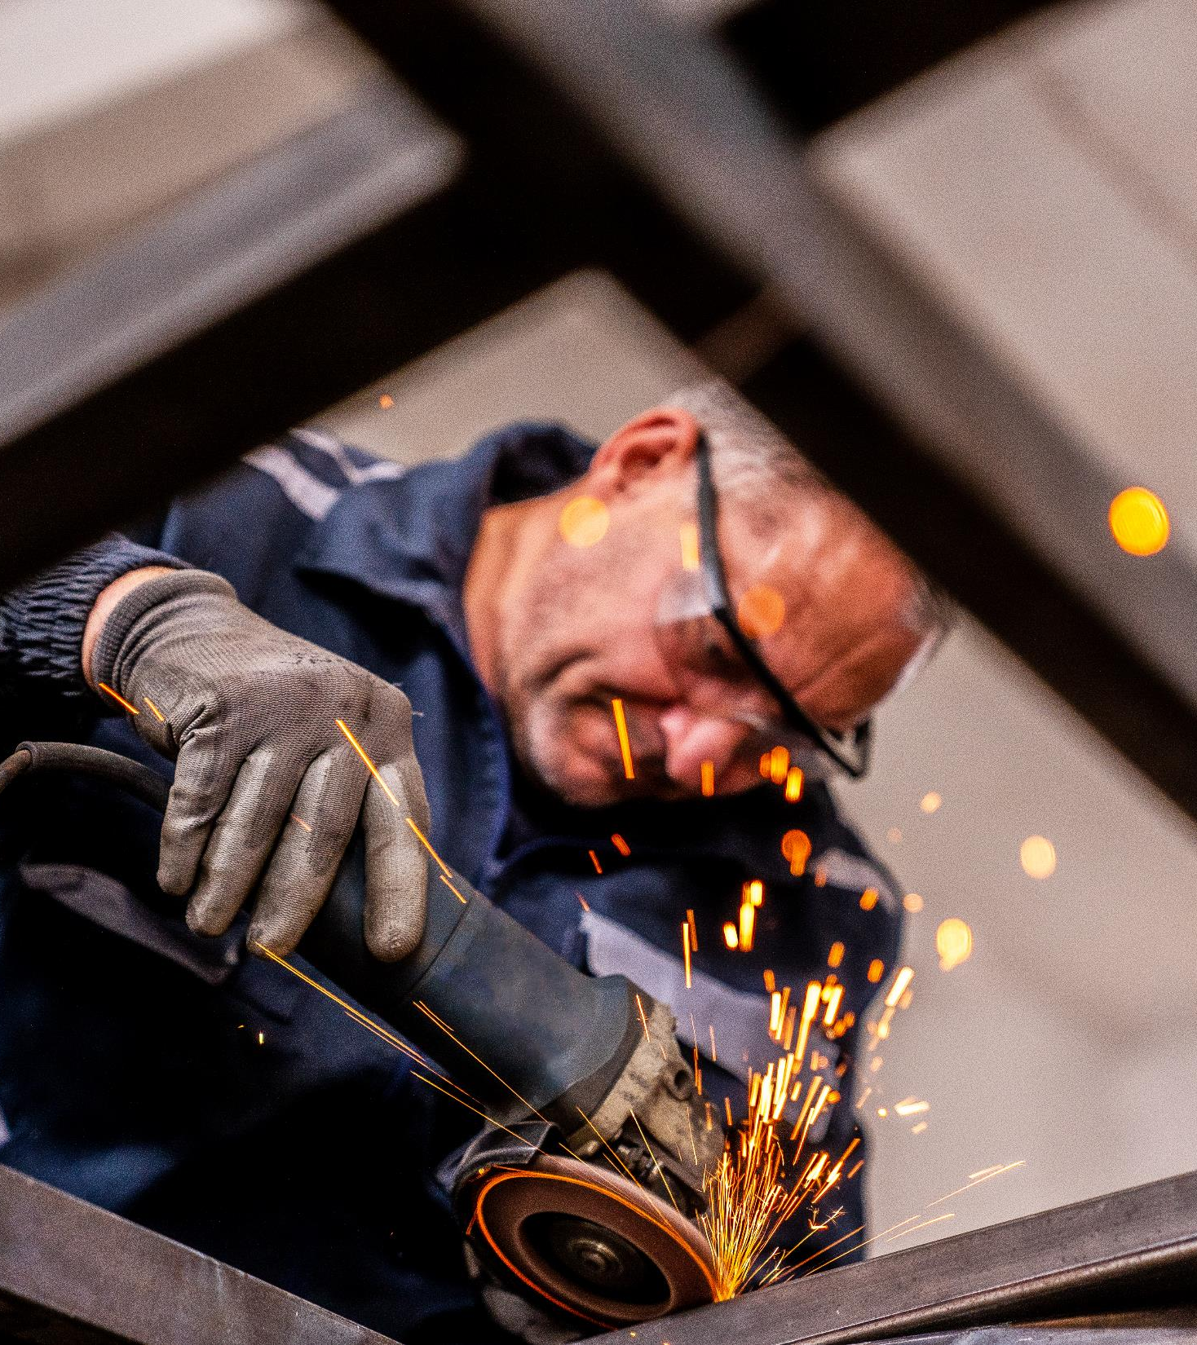
Hands and fingers are the most frequently injured body part in mining
Notes:
Hand and finger injuries account for about 15% of lost-time occupational injuries across all industries
Hand injuries sustained by mechanics, welders, machinery maintenance workers, manual handlers of materials, and laborers – all jobs found in the mining industry, result in more time lost from work compared to other jobs.
The U.S. mining community has been plagued by hand and finger injuries for decades, as documented by numerous published studies.
The Primary aim for this research is to identify nonfatal injury incidence rates, nature of injuries, work tasks associated with, and sources of hand and finger injuries in the mining industry,

Slide 4
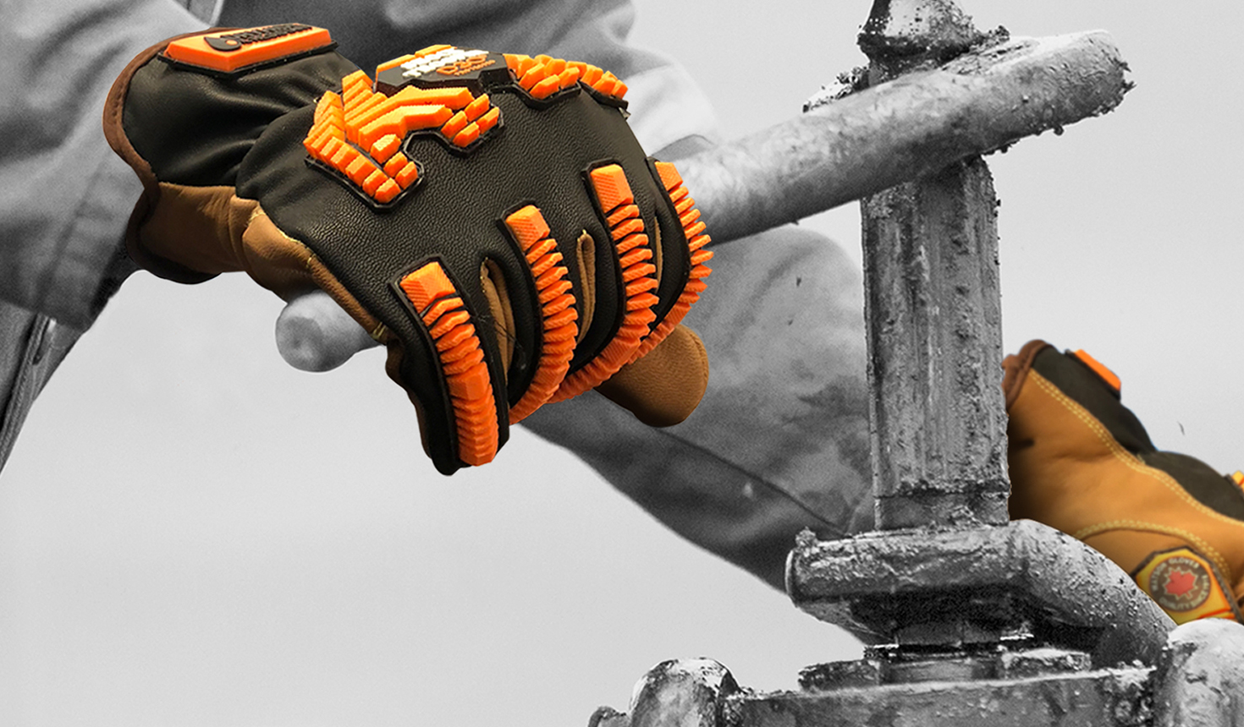
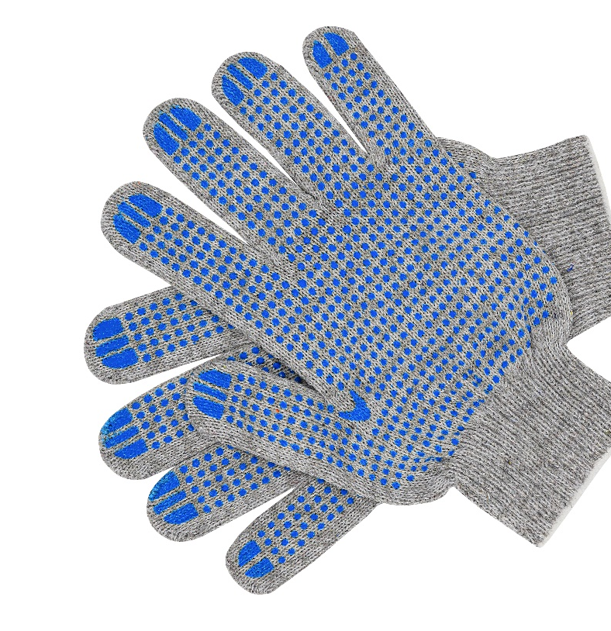
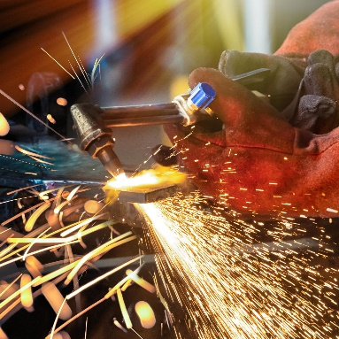
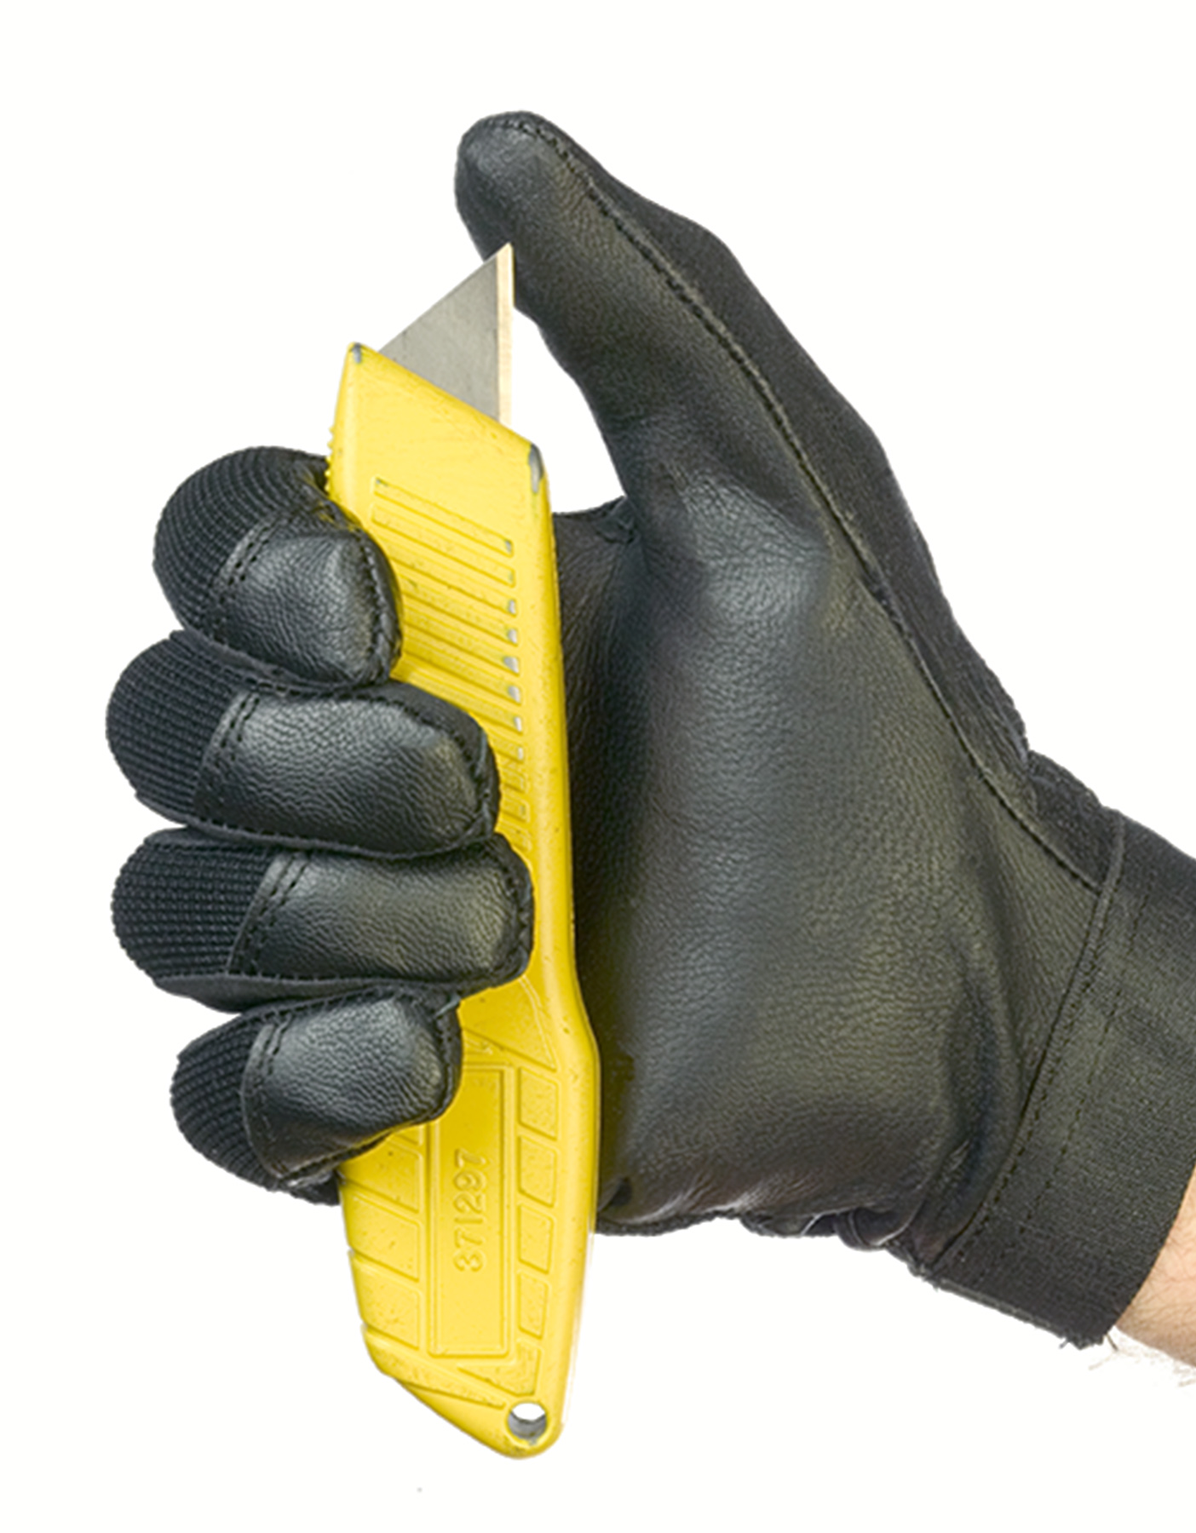
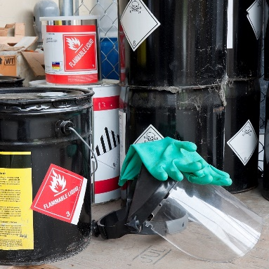
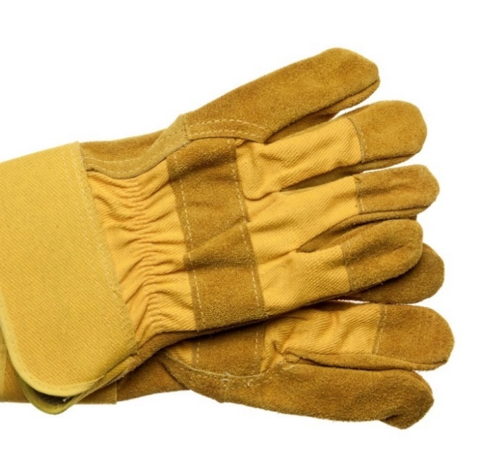
Gloves are commonly used for protecting hands and fingers
Notes:
Gloves are a common means of protecting hands and fingers. Hand protection is not explicitly stated in any MSHA regulations. Hand and finger protection may be inferred as regulated by MSHA when considered as protective equipment and clothing for hazards and irritants.
Several studies have evaluated the reduced hand performance when wearing protective gloves of all types. It is commonly accepted that gloves reduce power and pinch grip strength, impair dexterity and flexibility, and drastically diminish tactile sensitivity - so they may be involved in hand and finger injuries
Secondary aim: determine if gloves can be identified in the MSHA injury data and if they are associated with injury
(30 CFR § 57.15006 and 30 CFR § 56.15006) state: “Special protective equipment and special protective clothing shall be provided, maintained in a sanitary and reliable condition and used whenever hazards of process or environment, chemical hazards, radiological hazards, or mechanical irritants are encountered in a manner capable of causing injury or impairment
Although the Occupational Safety and Health Administration (OSHA) does not regulate the mining industry, they provide more specific regulations regarding the use of hand and finger protection under 29 CFR 1910.138(a), which includes hazards such as severe cuts and lacerations but does not state fracture. The 29 CFR 1910.138(b) expands on this regulation stating, “Employers shall base the selection of the appropriate hand protection on an evaluation of the performance
characteristics of the hand protection relative to the task(s) to be performed, conditions present, duration of use, and the hazards and potential hazards identified

Slide 5
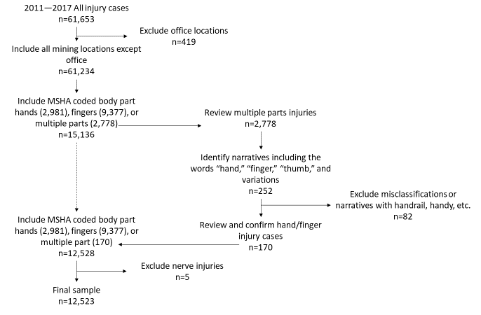
Identifying hand and finger injuries from the MSHA injury data is straightforward
Notes:
The data for this analysis came from two (MSHA) datasets. accident/injury/illness dataset for identifying injury and Employment used for calculating rates.
For this analysis, hand and fingers were pooled as injury prevention efforts are also usually combined.
(go through flowchart)

Slide 6
Identifying glove use from the MSHA injury data is a little trickier
Variable | Categories | Definition
Gloves worn | Yes/No/Unknown | Narrative indicates the injured worker was wearing gloves at the time of the injury.
Glove type | List | Description of glove worn by worker.
Worker removed glove(s) | Yes/No/Unknown | Narrative indicates that the worker removed one or both glove(s) prior to the injury.
Gloves contributed to injury | Yes/No/Unknown | Narrative clearly states that the glove became entangled, caught on, caught in, or was pinched between something that the mine worker was handling before injury occurred.
Would a glove prevent injury | Yes/No/Unknown | Authors used judgment to decide if the indicated injury could have been prevented or reduced in severity by wearing a more appropriate glove for the task of interest.
Glove characteristics needed to prevent injury | List | If the authors determined that a glove could have prevented the injury or reduced the severity of the injury, the narrative states the specific characteristics that would have been necessary to prevent or reduce the severity of the injury.
Area needing protection | List | If the authors determined that a glove could have prevented the injury or reduced the severity of the injury, the narrative states which part of the hand required protection.
Notes:
Injuries that involved gloves were identified from the final dataset (n=12,523 injuries) through a word search of the narrative field. A narrative text search for “glove” and “PPE” (personal protective equipment)—including spelling variations—.
After verifying glove use, 754 were identified as cases where gloves were worn by the injured worker
Coded for the following variables:

Slide 7
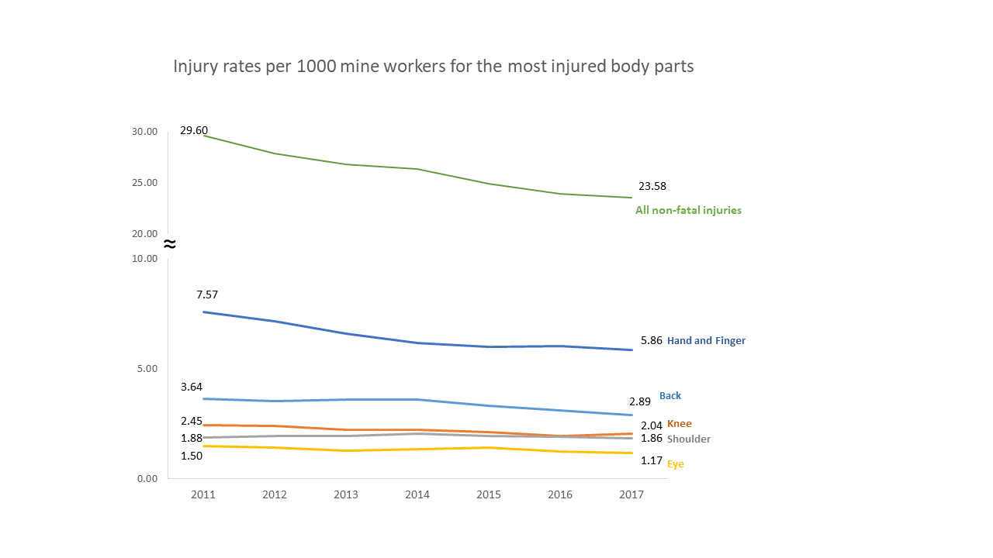
Hands and fingers consistently had the highest rate of injury
Injury rates per 1,000 full-time-equivalent mine workers for the most injured body parts.
Notes:
Results:
hands and fingers have the highest injury rate (averaging 6.53 injuries per 1,000 FTE workers), followed by the back, knees, and shoulders (3.41, 2.22, and 1.94 per 1,000 FTE workers, respectively).
The average rate of hand and finger injury was nearly two times the average back injury rate (Rate Ratio = 1.91;) and 5 times that of the average eye injury rate

Slide 8
Amputation injuries had the highest median and mean days lost from work
Nature of Injury | Frequency | Percent | Cases reporting days lost | Total days lost | Mean days lost | Median days lost
Cut, laceration, puncture | 6,682 | 53.4 | 5,950 | 54,679 | 9 | 0
Bone fracture, chip | 3,295 | 26.3 | 3,107 | 94,897 | 31 | 14
Crushing | 615 | 4.9 | 581 | 19,250 | 16 | 11
Contusion | 559 | 4.5 | 536 | 8,790 | 16 | 4
Amputation | 392 | 3.1 | 392 | 78,736 | 201 | 100
Sprain, strains | 274 | 2.2 | 265 | 9,453 | 36 | 8
Unclassified, not determined | 150 | 1.2 | 144 | 5,045 | 35 | 8
Burn or scald (heat) | 127 | 1.0 | 121 | 1,943 | 16 | 5
Other injury | 101 | 0.8 | 98 | 2,413 | 25 | 3
Multiple injuries | 78 | 0.6 | 75 | 2,261 | 30 | 9
Dislocation | 71 | 0.6 | 65 | 1,599 | 25 | 1
Noncontact electric arc burn | 47 | 0.4 | 44 | 1,117 | 25 | 12
Scratches, abrasions | 40 | 0.3 | 40 | 786 | 20 | 3
Joint, tendon, or muscle inflammation or irritation | 36 | 0.3 | 29 | 635 | 22 | 4
Electrical burn | 25 | 0.2 | 23 | 448 | 20 | 6
Burn, chemical | 16 | 0.1 | 15 | 368 | 25 | 5
Dermatitis | 10 | 0.1 | 7 | 9 | 1 | 0
Freezing, frostbite | 5 | 0.0 | 5 | 1 | - | -
Total | 12,523 | 100.0 | 11,497 | 282,430 | - | -
Notes:
Cuts, lacerations, and puncture injuries were the most prevalent nature of injury with 6,682 cases (53.4%), followed by bone fracture/chip injuries with 3,295 cases (26.3%). 75% of cases.
Bone fracture injuries accounted for the most total days lost from work between 2011 and 2017, accounting for 94,897 total lost days. Amputations were the 5th highest, with 392 cases (3.1%) but associated with the second largest total days lost from work, with 78,736 total lost days. Amputation injuries had the highest median and mean days lost from work.
These patterns were similar for the mine worker activities
Lost days = greater value (sum of days away fom work + restricted) or statutory

Slide 9
Leather gloves are the most common type of glove worn during a hand/finger injury
Nature of Injury | Cut-resistant | Grip | Heavy-duty | Latex / nitrile | Leather | Mechanics | Metacarpal / impact | Rubber / PVC | Welding | Work gloves | Total
Cut, laceration, puncture, contusion | 9 | 3 | - | 7 | 81 | 6 | 21 | 6 | 10 | 7 | 150
Fracture, chip, crushing | 2 | 1 | 3 | - | 5 | 1 | 16 | 1 | 1 | 1 | 29
Burn or scald (heat) | - | - | - | 1 | - | - | 1 | 2 | 2 | - | 6
Amputation | - | - | - | - | 1 | - | 1 | - | - | - | 2
Other injury or unclassified | - | - | - | 1 | 3 | - | 1 | - | - | - | 5
Total | 11 | 4 | 3 | 9 | 90 | 7 | 38 | 9 | 13 | 8 | 192
Notes:
Only 192 narratives (out of 754 that mentioned gloves) indicated the type of gloves worn when an injury occurred. There were ten main types of gloves identified: Leather gloves were the most common identified, with 90 cases (46.9%) mentioning leather gloves. Metacarpal gloves were the second most common type of glove identified, with 38 cases (19.8%

Slide 10
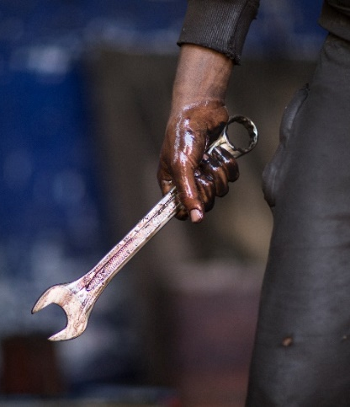
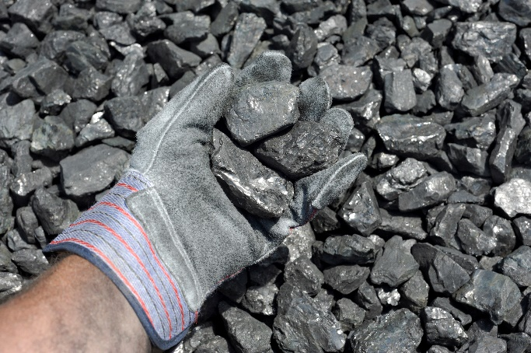
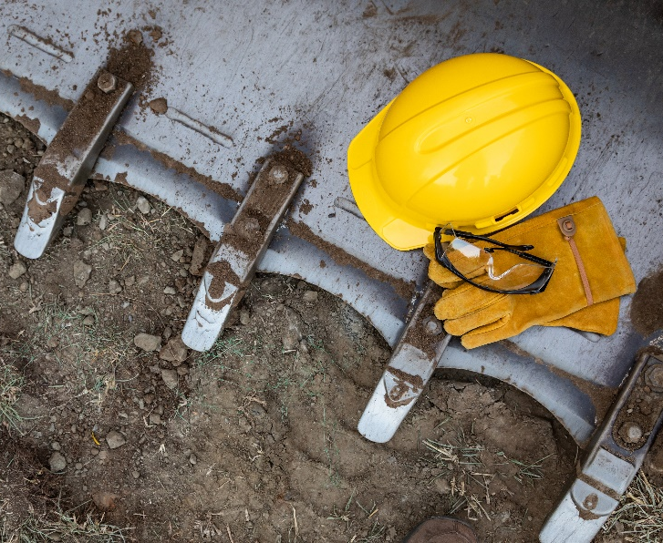
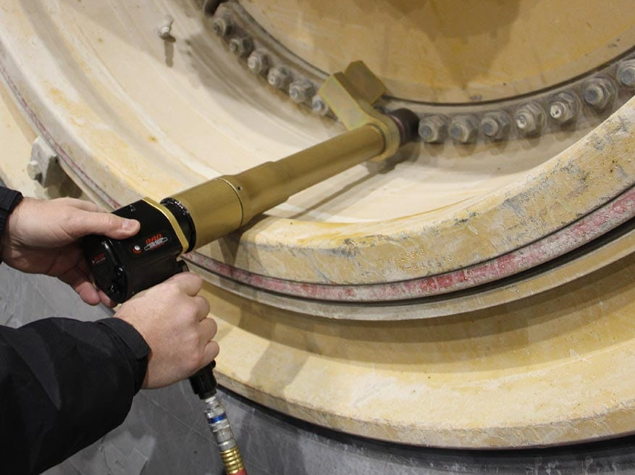
75% of hand and finger injuries occurred during five work activities
Photo by MSHA
Notes:
Handling Materials - Handling supplies/materials miscellaneous metals (pipe, wire, hand tools), metal guards,.
Machine Maintenance and repair - miscellaneous metals &, metal guards,.
Non-powered hand tools - knives (32%), followed by axe/hammer/, pry bars, and wrenches.
Roof Bolting –
Powered hand tools - Drills, grinders, and air tools were the most common tools used.

Slide 11
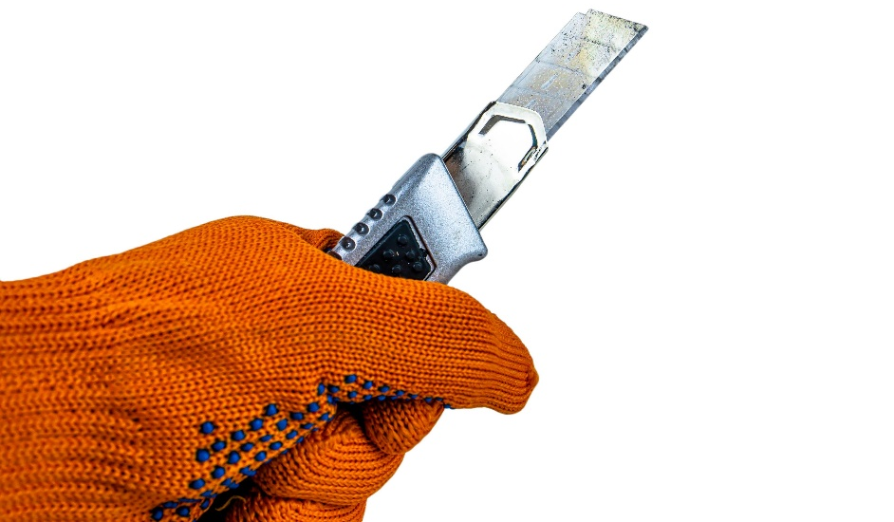
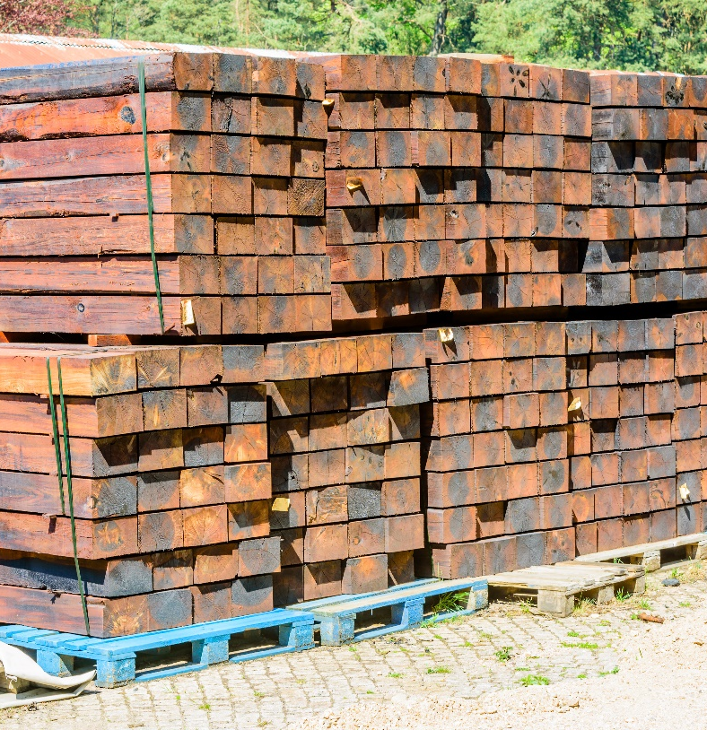
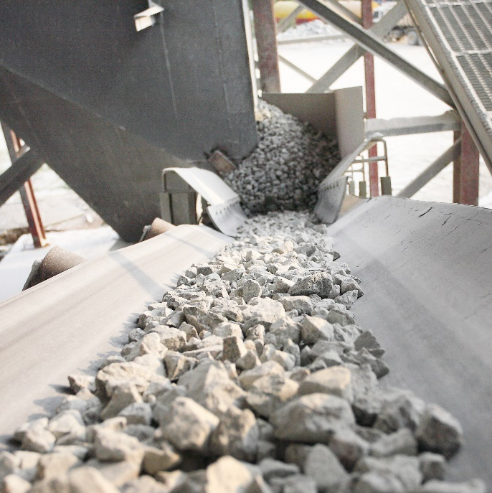
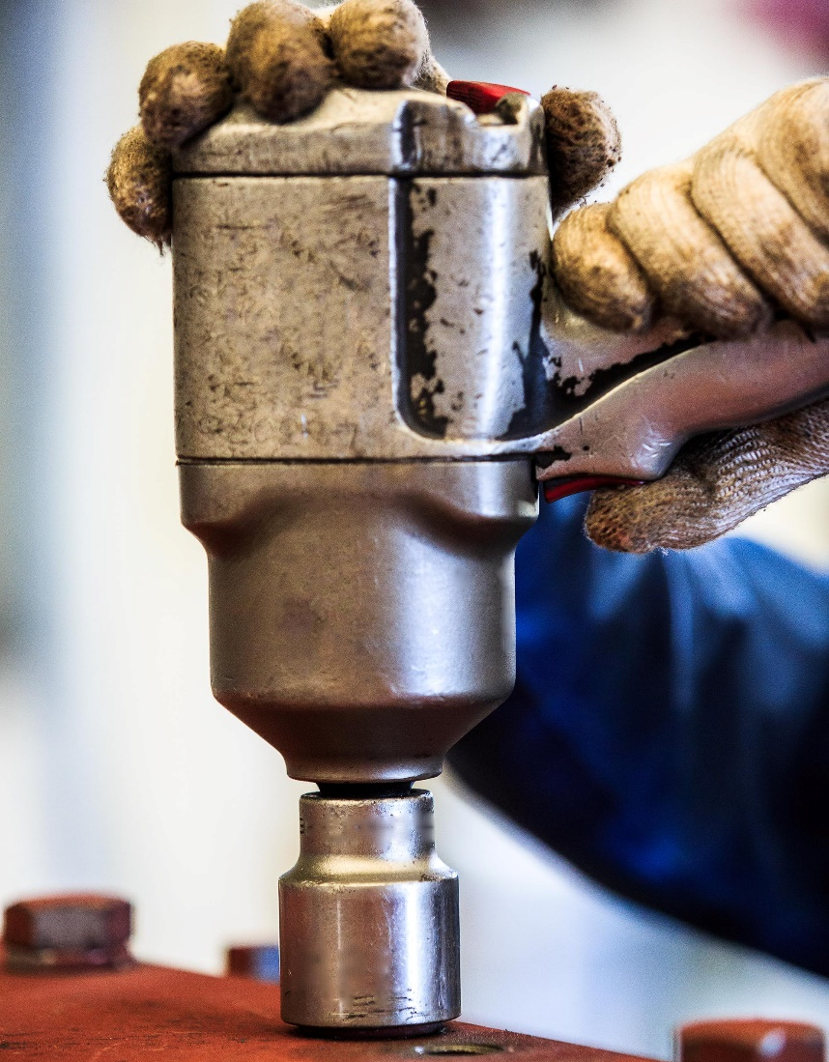
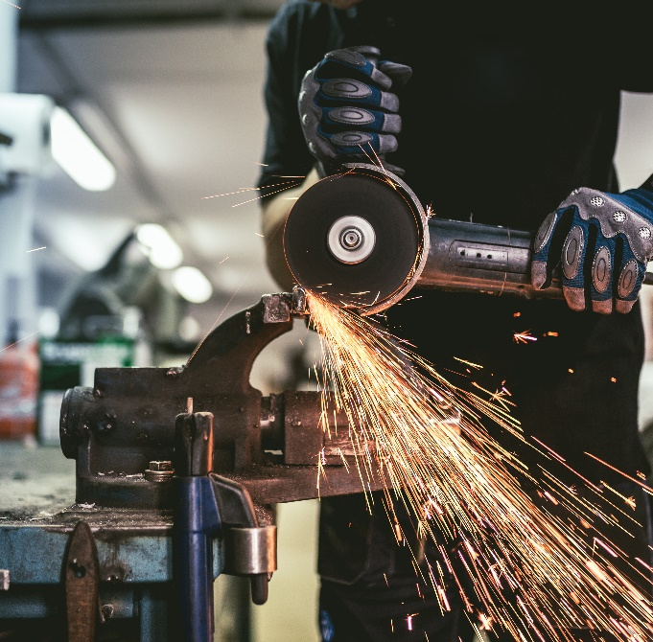
Specific work task patterns emerged while reviewing injury narratives for glove use
Notes:
These are outside of the normally used MSHA mwact variable. These categories are not mutually exclusive. Combination of text search and source of injury
Using utility knives –.”
Splice cable or conveyor belt – Power cables and conveyor belts are commonly spliced with a hand tool or knife during repair.
Removing strapping/banding – Heavy items are usually shipped on pallets and secured with straps or bands, - roof bolts and bolting supplies may also be strapped together for shipment.
Grinding tasks – Grinding is a common maintenance and repair task which involves the use of a portable or bench grinder with a rotating wheel.. Torque tools use – The use of powered torque tools like impact wrenches are common to fasten and loosen nuts and bolts during maintenance and repair.

Slide 12
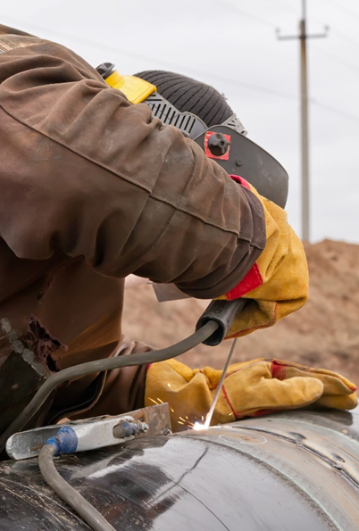
Sources of injury were similar between work tasks
Engineering controls and appropriate glove use can be effective for reducing lacerations when handling metal parts and materials
Hand tool use is associated with cuts/lacerations
Roof bolting continues to be an activity with high prevalence of hand and finger injuries
Notes:
Source of injury is similar and includes miscellaneous metals (pipe, wire, hand tools) and metal guards and hand tools.
Opportunity for tool manufacturers to provide specific protection guidance to workers

Slide 13
While MSHA injury data is not designed to capture PPE- related information, valuable insights are obtained from analyzing the injury data
Mention of gloves in narratives was low
(7.5% of all injury cases)
Nearly 20% of the cases that mentioned gloves indicated that gloves contributed to the injury
Leather and metacarpal gloves did not always protect against the intended hazard

Slide 14
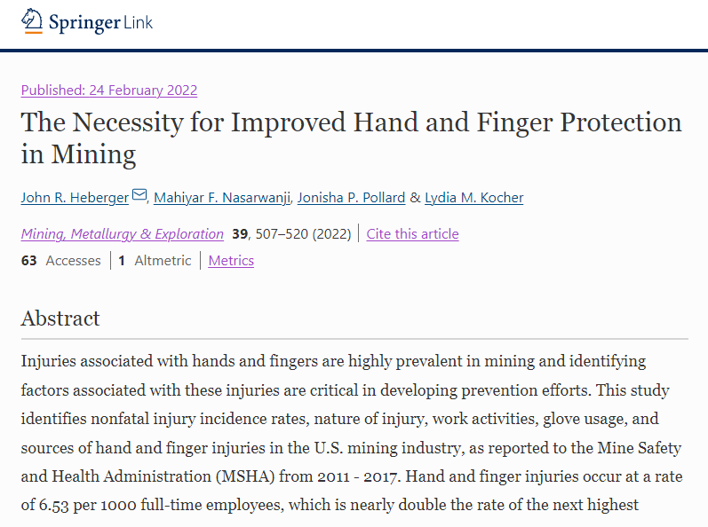
The entire research article is available to read

Slide 15
Thank you!
← You can help further the research
Mahiyar Nasarwanji
MNasarwanji@cdc.gov
412-386-5113

