Slide 1
Investigation of Mining Induced Ground Stress Evolution and Its Effect on Ground Stability
PACA Underground Stone Conference
October 6, 2022

Slide 2
Outline
Research Motivation
Background Pennsy Supply, Thomasville Mine
Field Monitoring & Data Collection
Data Analysis
Conclusions

Slide 3
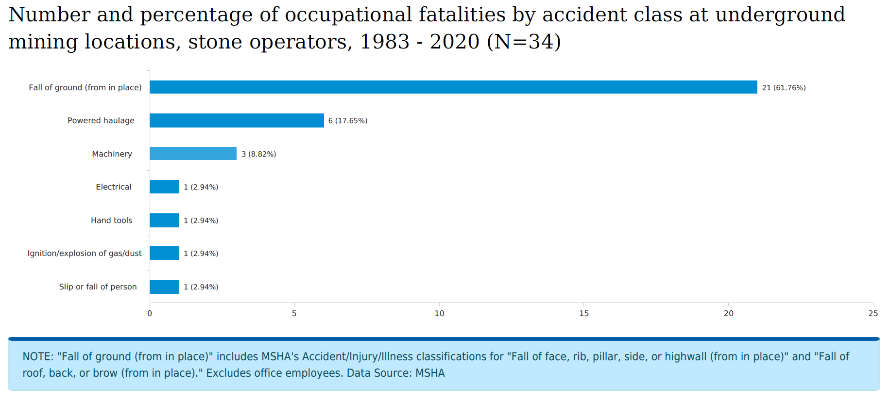
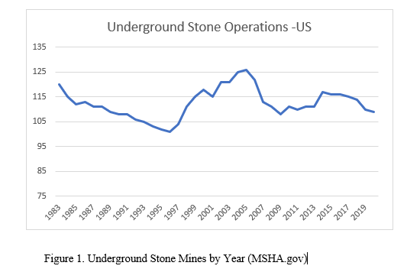
Research Motivation
Large open mines produce aggregate and other industrial minerals for use in wide range of consumer products/infrastructure
Ground control vital aspect of safe/productive mines
Pillar design theories use Factor of Safety
Mine-induced stresses not well understood
Recent massive pillar collapses highlight need for in-depth studies

Slide 4
Background - Geology
General Geology
Lower Cambrian Age
Kinzer Formation – Thomasville Member
Characterized as Limestone, Marble & Breccia
Broad Anticline NE to SW
Several Contacts
Triassic - Ledgers
Phyllite

Slide 5
Background - Geology
Stratigraphy
Bedded Units
Marker Beds
Unique to Thomasville Member
Cross faults prevalent throughout deposit

Slide 6
Background – Mine Layout

Slide 7
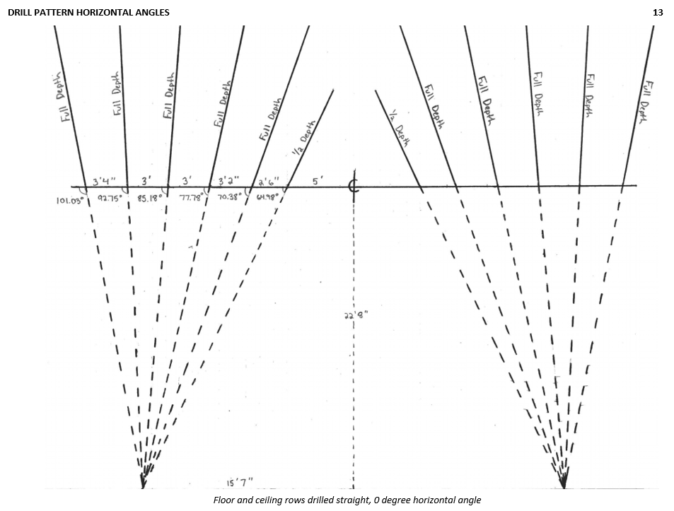
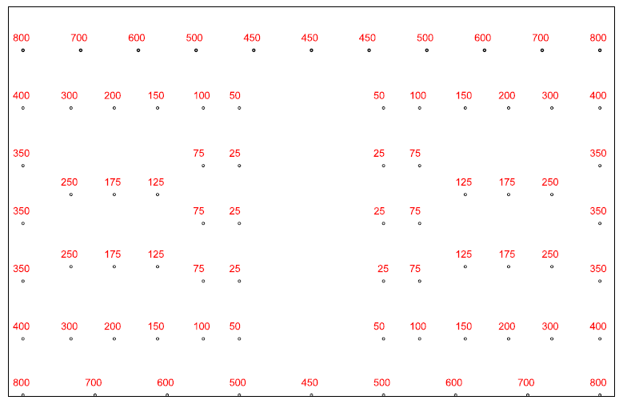
Background – Mine Blasting Procedures
Room and Pillar
Extraction via Drill/Blast
74 Hole V Cut Pattern
2” Holes
MS Delays
8-12 holes per delay
Bulk Product
22.5lbs/ hole Emulsion
15lbs/ hole ANFO

Slide 8
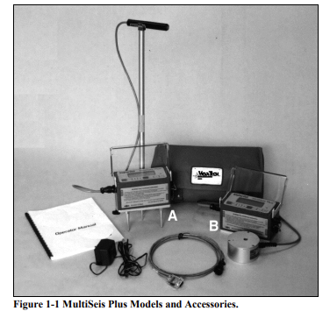
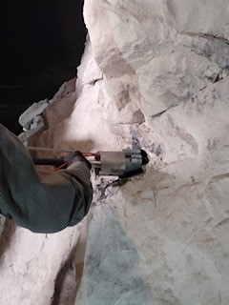
Field Monitoring & Data Collection
Strain Gauges
Geokon 4360
Seismographs
MultiSeis Plus Geophones
Data Loggers
Ability to Capture Static and Dynamic strain
Dynamic Monitoring
Triggered by blast event
Static Monitoring
Min, Max and Average in varying intervals

Slide 9
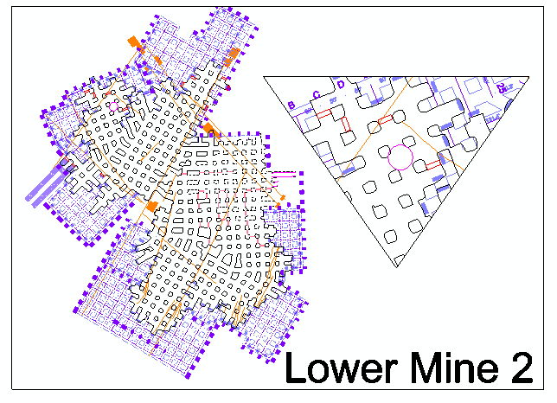
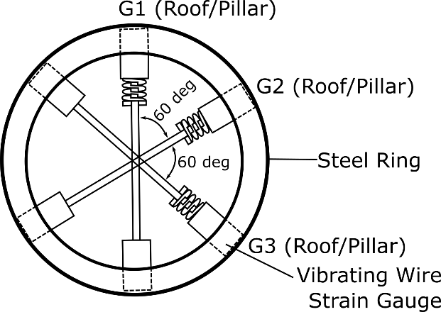
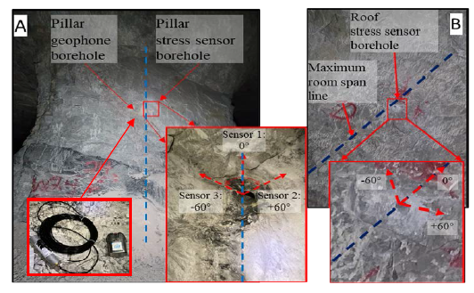
Field Monitoring & Data Collection
Lower Mine 2
90% of Production
Strategically located to maximize recordings
6 Strain Sensors Total
Oriented at 0, 60 and 120 degrees to measure strain changes in each plane
1 Geophone
Trigger at 0.05 inches/second Velocity
2 Data Collectors

Slide 10
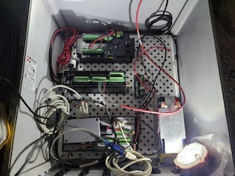
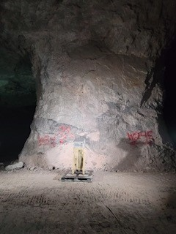
Field Monitoring & Data Collection
Weekly Data Collection
CR8 – Laser, Temp, RH
CR6 – Static and Dynamic Strain Data
Battery Powered

Slide 11
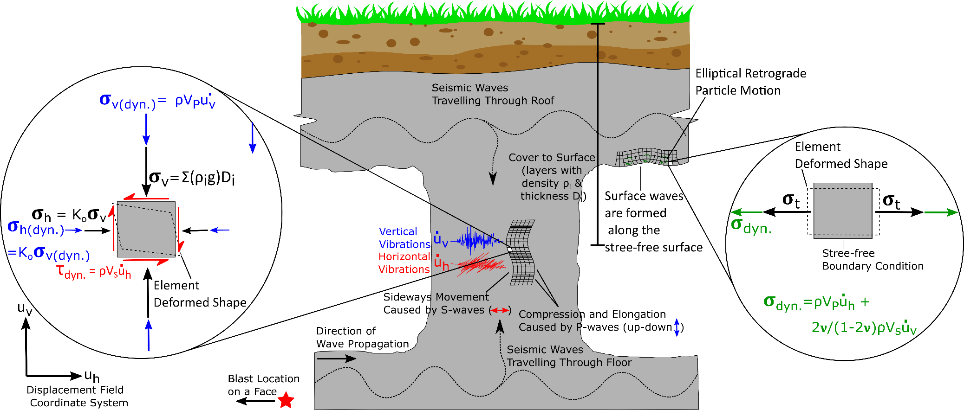
Data Analysis

Slide 12
Data Analysis

Slide 13
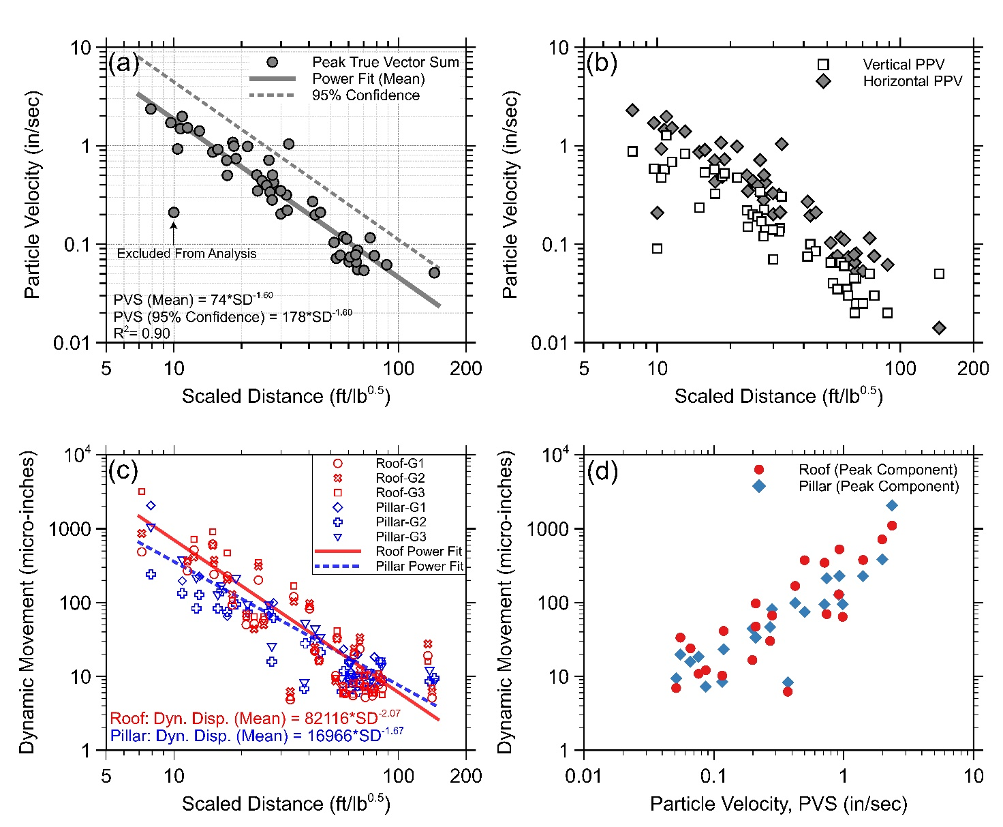
Data Analysis
Attenuation Studies
Vibration Attenuation
Vibration Attenuation Each Plane
Attenuation of Dynamic Movement Roof and Pillar Boreholes
Correlation Borehole Dynamic Movement and Particle Velocity in Pillar
Small scatter of data
Maximum Particle Velocity – Horizontal Plane
Positive Correlation between PV and borehole dynamic movement

Slide 14
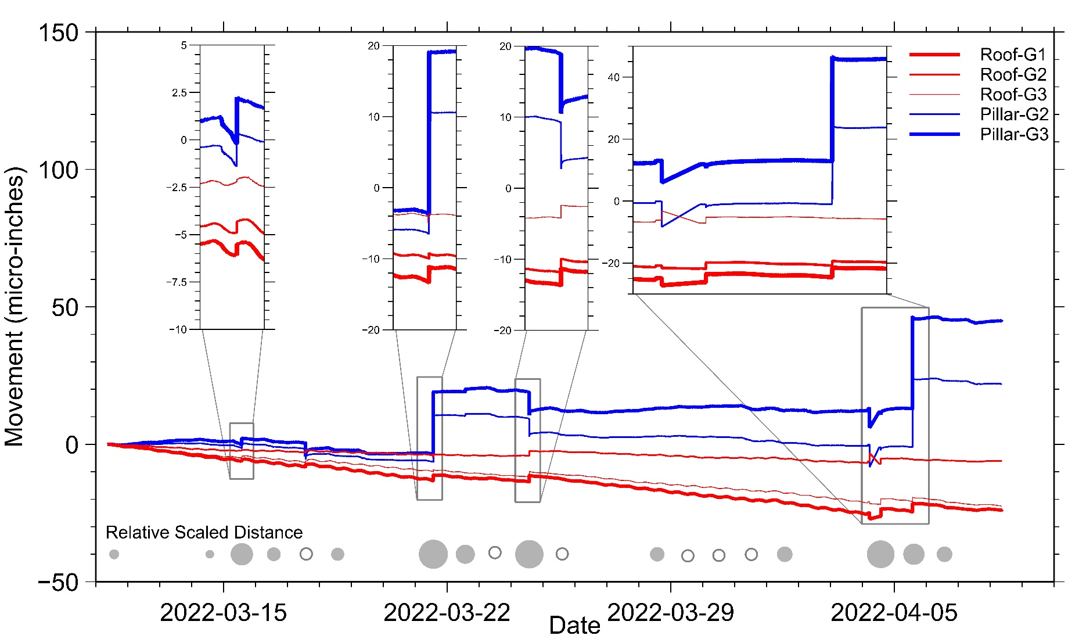
Data Analysis
Static Change – 1 month
Circles proportional to size of blast – lower SD = Large Circle
Upward movement represents expansion, downward movement shrinkage
Borehole response directly related to SD of blast.

Slide 15
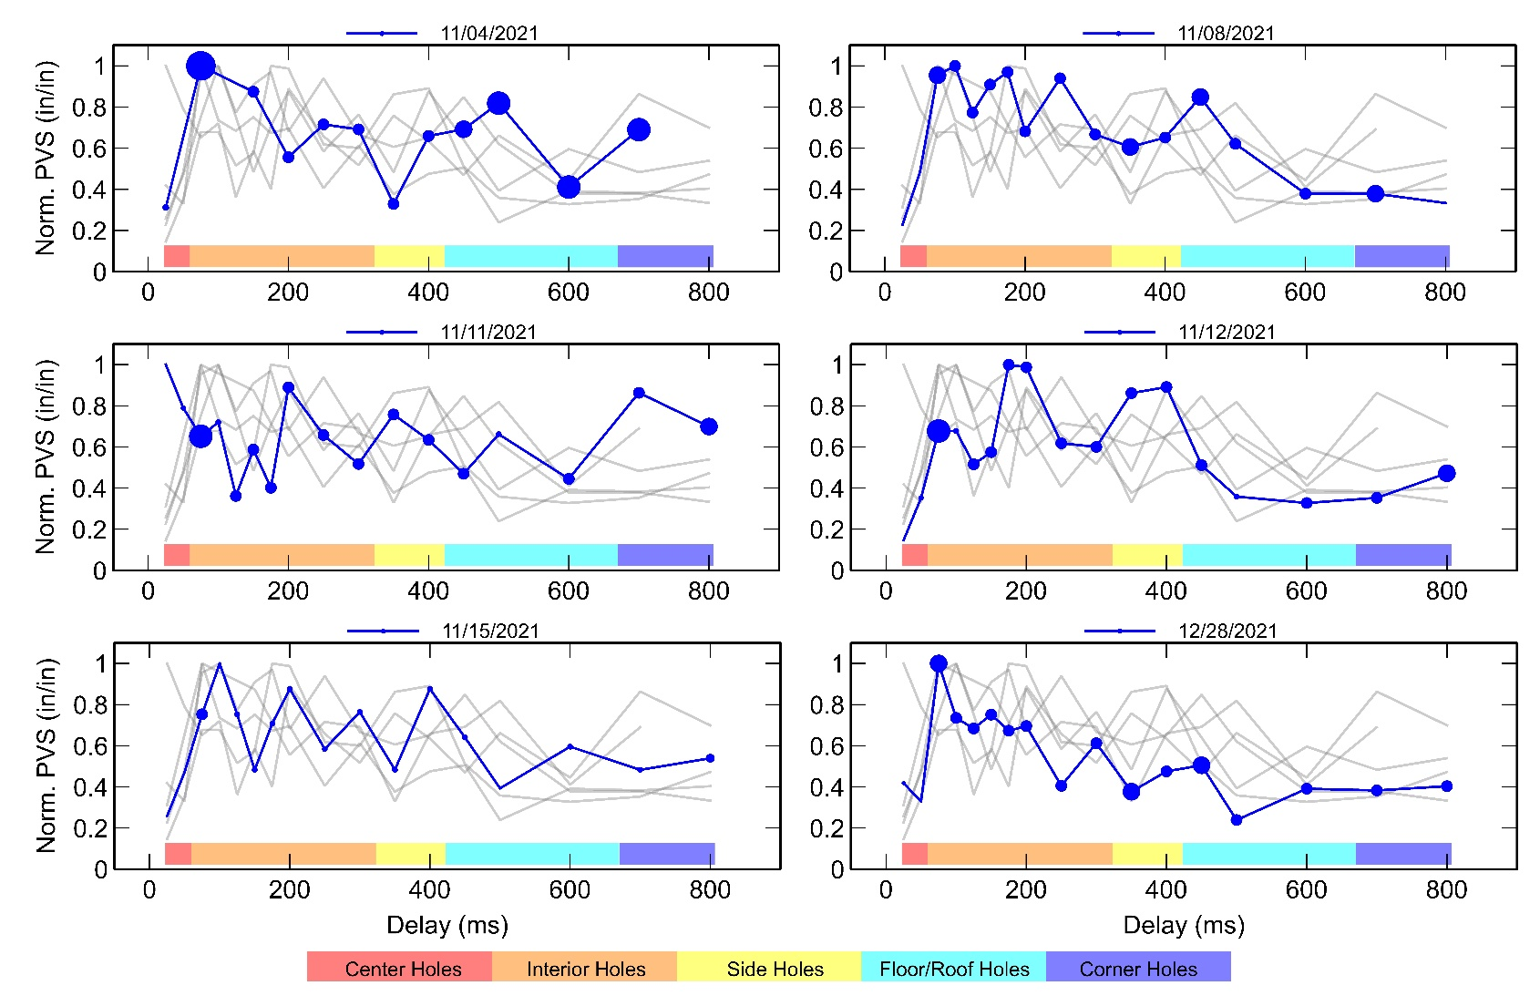
Data Analysis

Slide 16
Conclusions
PPV attenuates as expected with SD
Peak Vector Sum likely to happen within detonation of interior holes
Correlation between SD and sudden changes
Horizontal PPV almost greater by factor of 2.2

Slide 17
Thank You! Questions?

