Slide 1
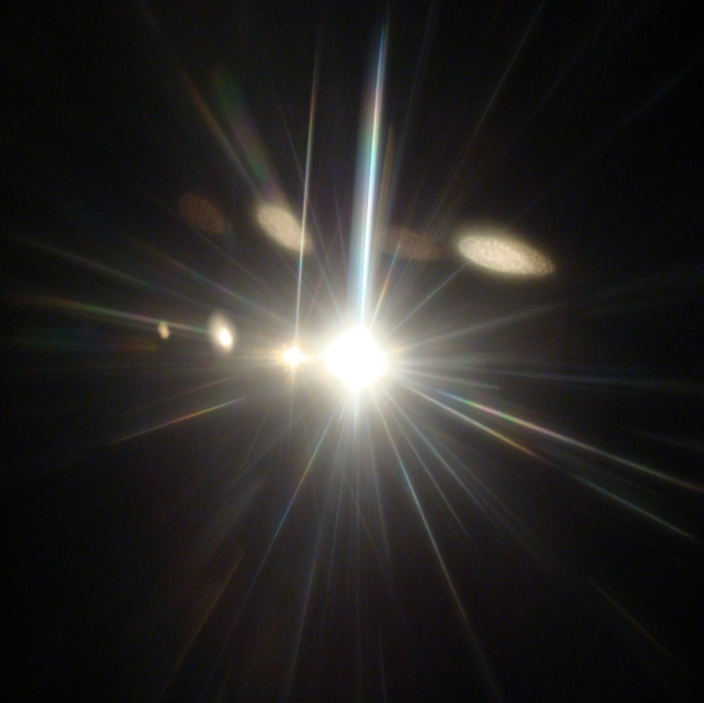
Illumination Technologies to Improve Miner Safety
John J Sammarco, PhD
Principal Research Engineer
Jsammarco@cdc.gov
1 (412) 386-4507
National Institute for Occupational Safety and Health (NIOSH), Pittsburgh Mining Research Division

Slide 2
Overview
Why is lighting important?
Mine lighting history
Light fundamentals
Improving miner safety via lighting
Mining shift work
2023 Shift work field study to reduce circadian disruption

Slide 3
Life follows the sun rising and sun setting cycle

Slide 4
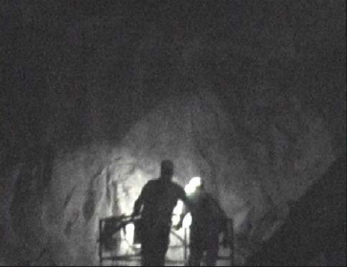
Lighting is important
Good lighting is fundamental for safety
Miners depend heavily on visual cues to spot hazards
Vision declines with age and mining has an aging workforce

Slide 5
Lighting is important because of visual and nonvisual effects that can improve miners’ health and safety

Slide 6
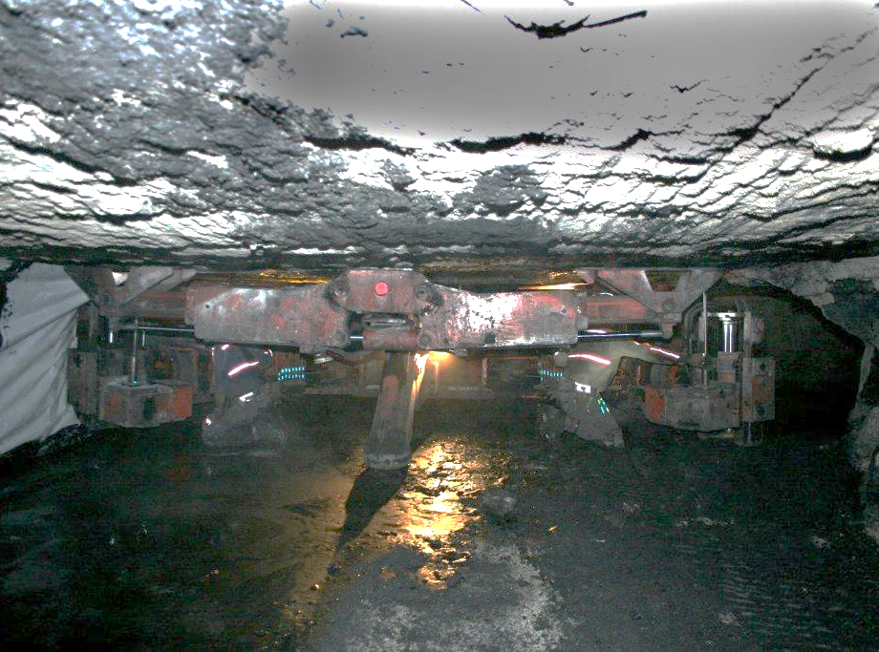
Underground mines are one of the most difficult environments to illuminate*
Dynamic environment
Dust
Water
Confined spaces
Low surface reflectance
Low visual contrasts
Older workforce
*Illuminating Engineering Society of North America (IESNA)

Slide 7
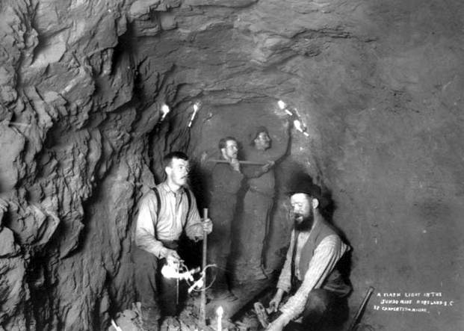
A Brief History of Lighting

Slide 8
Oil Lamps
Oil wick lamps improved safety by containing open flames. Miners found them easier to use than candles.
Photos: Royal BC Museum, British Columbia, Canada, http://www.royalbcmuseum.bc.ca/

Slide 9
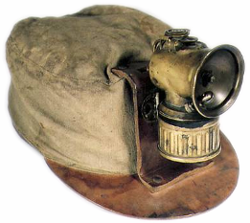
Carbide lamps
The transition to helmet-mounted lighting began with the introduction of the carbide lamp
Photo: Royal BC Museum, British Columbia, Canada, http://www.royalbcmuseum.bc.ca/
Quotation: Where the Sun Never Shines, Priscilla Long, Paragon House, New York, 1989.

Slide 10
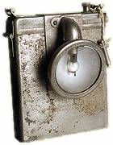
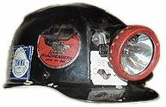
Incandescent Lights
The incandescent lamp eliminated open flame concerns within the mine
and was much more controllable than an open flame’s light
Photos: Royal BC Museum, British Columbia, Canada, http://www.royalbcmuseum.bc.ca/, Cape Breton Mine Museum, www.minersmuseum.com

Slide 11
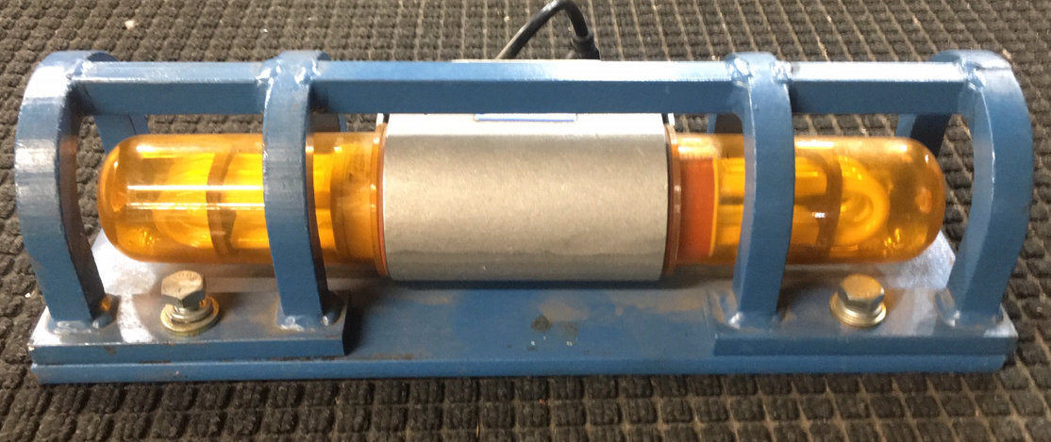
Florescent Lights
Fluorescent lights have many advantages over incandescent that include more efficiency and a longer lifespan.

Slide 12
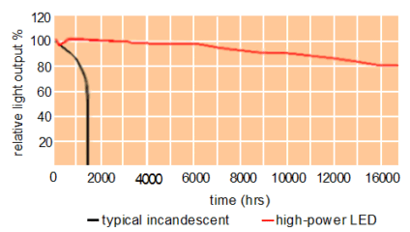
Light-emitting Diode (LED)
LED lights have many advantages that include high efficiency, long useable life, shock resistant, and they enable more design and light distribution flexibility.
NIOSH Saturn Light

Slide 13
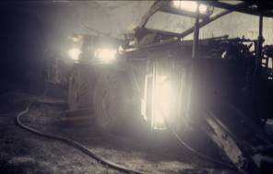
What is light?

Slide 14
Visible Light is a Narrow Band of Electromagnetic Radiation

Slide 15
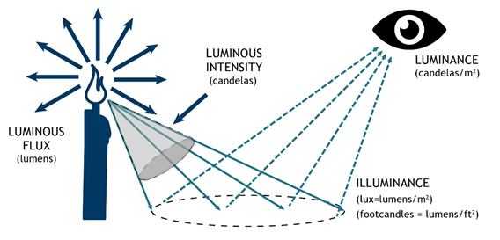
Visible Light Definitions and Measurement Units
Source: What’s the Difference: Luminance, Luminous Flux, Illuminance, Luminous Intensity, Lux, Lumens? Yi-Ying Lai 2022
Notes:
The amount of light emitted from or reflected off an object is called its luminance—commonly referred to as brightness. Luminous flux is a measurement of the total amount of light a light source emits, integrated over the entire angular span of the light. We quantify luminous flux in units of lumens (lm), a photometric unit of measurement. Luminous intensity is a measure of the light that shines from the source in a given direction. Illuminance refers to the amount of light that shines onto a surface, measured in lumens per square meter (lm/m²), also called lux.
Source: What’s the Difference: Luminance, Luminous Flux, Illuminance, Luminous Intensity, Lux, Lumens? Yi-Ying Lai 2022

Slide 16
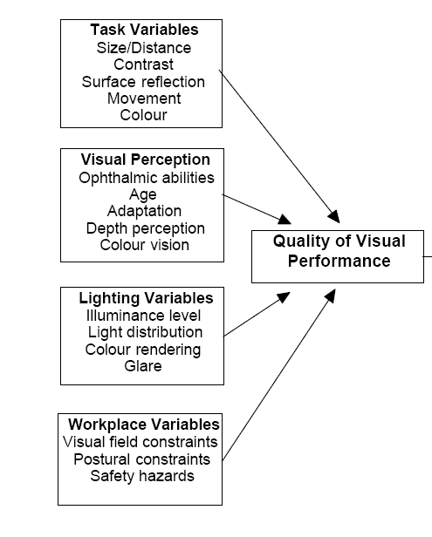
Visual Performance Depends on Many Factors
Visual performance is the ability to see an object measured by:
how fast you see the object
miss rates
Positive “hit”
Positive miss
False positive
False negative

Slide 17
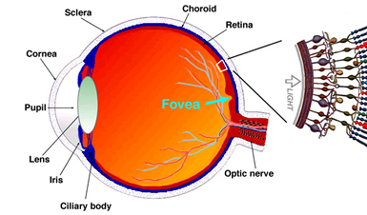
Age Effects on Vision
Vision decreases with age
Smaller pupil
Eye less able to adapt to light
Fewer rod receptors
More glare
Cloudy eye lens
This Photo by Unknown Author is licensed under CC BY-SA

Slide 18
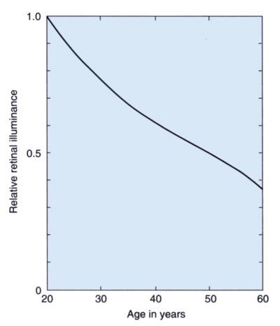
Human visual performance declines with age
Eye lens yellowing
(age in years)
Source: Lighting Research Center
43 yrs.
40% less light
than 20 yrs. old

Slide 19
Light Spectrum is a Factor for Visual Performance
“Cool white” light from LEDs have more short wavelengths
Better depth perception
Better color rendering
Better visual performance

Slide 20
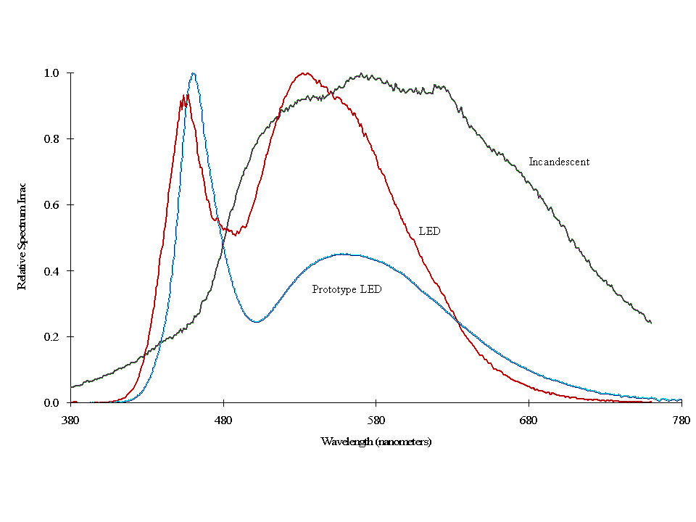
Spectral Power Distribution Characterizes the Light

Slide 21
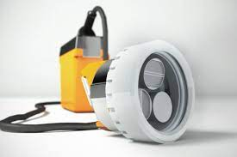
Cap Lamp Research: visual performance and glare improved with more short wavelength light ¹
Conditions
30 people tested
3 age groups
3 cap lamps
Incandescent 2600K
“neutral white” LED 4000K
“cool white” LED 5000K
Same intensity
Same light distribution
Results with “cool white” cap lamp
53.8% less disability glare
15% better peripheral detection
23.7% better floor hazard detection
1. Sammarco, J., Gallagher, S., and Reyes, M. (2010). Visual Performance for Trip Hazard Detection When Using INC and LED Miner Cap Lamps. Journal of Safety Research Vol. 41
Notes:
cool-white LED can improve visual acuity because the eye is more sensitive to that part of the color spectrum in low-light mining conditions

Slide 22
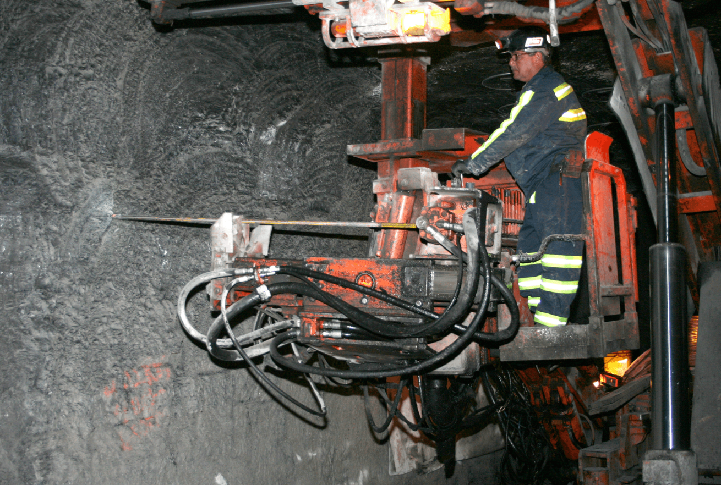
Machine Lighting: Roof Bolters
Roof bolters are one of most dangerous machines
Safety issues
Low light levels:
Difficult to see hazards
Difficult to perform tasks
Solution: increase light ?
Excessive glare
Difficult to see hazards
Difficult to perform tasks
Solution: decrease light ?
Photo source: JH Fletcher & Co

Slide 23
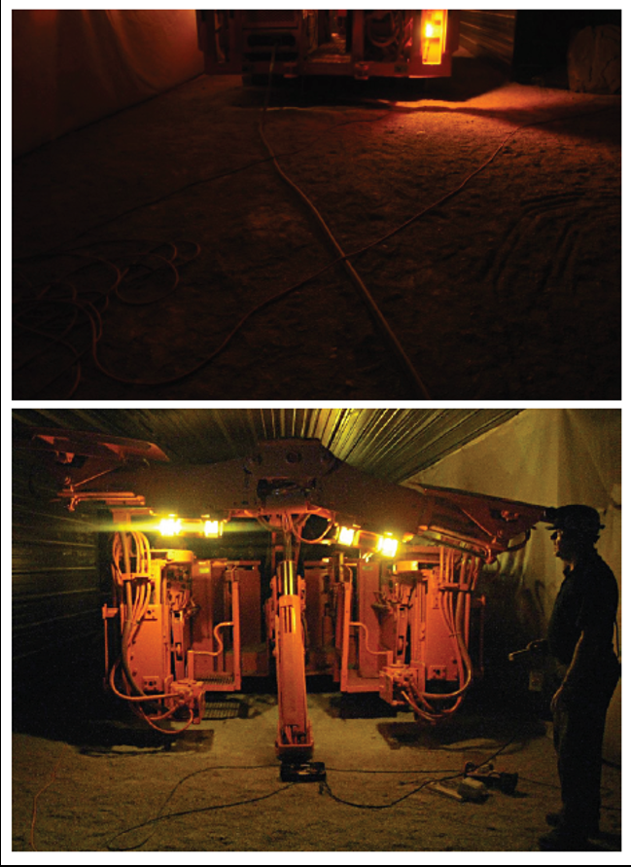
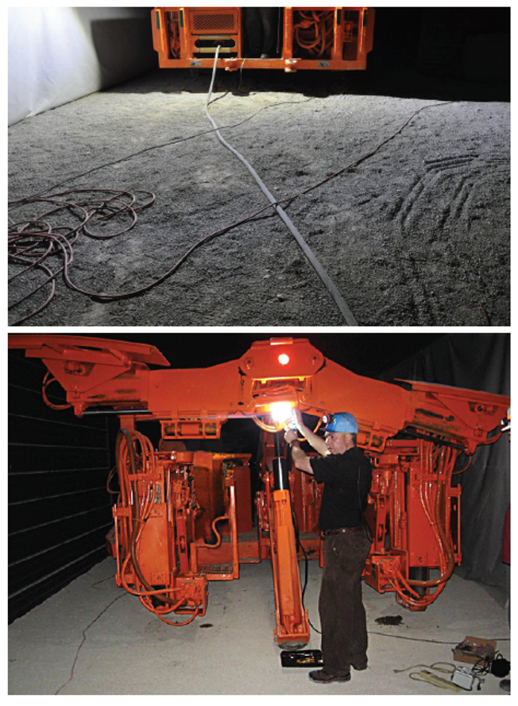
Existing lighting
NIOSH LED Saturn light
6

Slide 24
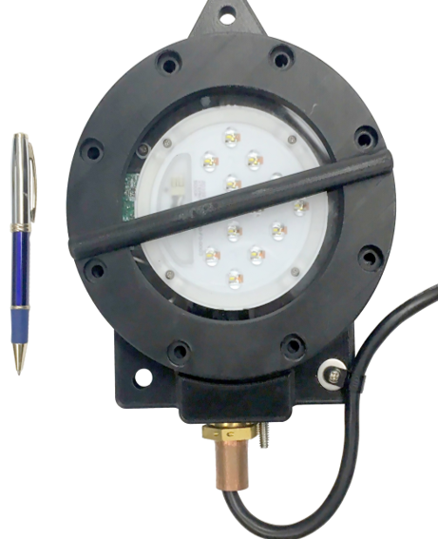
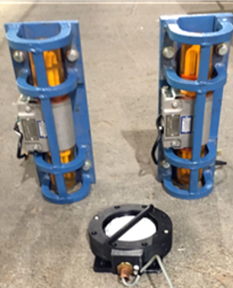
NIOSH Saturn LED Area Light Designed to Reduce Glare and Improve Hazard Detection
Saturn
One Saturn replaces two compact fluorescent lamp (CFL) lights
11 watts vs 100 watts power
Smaller size gives more placement flexibility
5

Slide 25
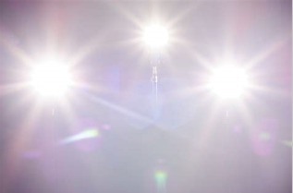
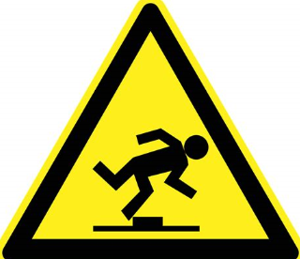
Saturn Had Reduced Glare and Better Visual Performance Compared to Incandescent Light¹
De Boer discomfort glare improved by three levels
Trip object detection speed improved up to 57%
Trip object detection miss rates, false positive, detectability improvements
¹Sammarco, JJ; Macdonald, BD; Demich, B; Rubinstein, EN and Martell, MJ. LED Lighting for Improving Trip Object Detection for a Walk-Thru Roof Bolter. Lighting Research & Technology. 2018
8

Slide 26
Trip object miss, false positive, and detectability improvements
Discriminability index (d'): A metric for visual performance that quantifies how well the presence or absence of a signal (trip object) can be distinguished
Smaller d’ more likely detected by chance
d’ > 4 indicates nearly perfect discrimination
Luminaire | Miss Rate | False positive rate | d’
Saturn | 0.4% | 5.0 % | 4.28
Existing lights | 42.1% | 11.7% | 1.39
9

Slide 27
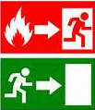
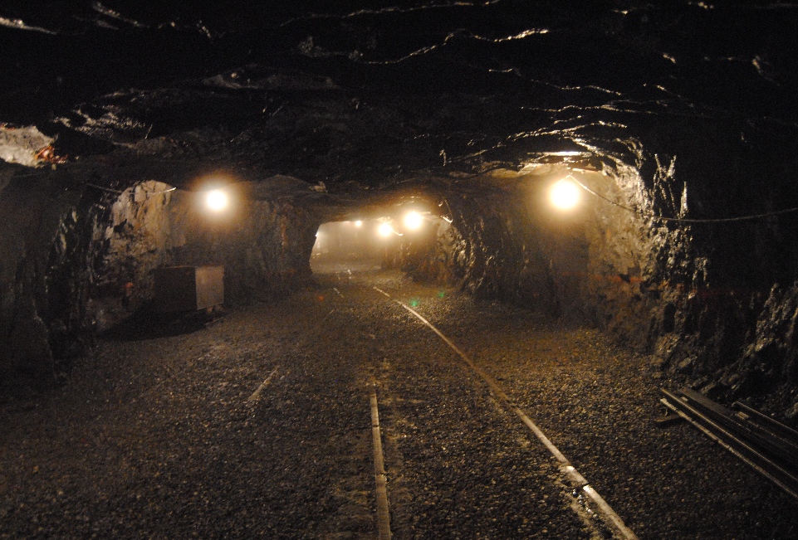
Self-escape Research

Slide 28
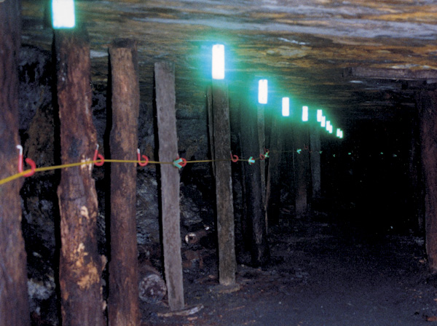
Escapeway Markers
Indicate primary & secondary escape routes

Slide 29
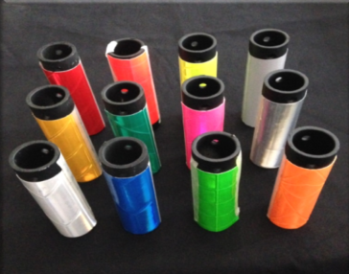
Improving Escapeway Marker Visibility Can Enhance Self Escape
Issues
No color code for escape routes
Colors for optimal visual detection are unknown
Can cause confusion for miners that worked at a different mine

Slide 30
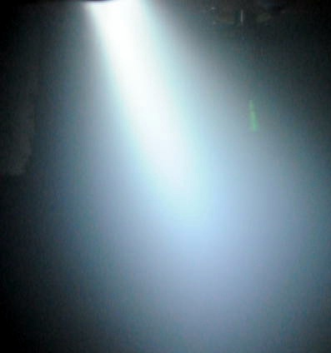
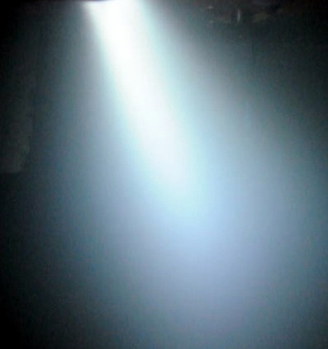
Escape Markers in Smoke Illuminated by LED Cap lamp

Slide 31
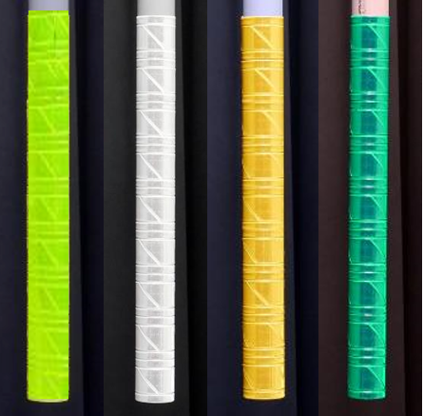
The four most visible markers in smoke
Based on testing forty participants’ detection of 17 marker color combinations in smoke conditions
Longer detection distance is better
Fluorescent yellow-green had the longest detection distance
24 in.
Detection distance difference
11

Slide 32
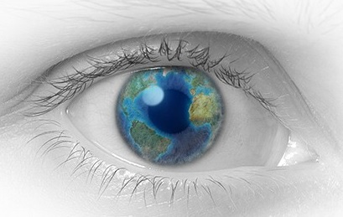
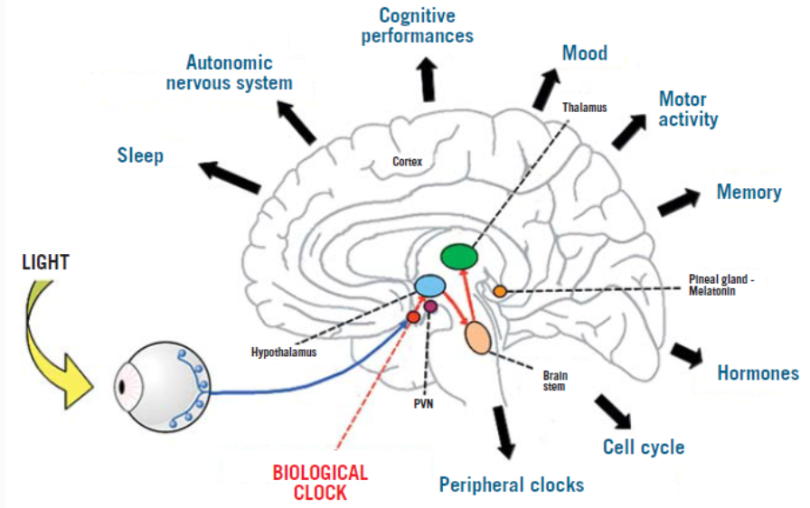
Lighting can improve safety and health via visual and nonvisual means
Visual
Roof bolting machine lighting
Trip detection
Glare
Self escape: Escapeway marker detection
Nonvisual
Shiftwork and circadian disruption
3
Notes:
Underground miners spend most of the day in darkness, makes them especially vulnerable to fatigue.

Slide 33
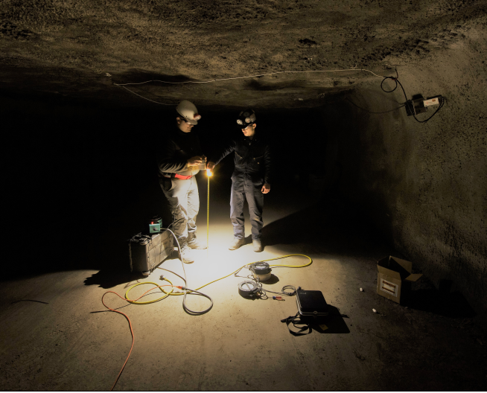
Underground Miner Shiftwork Issues
Shiftwork results in circadian rhythm disruption
sleep loss
fatigue
alertness
productivity losses
health risks include:
obesity
cancer (occupational carcinogen)
diabetes
More likely to be involved in accidents
Additional issue that miners have less daylight exposure
Pittsburgh, USA: 15% daylight Dec. 21; 47% of daylight June 20
142

Slide 34
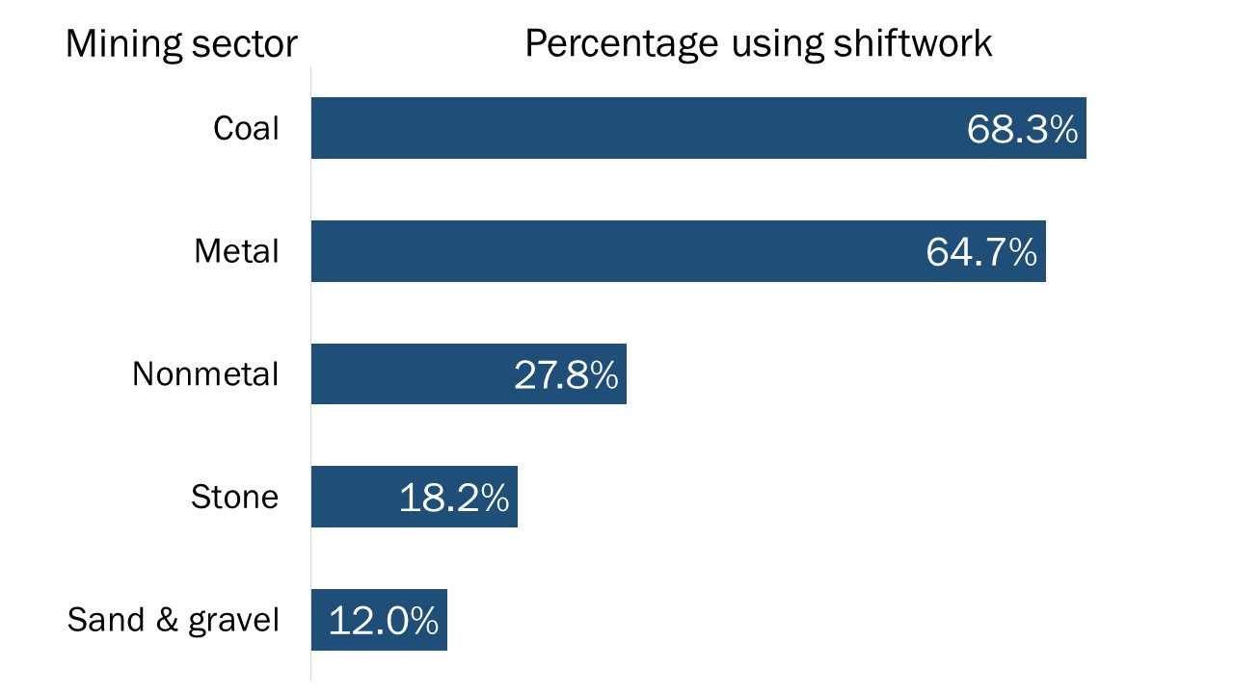
There is a predominance of mine shift work that disrupts circadian rhythms and can potentially lead to safety and health risks.
Circadian rhythm disruption
Increased workplace errors, greater risk of accidents and injuries. ^{1,2}
Circadian rhythm disruption health issues: cancer, obesity, diabetes, depression, bipolar disorder, seasonal affective disorder, and sleep disorders.³
Research gap: no human-centric lighting interventions for mining
1. Folkard S, Lombardi DA, Tucker PT. Shiftwork: safety, sleepiness and sleep. Industrial Health. 2005;43(1):20–3
2. Van Dongen HPA, Balkin TJ, Hursh SR. Performance deficits during sleep loss and their operational consequences. In: Kryger M, Roth T, Dement WC, editors. Principles and Practice of Sleep Medicine. Philadelphia: Academic; 2016. pp. 682–88.
3.

Slide 35
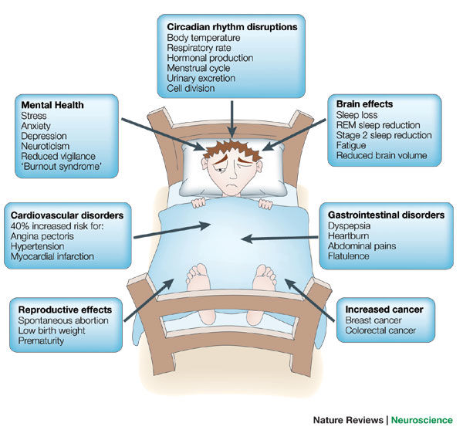
Shift work can potentially lead to physical and mental health problems
Source: Nature Reviews Neuroscience 6, 407–414 (2005)

Slide 36
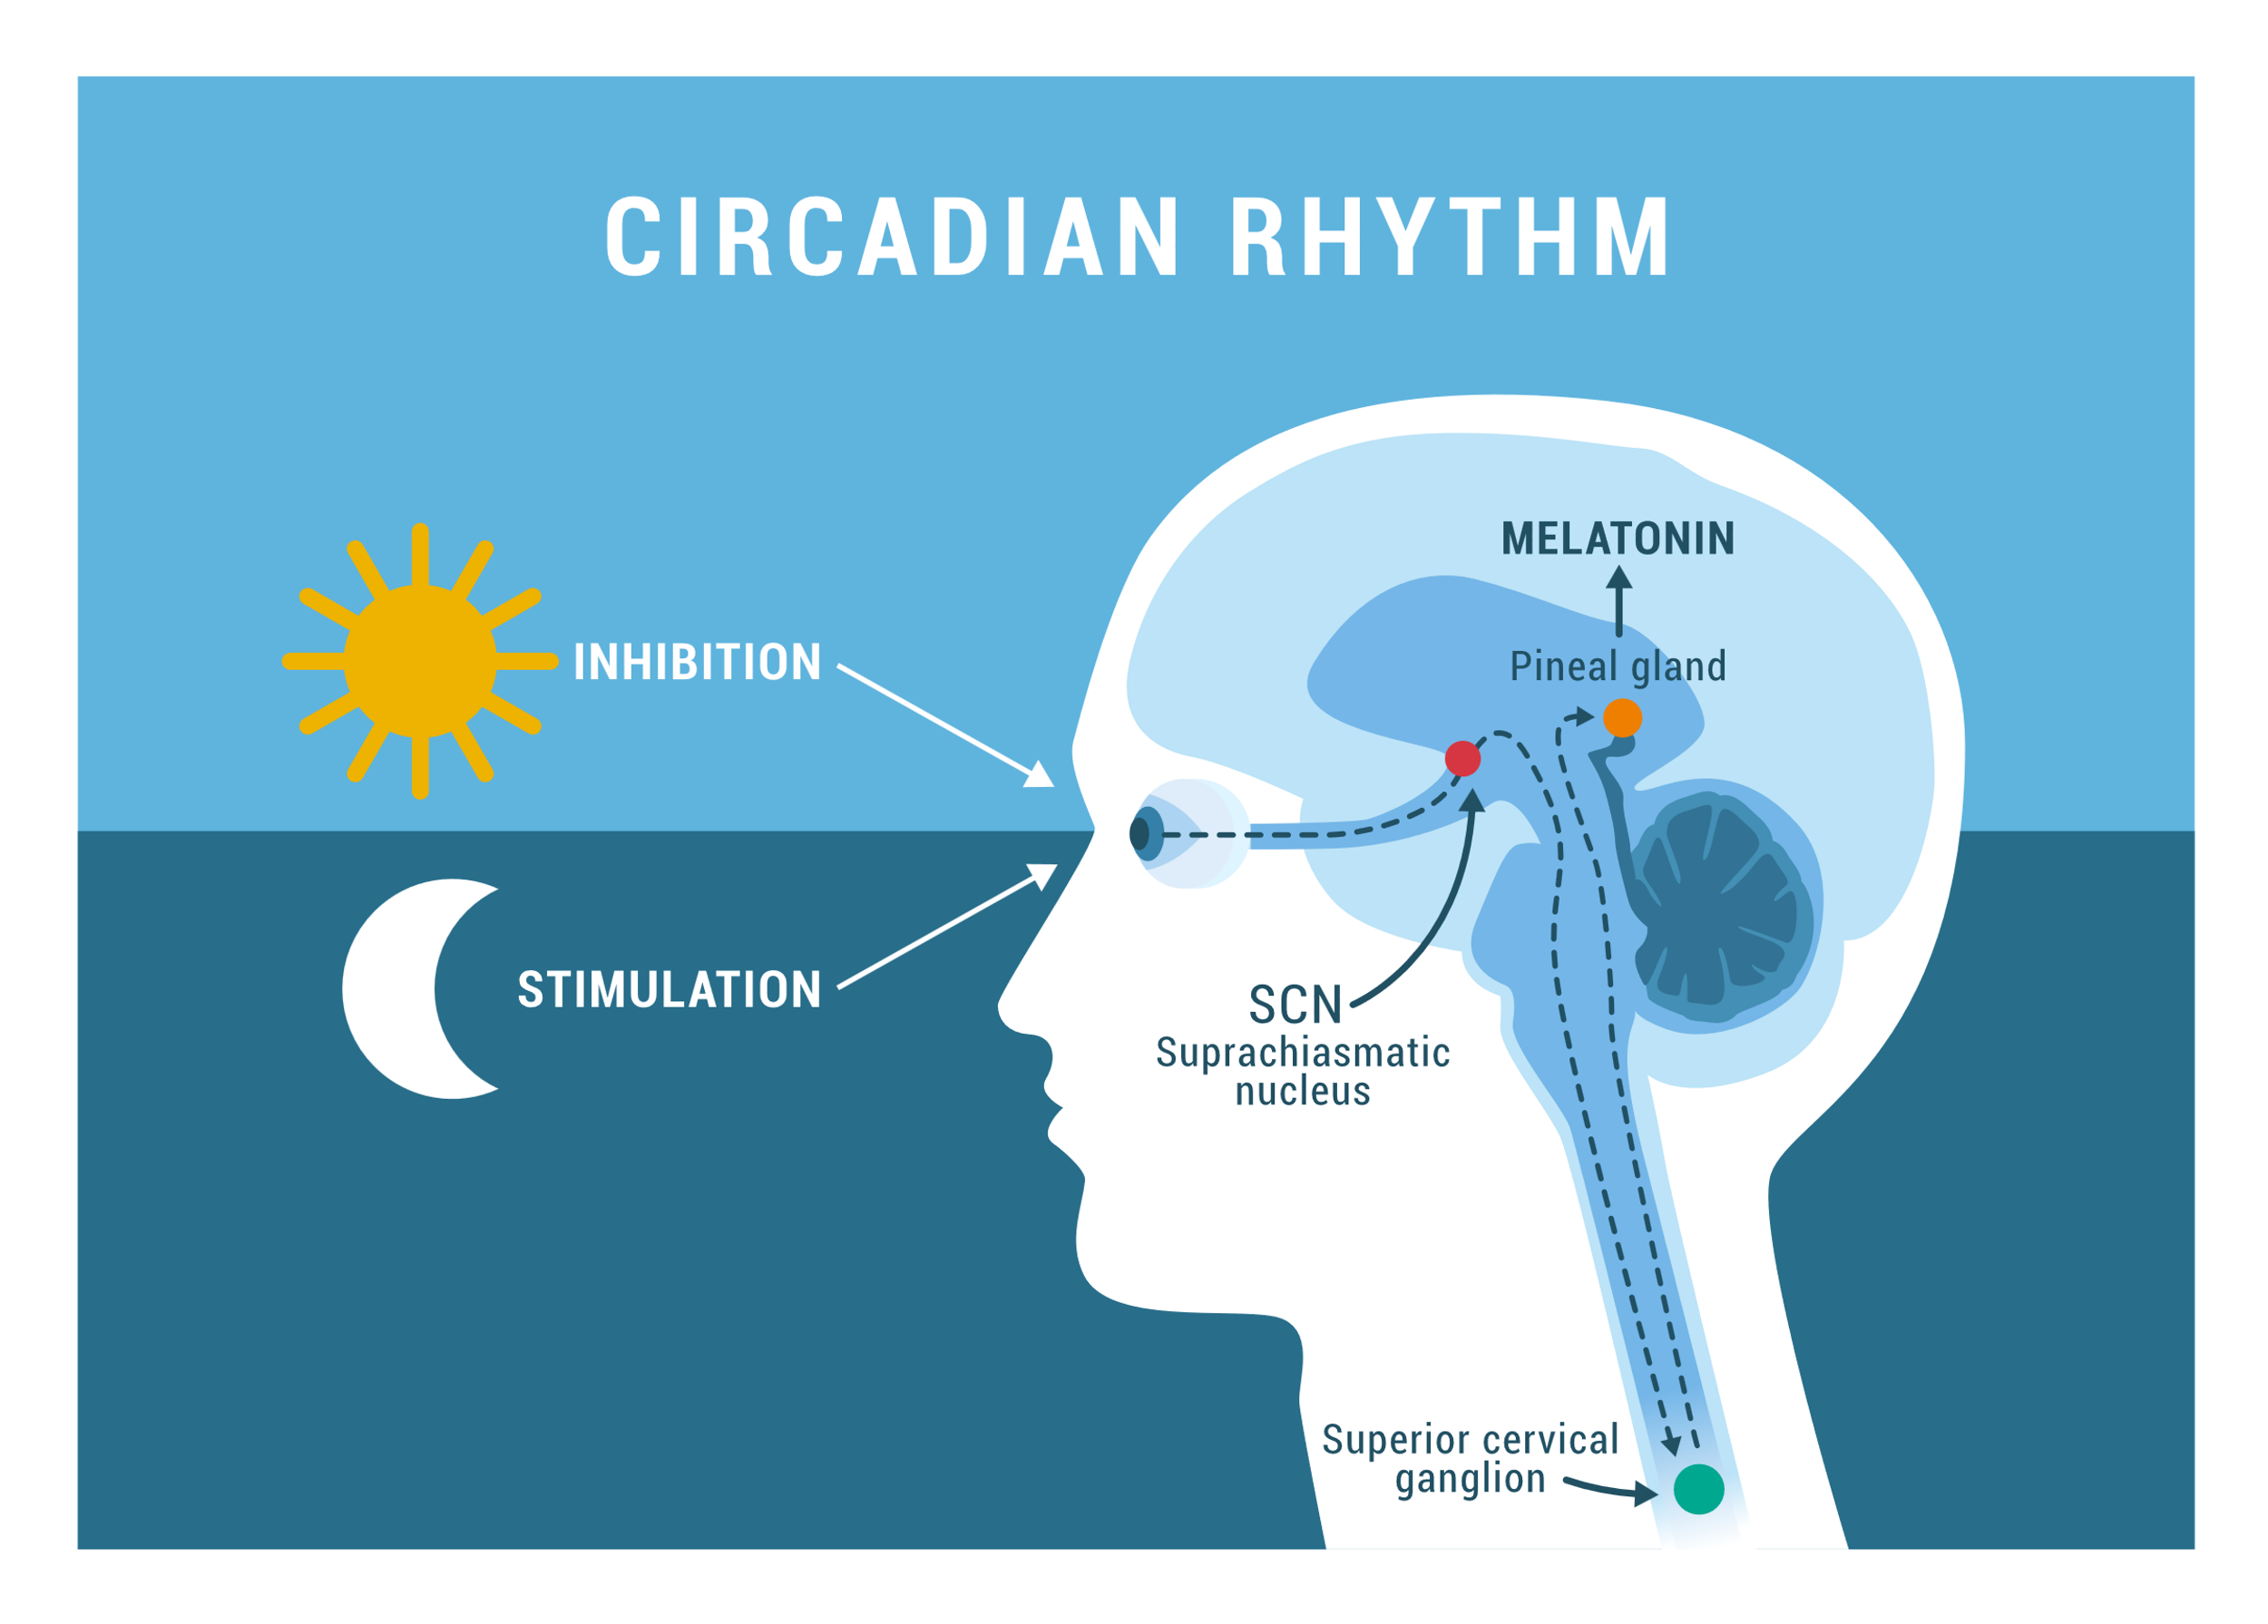
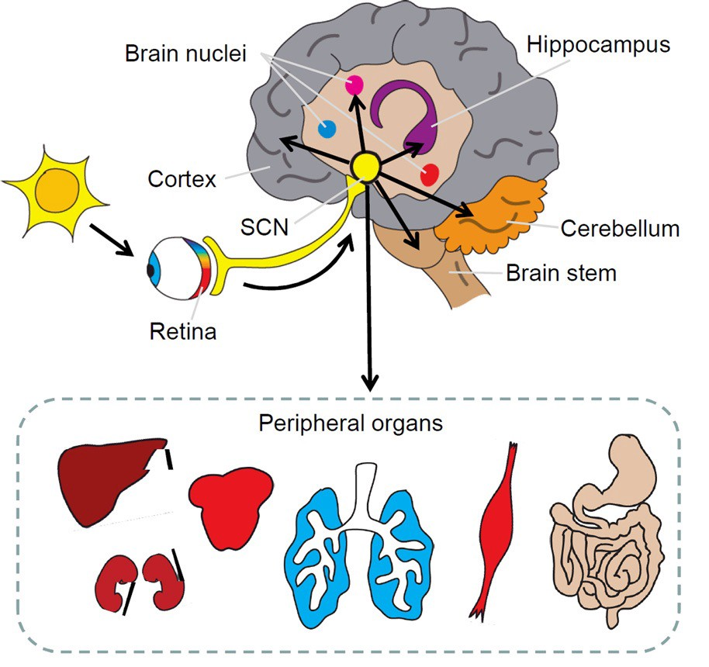
Our master clock , the suprachiasmatic nucleus (SCN), controls circadian rhythms and is synchronized by the day/night cycle
15
Notes:
The suprachiasmatic nucleus or nuclei (SCN) is a tiny region of the brain in the hypothalamus. It is responsible for controlling circadian rhythms. Regulates many different body functions in a 24-hour cycle. ]
The SCN interacts with many other regions of the brain.
The primary circadian clock i is located in the suprachiasmatic nucleus (or nuclei) (SCN located in the hypothalamus. The SCN receives information about illumination through the eyes. The retina of the eye contains specialized ganglion cells ipRGCs are the intrinsically photosensitive retinal ganglion cells. Unlike other ganglion cells, the ipRGCs can themselves convert the electromagnetic light signal into a neurochemical signal through their expression of melanopsin, a light-sensitive protein that are directly photosensitive, and project directly to the SCN, where they help in the entrainment (synchronization) of this master circadian clock.[78]
These cells contain the photopigment melanopsin and their lead to the SCN takes the information on the lengths of the day and night from the retina, interprets it, and passes it on to the pineal gland, that secretes the hormone melatonin.[80] Melatonin peaks at night and ebbs during the day and its presence provides information about night-length.

Slide 37
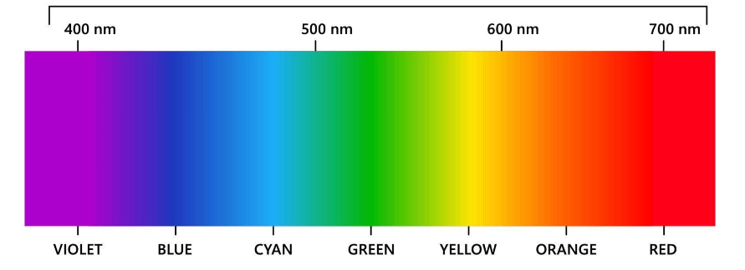
Light Color Affects the Circadian Rhythms
Short wavelength light (blue color 480 nm) has the greatest affect on synchronizing circadian rhythms.
Blue light suppresses melatonin.

Slide 38
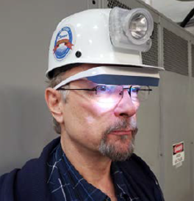
Shiftwork Field Study
Scope: Underground metal and coal mines
Participants: Miners on fixed shifts
Specific aim: Reduce circadian disruption via wearable lighting interventions during pre-shift
Interventions
Blue-enriched white light
Red light

Slide 39
Wearable Lighting Intervention for Shift Workers
Wear light-emitting glasses for 30 minutes before the shift
Exposure to blue-enriched white light peaked at 468 nm and 570 nm to reduce circadian disruption
Exposure to red light peaked at 660 nm to increase alertness
19

Slide 40
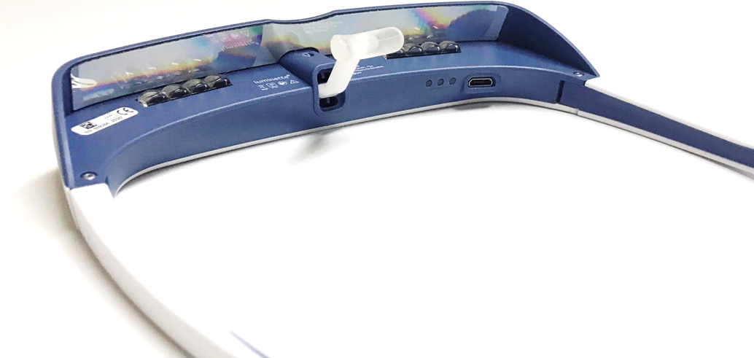
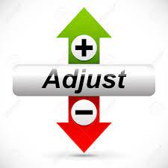
Lighted eyewear
Holographic film
Nose Piece
Battery
charge LED
Micro-USB
charging port

Slide 41
Overall Schedule
Wear lighted eyewear 3 weeks
No lighted eyewear 2 weeks
Wear lighted eyewear 3 weeks
FINISHED
Baseline week no lighted eyewear
Weeks 1-3
$100
Weeks 4-5
Weeks 6-8
$150

Slide 42
Next Step: Locate mines for field tests

Slide 43
Next Step: Locate mines for field tests

Slide 44
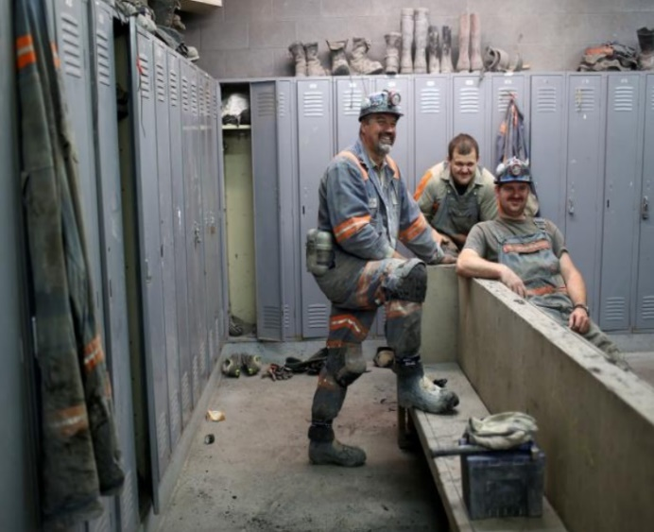
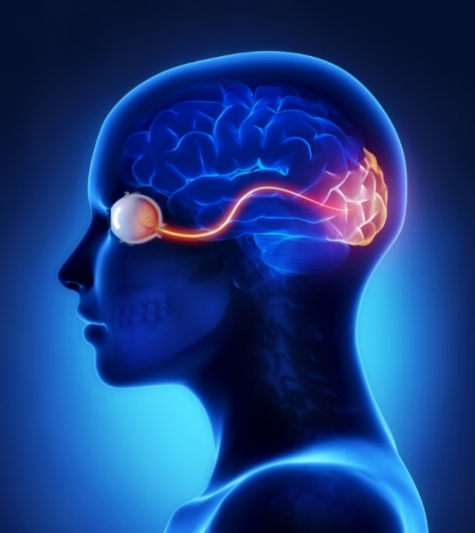
Summary
Light color and distribution are significant factors to improve miner's safety by reducing glare and improving visual performance of trip object detection and peripheral hazard detection.
Color is a significant factor for illuminated escapeway marker detection and recognition
Human-centric lighting encompasses addresses the visual and nonvisual pathways
Shiftwork can negatively affect safety and person’s physical and mental health
New NIOSH project is addressing shift worker circadian disruption via wearable lighting interventions.

Slide 45
Questions
John J Sammarco, PhD
Principal Research Engineer
Jsammarco@cdc.gov
1 (412) 386-4507

