Slide 1
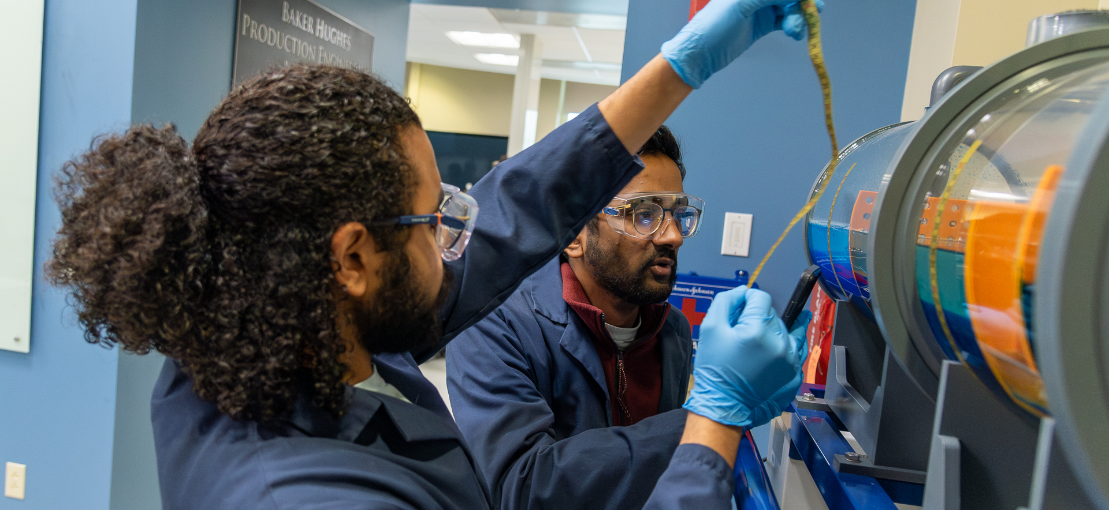
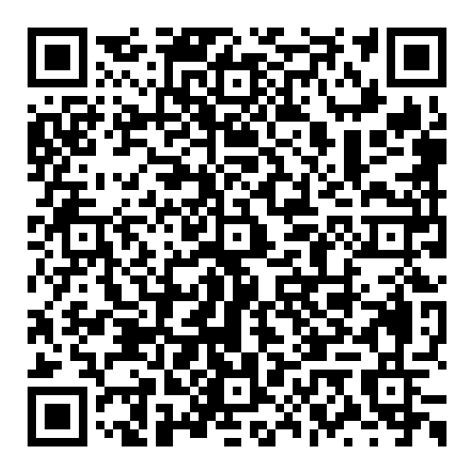

Looking to hire? We have great students!
Register for Penn State’s Extraction Industries Career Fair
STUDENTS ATTENDING:
Focus is on students in Mining Engineering, Petroleum and Natural Gas Engineering. Students in Environmental Systems Engineering, Energy Engineering, Exploratory Geosciences, and other engineering students interested in extraction careers are invited to attend too.
DATE: Wednesday, September 17, 2025
TIME: 5 p.m. to 8 p.m.
WHERE: Atrium, Steidle Building
Please use the QR to register!
Opportunities to conduct interviews on Sept. 18

